Slide 1
Lesson plan for week 1 primary 6
Use photodendro and download the books

Slide 2
Unit 5 pupil’s book day 1
Lesson 1 diaries PAGE 50-51
COMPLETE ACTIVITIES
Activity a
Activity b
Activity c
Activity d

Slide 3
New words page 50 pupil’s book
High heeled ψηλοτακουνα
A pair of ένα ζευγαρι
Record δισκοσ
Bell bottomed pants παντελονι καμπανα
Seemed to φαινοταν
Admire θαυμαζω
Wore his hair in a pony tail ειχε τα μαλλια αλογοουρα
Canapes μικρα κομματακια φαγητου
Explained εξηγησε
Linen λινο
Wool μαλλι
Tunics μανδυεσ

Slide 4
Day 2
Grammar used to PAGES 52-53
Look at the grammar boxes PAGE 52
Fill in the information PAGE 52
Look at practice page PAGE 53
Do these fun activities !!!
Listen to the song ‘yesterday’ by beatles/ YOU TUBE

Slide 5
Day 3 finish workbook exercises lesson 1
Page 35 WORKBOOK

Slide 6
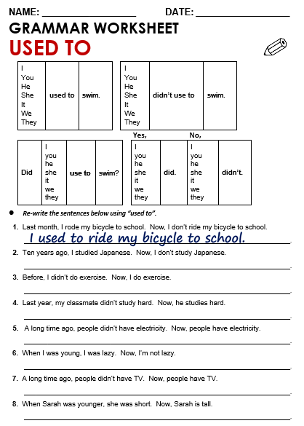

Slide 7
