Slide 1
HELLO KIDS LESSON PLAN FOR WEEK 1

Slide 2
USE FOTODENDRO TO FIND THE BOOKS ON LINE AND THE LISTENING PARTS
DAY 1
DAY 2
DAY 3

Slide 3
DAY 1
OPEN YOUR PUPIL’S BOOK FIND THE TEXT LIVING IN THE CITY OR IN THE COUNTRYSIDE
READ THE TEXT AND CHECK NEW WORDS
AFTER READING DO THE EXERCISE BELOW TRUE OR FALSE
THEN WRITE A SHORT REPORT ABOUT ATHENS AND THESSALONIKI
SIZE
POPULATION
TEMPERATURE
RIVERS

Slide 4
DAY 2
Study the rules

Slide 5
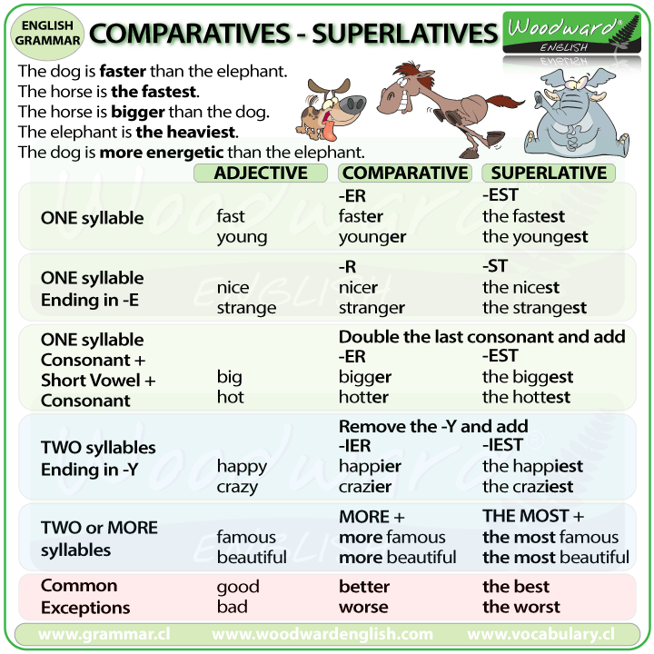

Slide 6
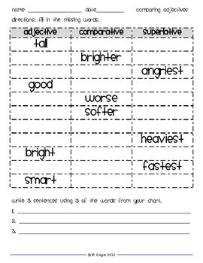

Slide 7
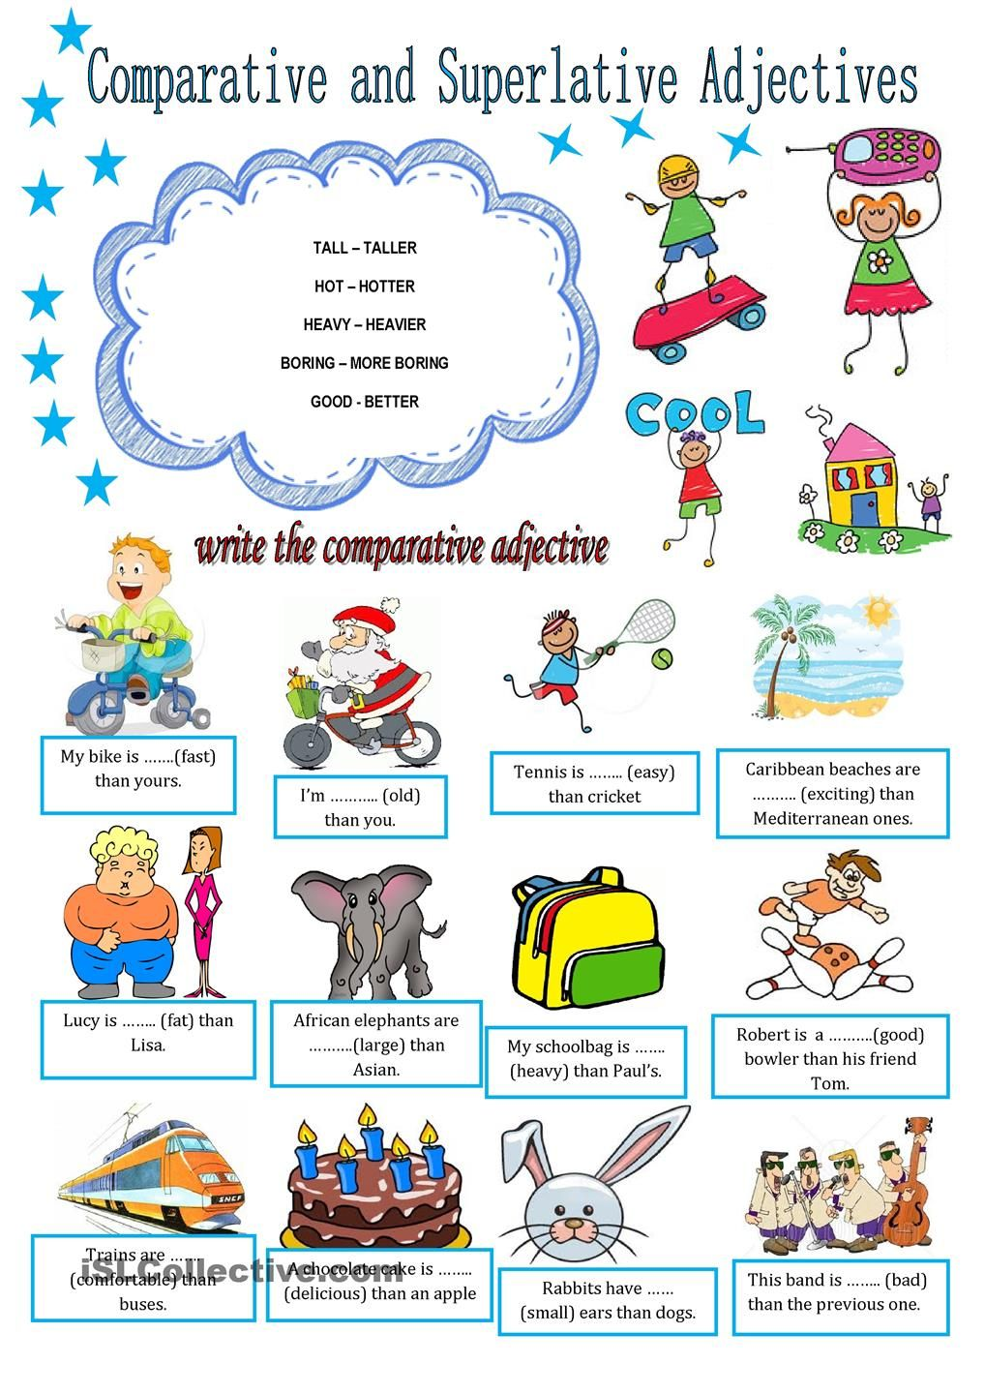

Slide 8
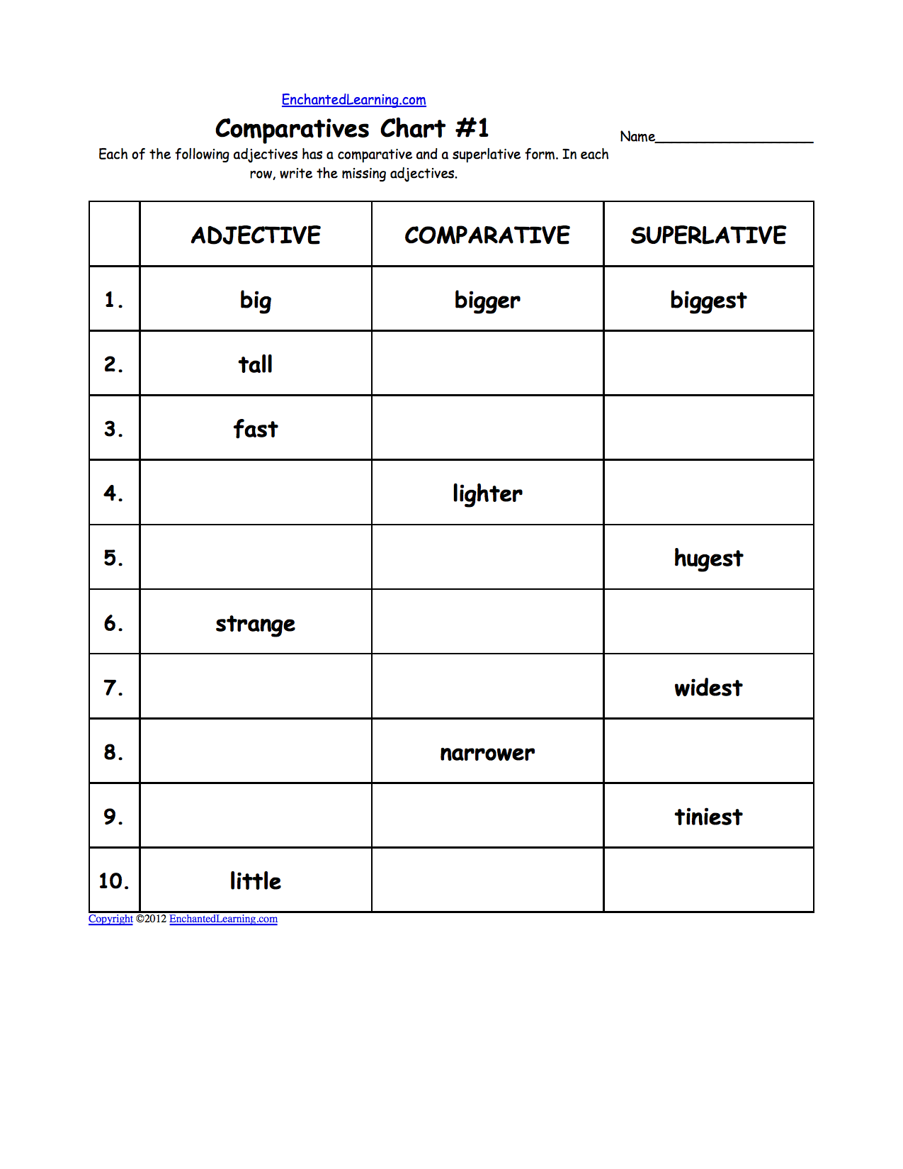

Slide 9
Day 3 extra practice on comparative superlative
Finish all the exercises in workbook….

