Slide 1


It’s
Spring
By Marianthe Hassapis

Slide 2


Spring is here! What can you see?
blue sky
yellow sun
Green grass
Red, yellow, pink
and white flowers

Slide 3





How many flowers?

Slide 4

This is a tree. Say ‘hello’ tree!

Slide 5

This is a butterfly! Say ‘hello’ butterfly.
A butterfly can fly!
Let’s all fly like a butterfly!

Slide 6

This is a ladybug! Say ‘hello’ ladybug.
A ladybug can fly!
Let’s all fly like a ladybug!

Slide 7

This is a bumblebee!
Say ‘hello’ bumblebee.
A bumblebee can fly!
Let’s all fly like a bumblebee!

Slide 8
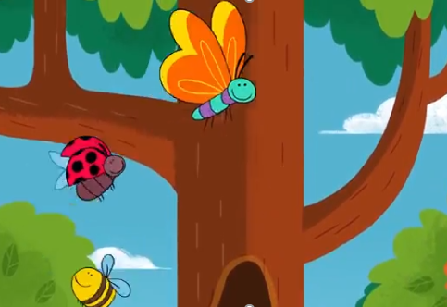
What are they doing?
Yes, they are flying around the tree.
Let’s all fly around the tree!

Slide 9
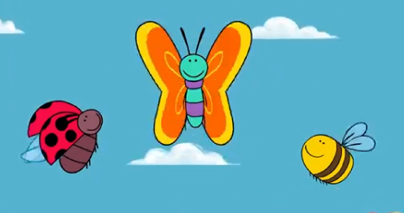
What are they doing now?
Yes, they are flying high into the sky!
Let’s all fly high into the sky!

Slide 10

Now, let’s learn a new song! Let’s sing about butterflies, ladybugs and bumblebees!
Butterfly Ladybug Bumblebee | Super Simple Songs
https://www.youtube.com/watch?v=EgiQ6GliTrI

Slide 11



What can you see?

Slide 12
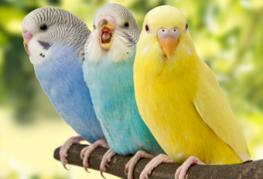



What can you hear?

Slide 13
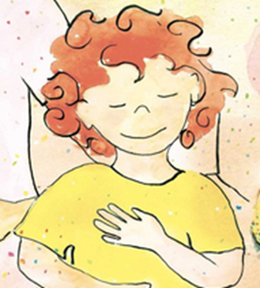
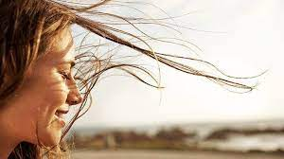

What can you feel?

Slide 14

I can see a rainbow!
Can you draw a rainbow?

Slide 15
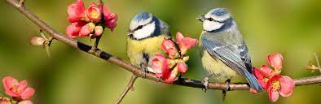
I can hear the birds.
Let’s all ‘tweet’ like birds!
Can you draw a bird?

Slide 16


I can feel the sun!
Let’s all feel the sun!
Can you draw the sun?

Slide 17

I can see the butterflies!
Let’s all be butterflies!
Can you draw a butterfly?

Slide 18

I can hear the bees.
Let’s all buzz like bees.
Can you draw a bee?

Slide 19


I can feel the wind.
Let’s all blow like the wind.
Let’s all feel the wind!

Slide 20

Let’s sing ‘Spring is here!’ [half the song]
Spring Song for Kids - Spring is HERE by ELF Learning - ELF Kids Videos https://www.youtube.com/watch?v=_ZXdJ46IX0I

Slide 21

Goodbye my little ladybugs!
See you next time!

