Slide 1
Our School
Model General Lyceum of Heraklion

Slide 2
MODEL SCHOOLS IN A NUTSHELL
-What is the purpose of model schools in general ?
Model schools are school units in all levels of education , where new teaching tools, educational approaches and teaching methods are tested.
They offer students the chance to participate in research programs.
-How do l join this high school ?
To join the Model General High Schools, you need to pass through strict exams in which you are tested on knowledge you have gained throughout the previous school years.
Like in every other school, at the end of the school year (late May), all students take exams to advance to the next grade.

Slide 3
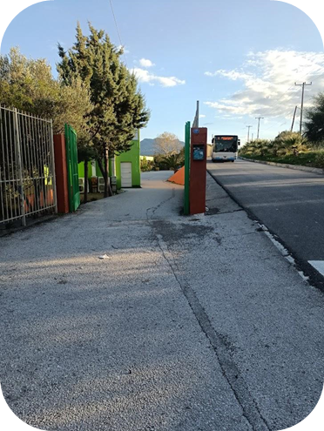
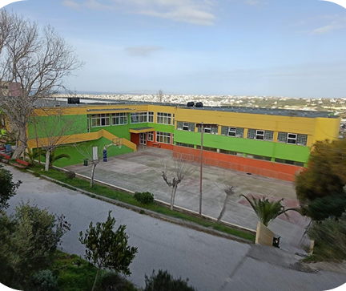
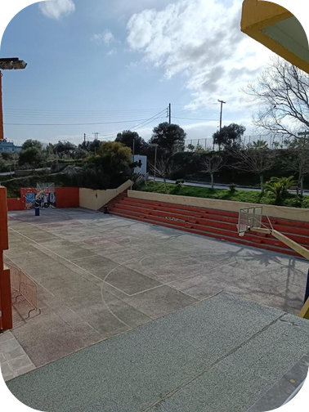
A Glimpse of our School
The main entrance
The basketball court

Slide 4
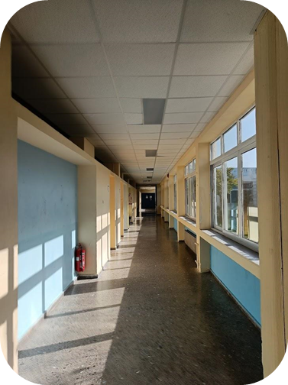
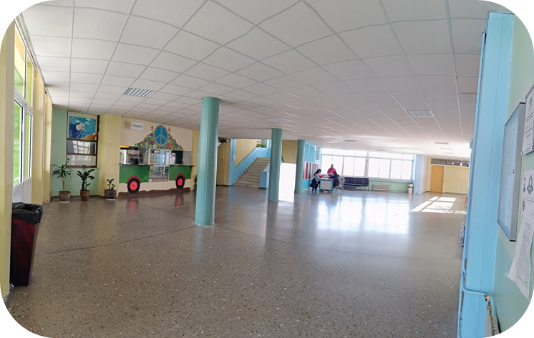
A Glimpse of our School
Interior
The canteen Area

Slide 5
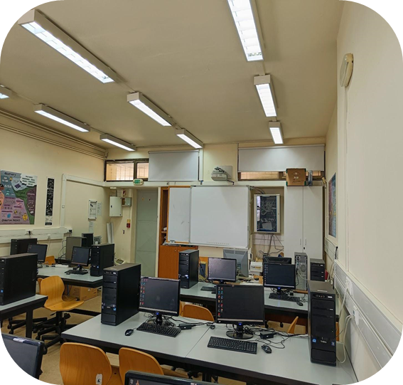
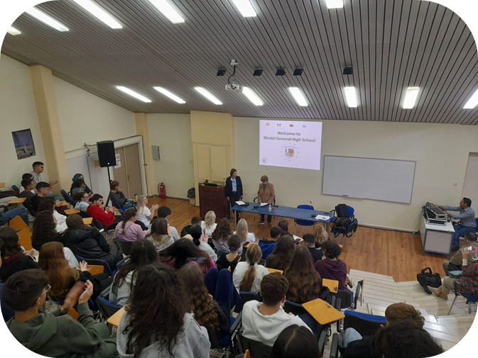
A Glimpse of our School
Our computer Science lab
Auditorium

Slide 6
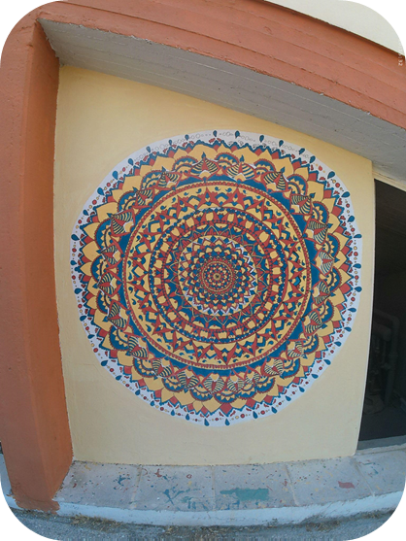
A Glimpse of our School
Student’s art work

Slide 7
After School Clubs
What can you do in after-school clubs?
Clubs cover topics that the school curriculum doesn’t cover: a wide variety of subjects and activities, from learning poetry, movie making to science and robotics.
What do they have to offer?
These clubs are a great way to learn more about a subject you may be interested in.
Students acquire knowledge through engaging ways of teaching, a notable example is being taught about the wildlife and gardening whilst being in nature.
It is a way of socializing since participants get to know, students from other grades.

Slide 8
STEM CLUB
Experiments in the lab
Water quality
Filters
Arduino
Handmade wax ointment
Competitions
1st place in the International Stem Hackathon Competition

Slide 9
Creative Writing Club
We are a group of students from all three grades of our school who enjoy creative writing
We try to individually create various short stories and poems, some of which we sign up for different competitions
We take part in a lot of writing exercises, which help us come up with ideas, and simultaneously improve our writing skills
Our members have won competitions in and out of Greece in a wide range of writing categories

Slide 10
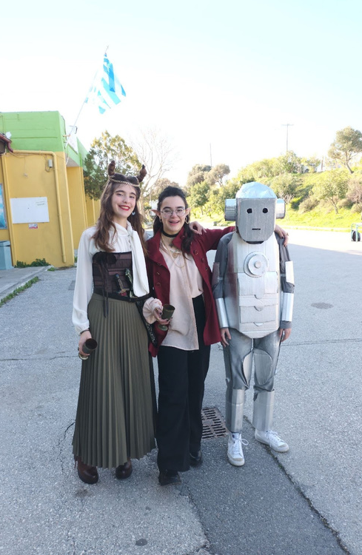
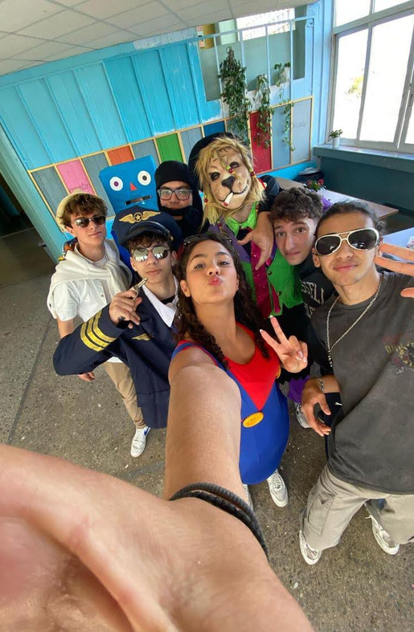
Activities
TSIKNOPEMTI
A day when everyone dresses up as anyone they want

Slide 11
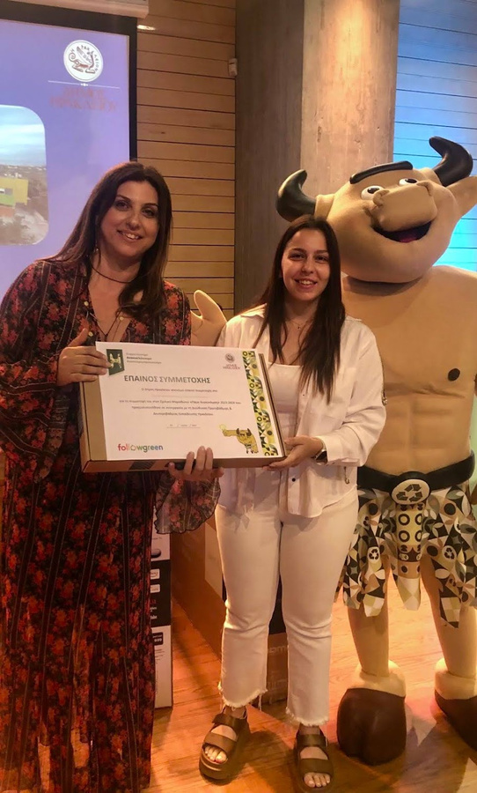
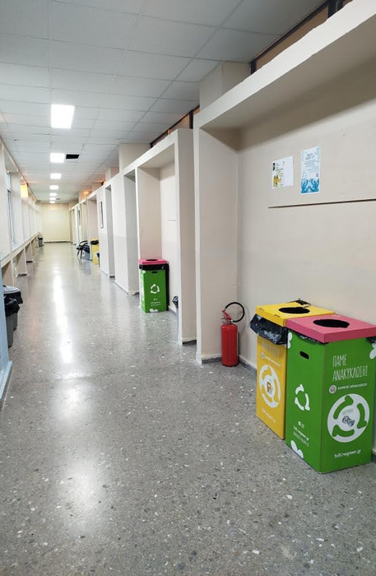
Activities
RECYCLING COMPETITION
With other schools in our region

Slide 12
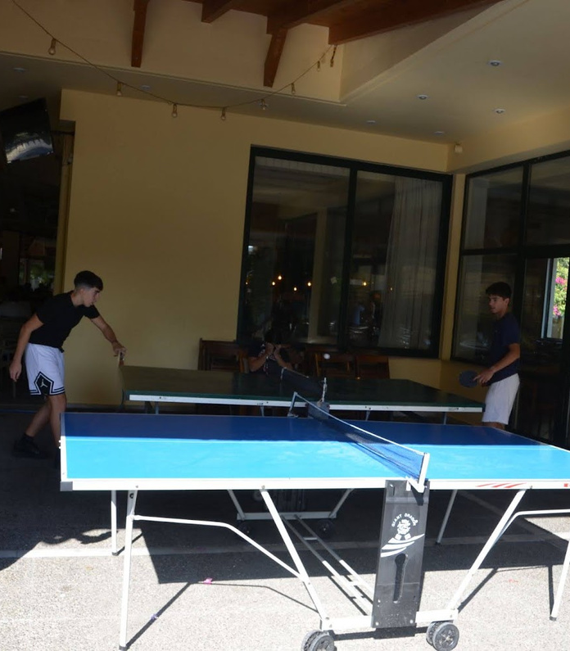
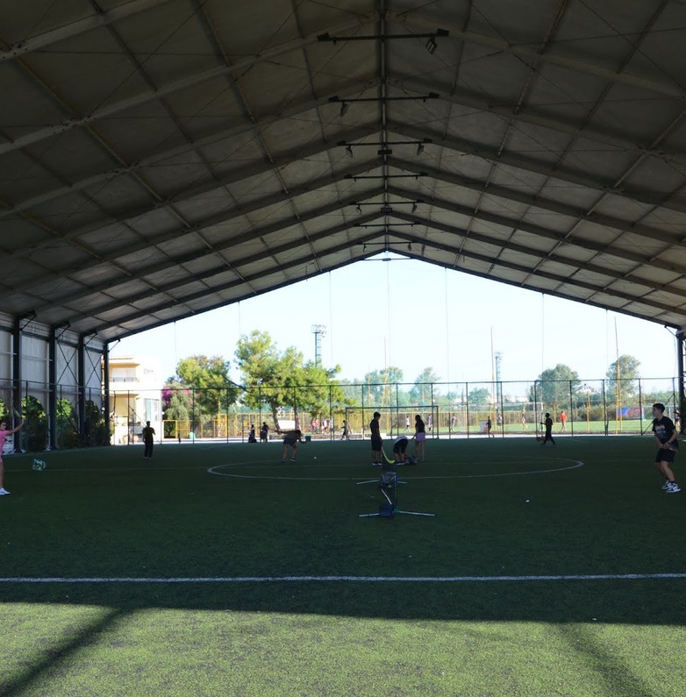
International Day of Sport

Slide 13
Thank you for listening

