Slide 1
Model General Highschool of Heraklion
Heraklion, Crete 2023-24

Slide 2
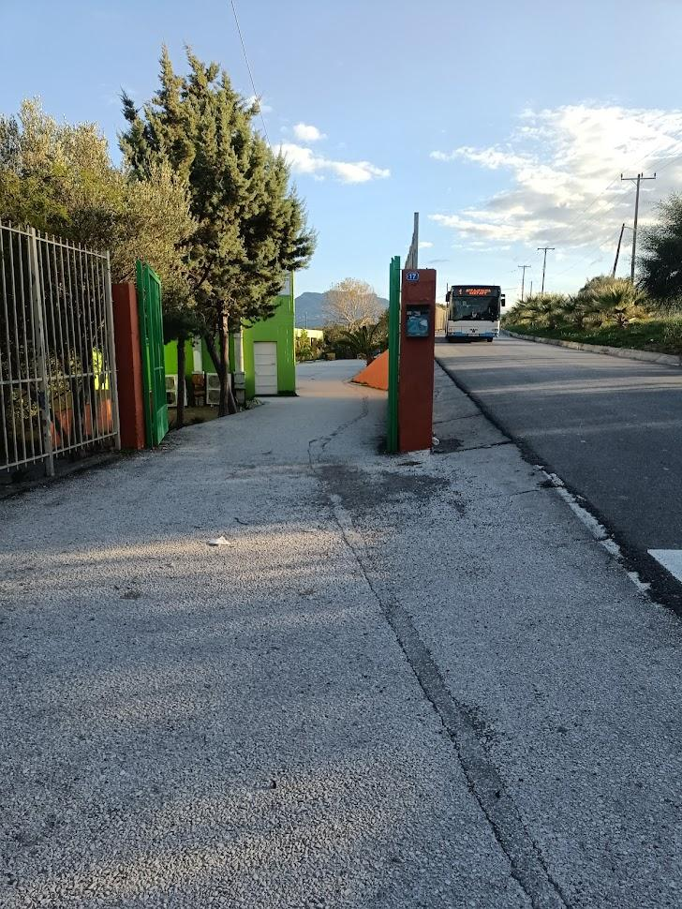
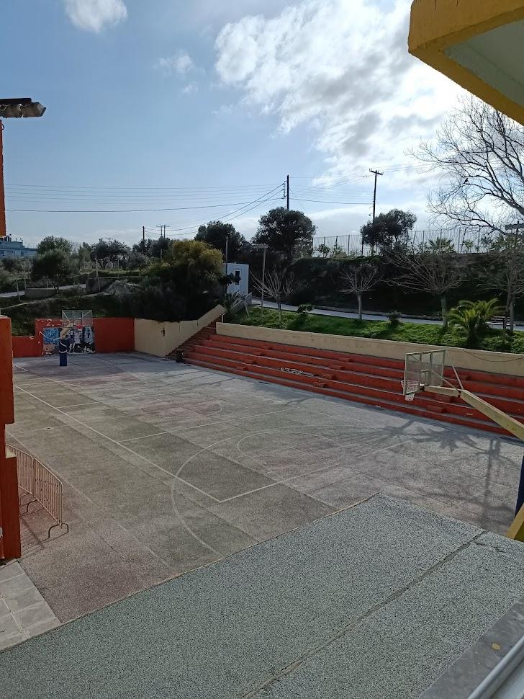
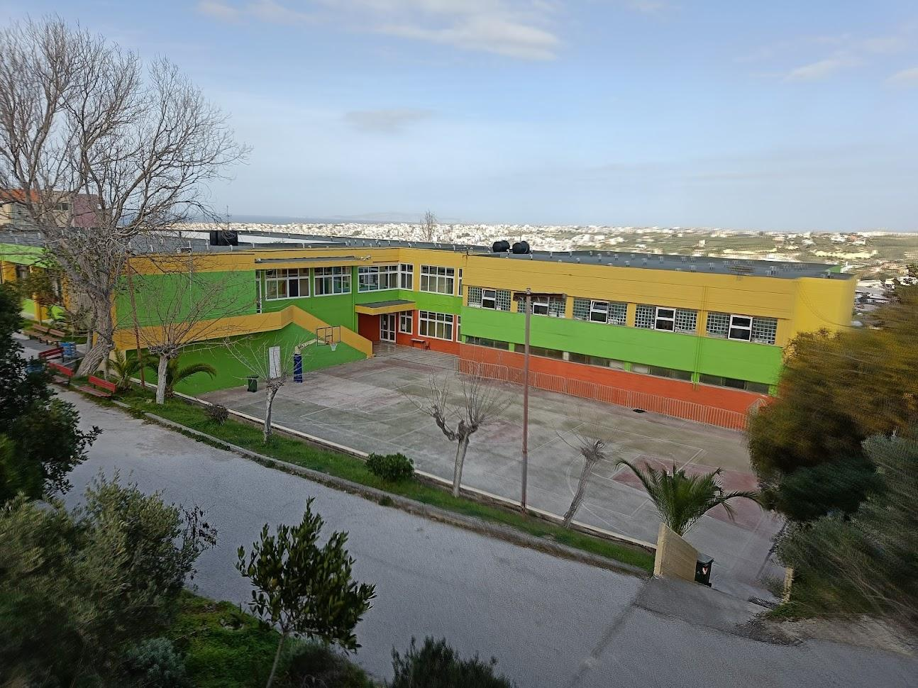
A glimpse of our school
The Main Entrance
The Basketball Court

Slide 3
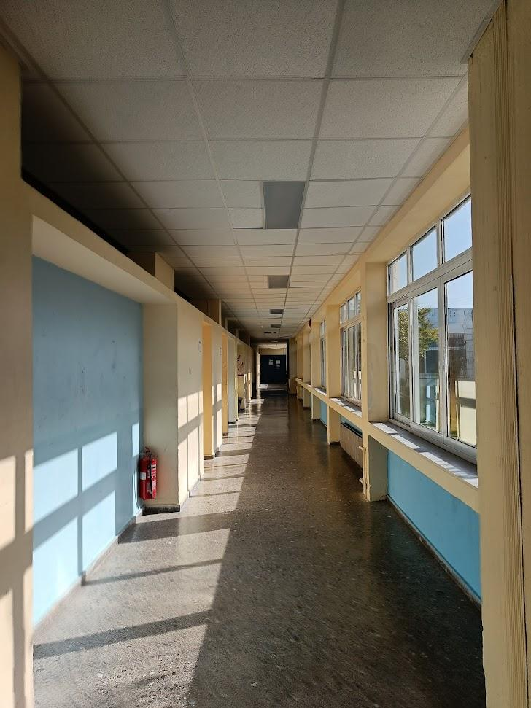
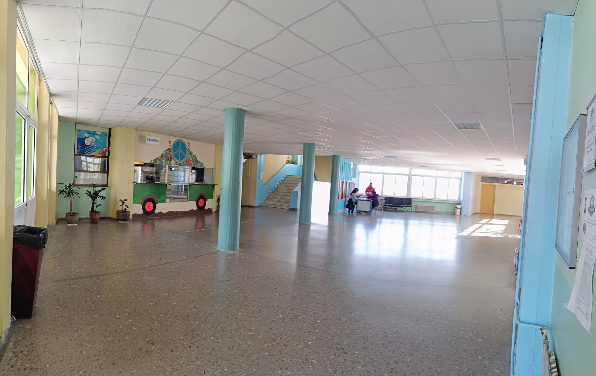
A glimpse of our school
Interior
The Canteen Area

Slide 4
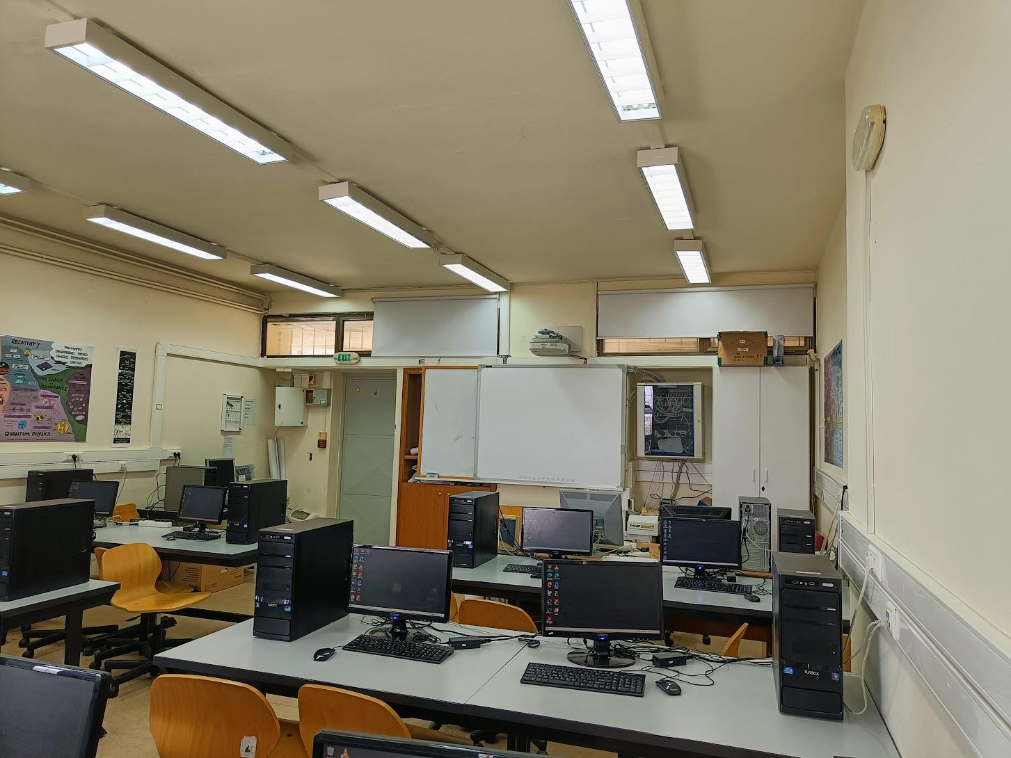
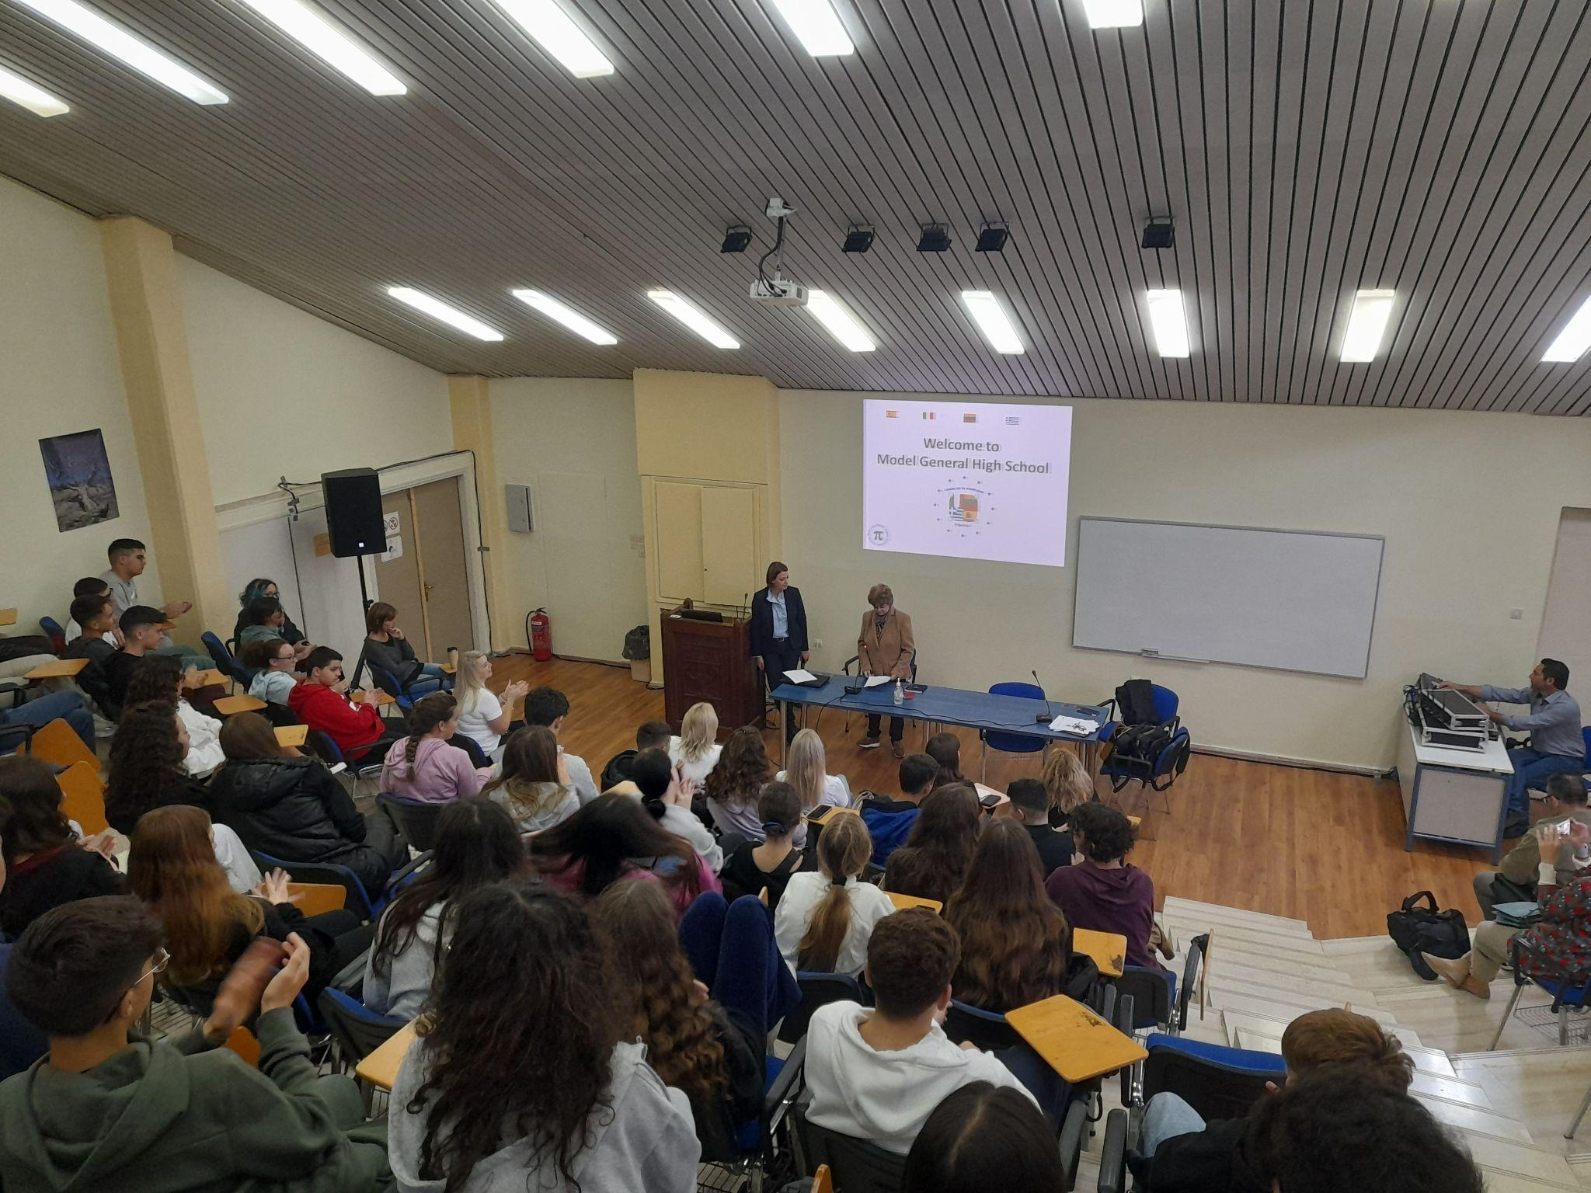
A glimpse of our school
Our Computer Science Lab
Auditorium

Slide 5
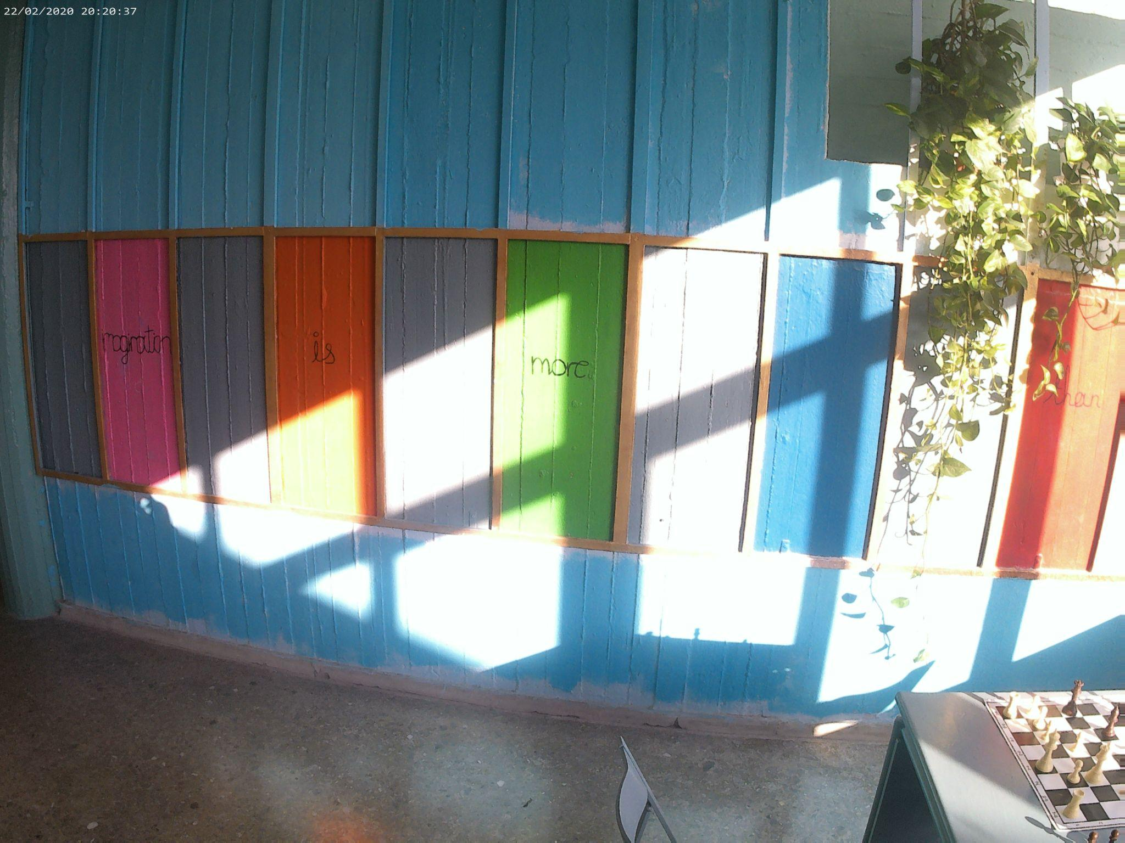
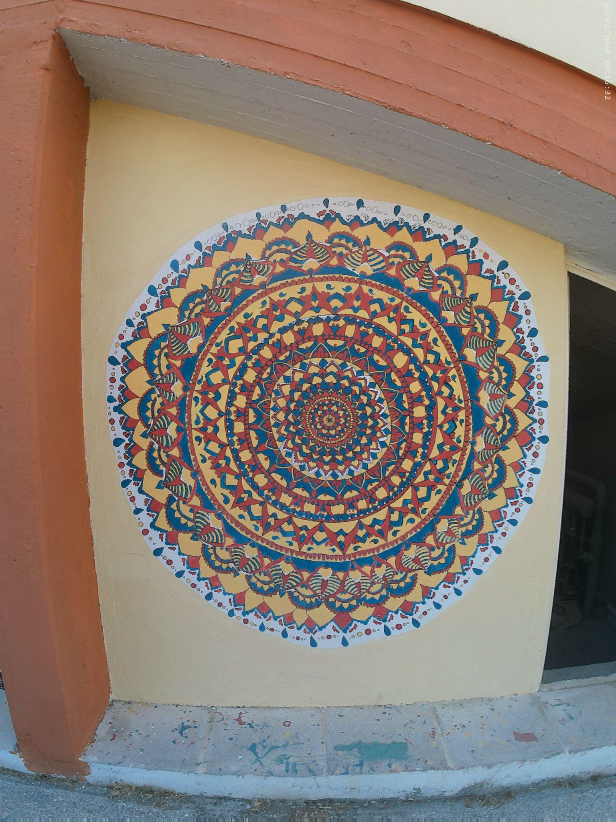
A glimpse of our school
Students’ Art Work

Slide 6
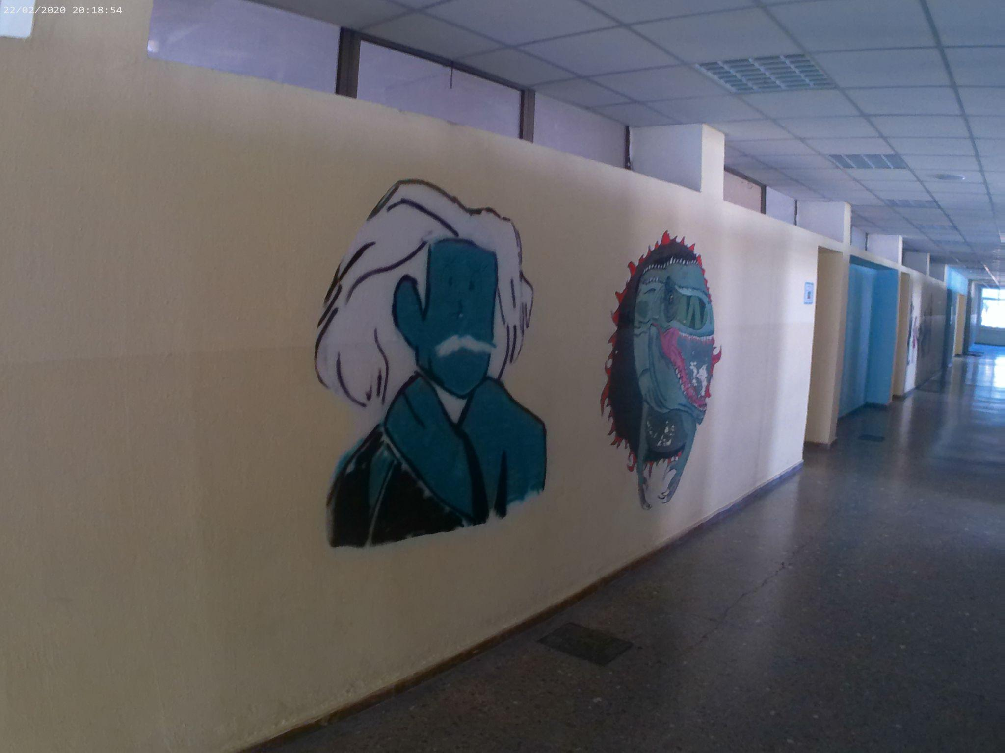
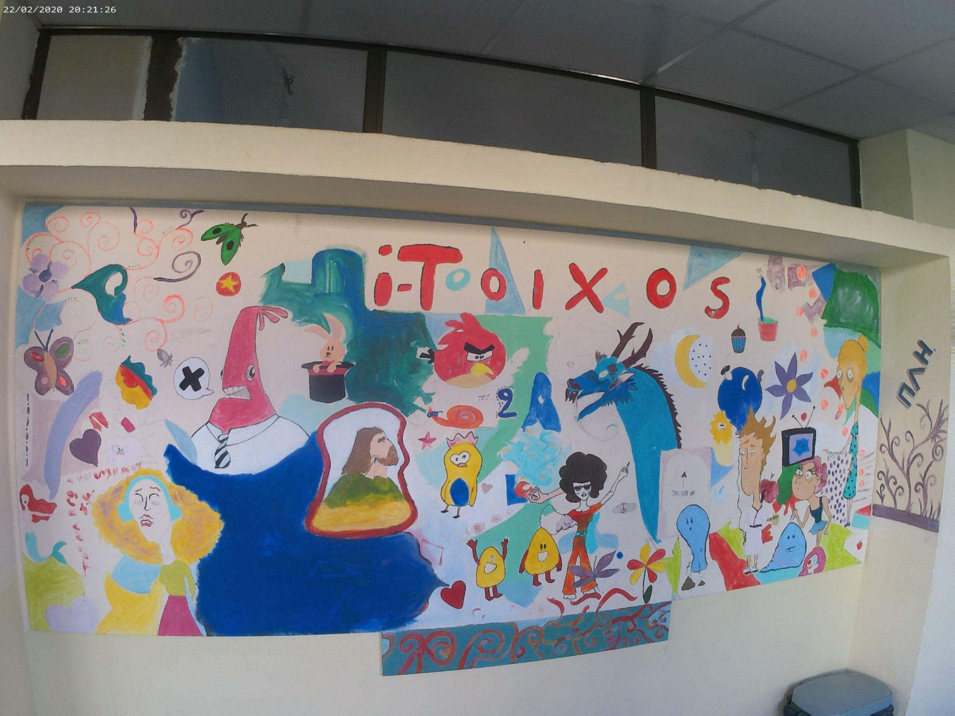
A glimpse of our school
More art

Slide 7
MODEL SCHOOLS IN ... A NUTSHELL
-What is the purpose of model schools in general ?
Model schools are school units in all levels of education , where new teaching tools, educational approaches and teaching methods are tested.
They offer students the chance to participate in research programs.
-How do l join this high school ?
To join the Model General High Schools, you need to pass through strict exams in which you are tested on knowledge you have gained throughout the previous school years.
Like in every other school, at the end of the school year (late May), all students take exams to advance to the next grade.

Slide 8
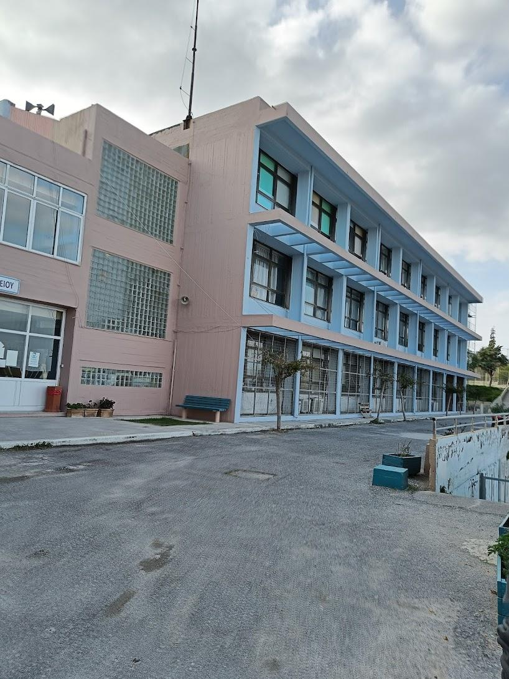
After-School Clubs
-What can you do in after-school clubs?
Clubs cover a wide variety of subjects and activities, from learning poetry, movie making to science and robotics.
-What do they have to offer?
These clubs are a great way to learn more about a subject you may be interested in.
Students acquire knowledge through engaging ways of teaching, a notable example is being taught about the wildlife and gardening whilst being in nature.
It is a way of socializing since participants get to know, students from other grades.

Slide 9
Thanks!

