Slide 1
«A different view of the world» 1-6 October
Poland
2022-1-PL01-KA220-SCH-000085355

Slide 2
Our City ,
Heraklion,
Greece

Slide 3
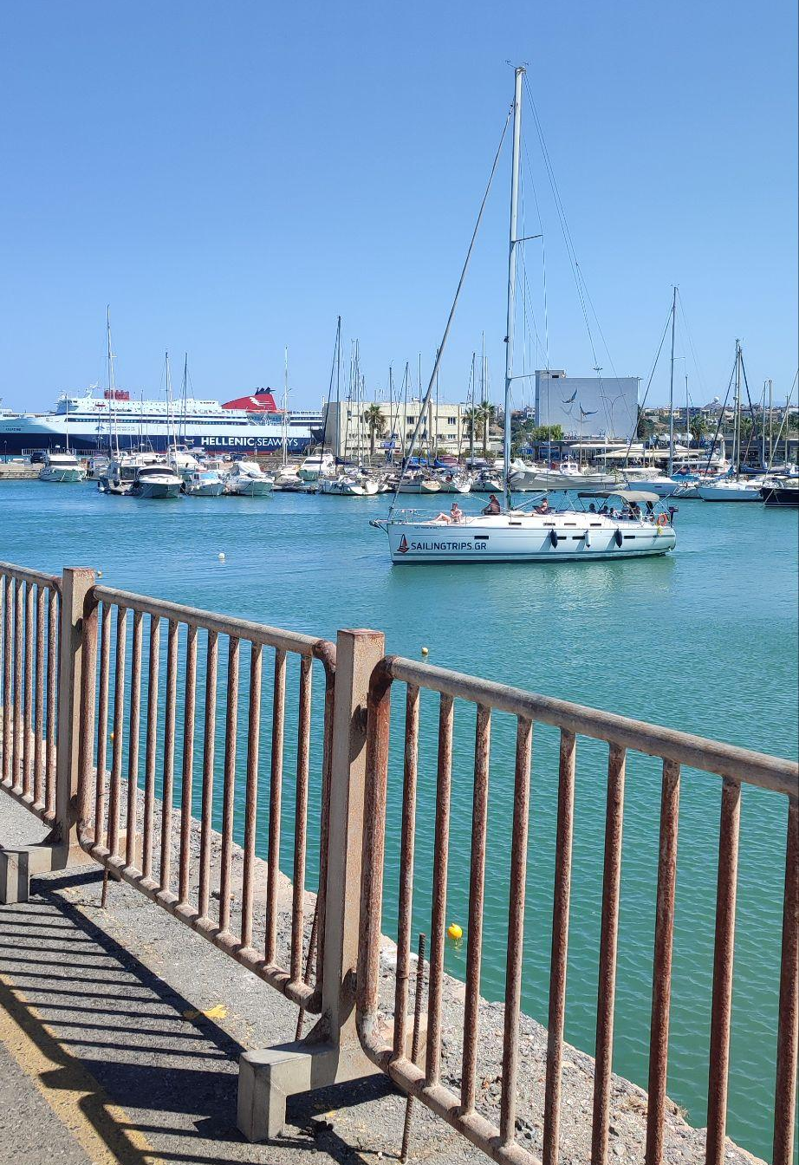
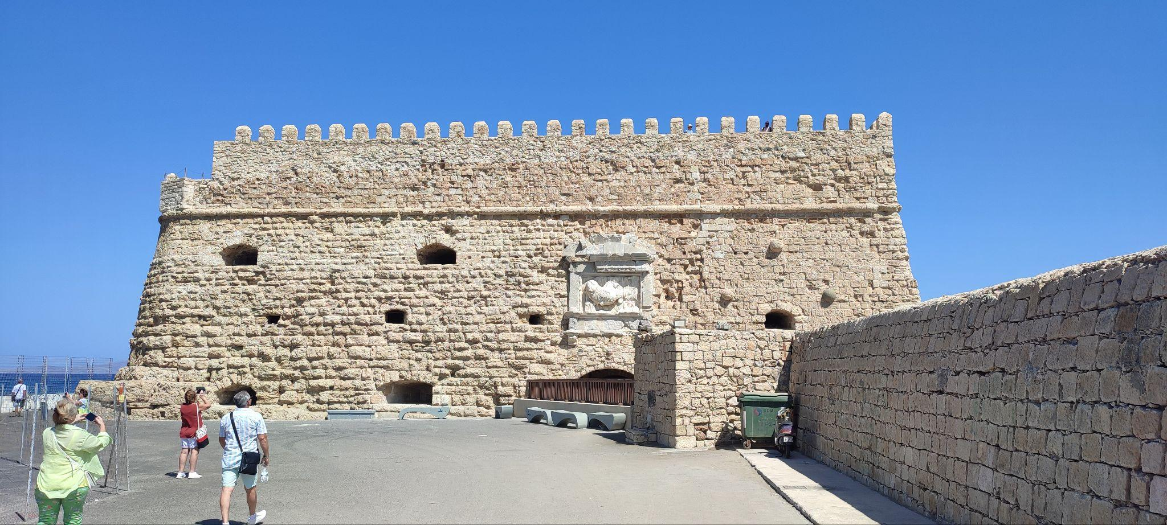
Koules
The Koules is a fortress located at the entrance of the old port of Heraklion, Crete.
It was built by the Republic of Venice in the early 16th century.

Slide 4
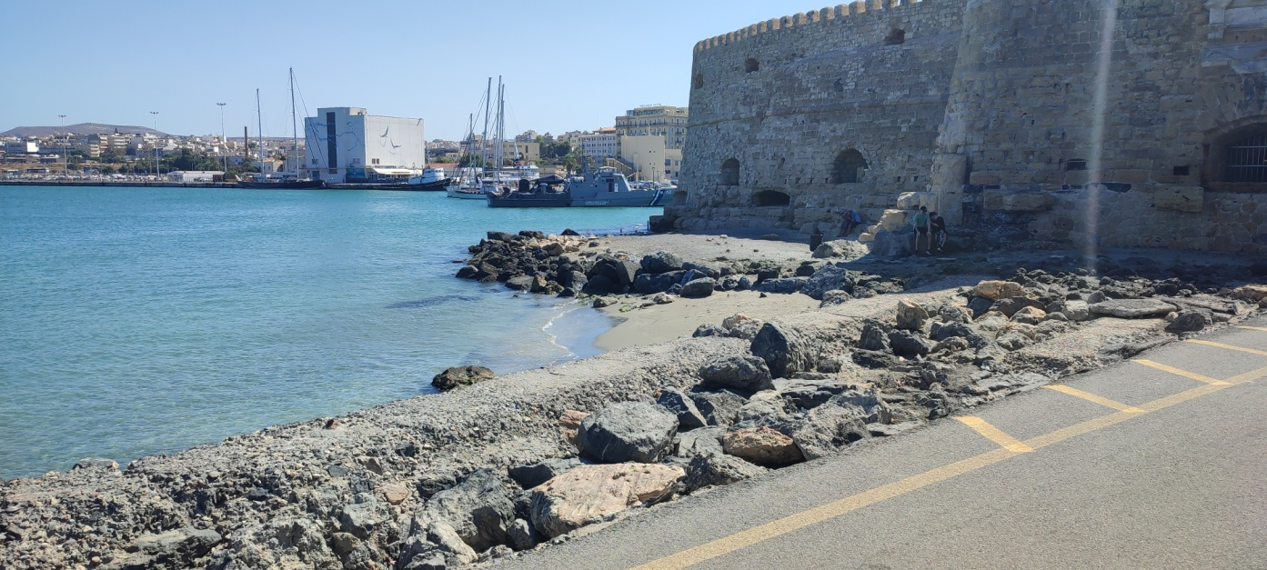
In 1630, the fort was armed with 18 cannons on the ground floor, and 25 cannons on the pathway leading to the roof.
Furthermore, the fortress is made up of two parts: a high rectangular section, and a slightly lower semi-elliptical section.

Slide 5
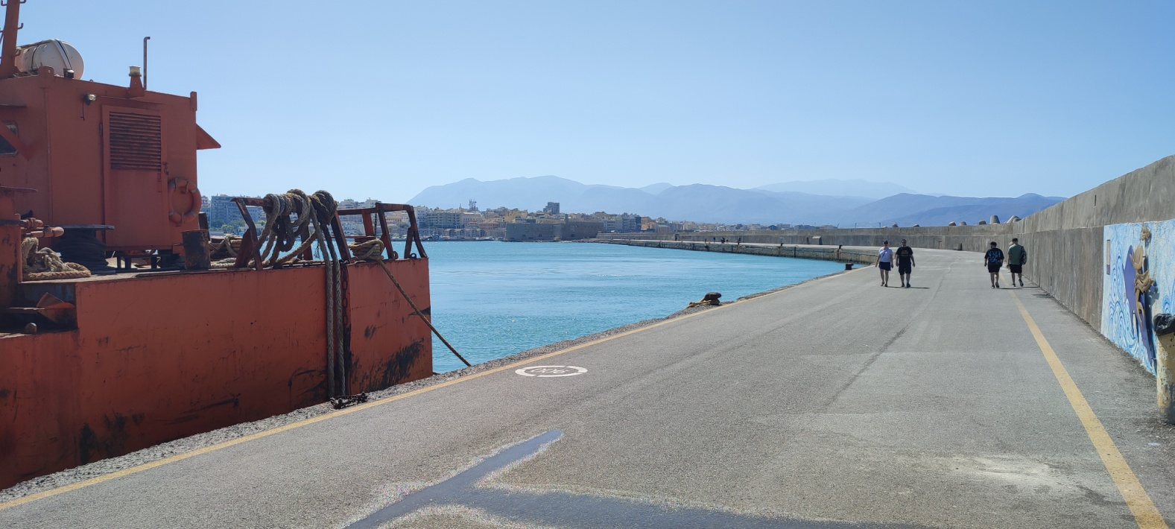
It has very thick walls for protection against intruder attacks.
The fort has two stories, three entrances and a total of 26 rooms, which were mostly utility rooms like storage rooms, a water reservoir, a church, a mill and a bakery.

Slide 6
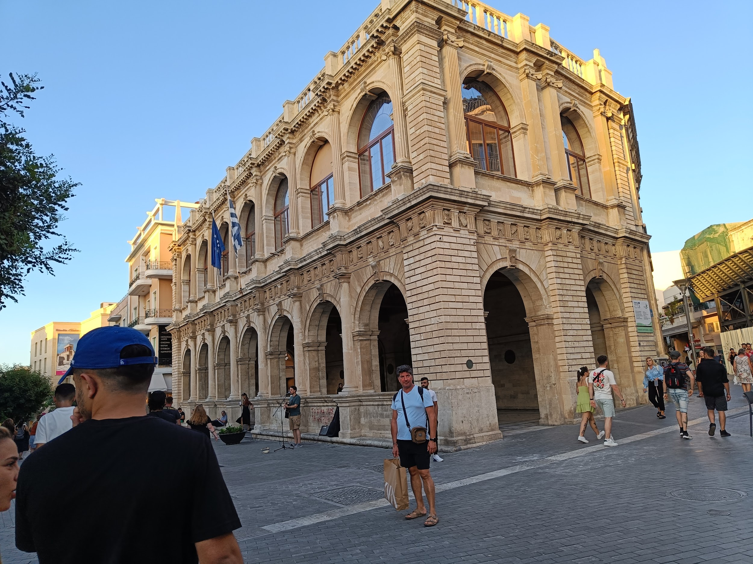
Loggia
This old building in the picture is called Loggia. Loggia of Heraklion is a Venetian building which was built by Francesco Morosini in the years 1625-1628 and was one of the most elegant buildings of that era, where deliberate the nobles and the lords of that time.
4

Slide 7
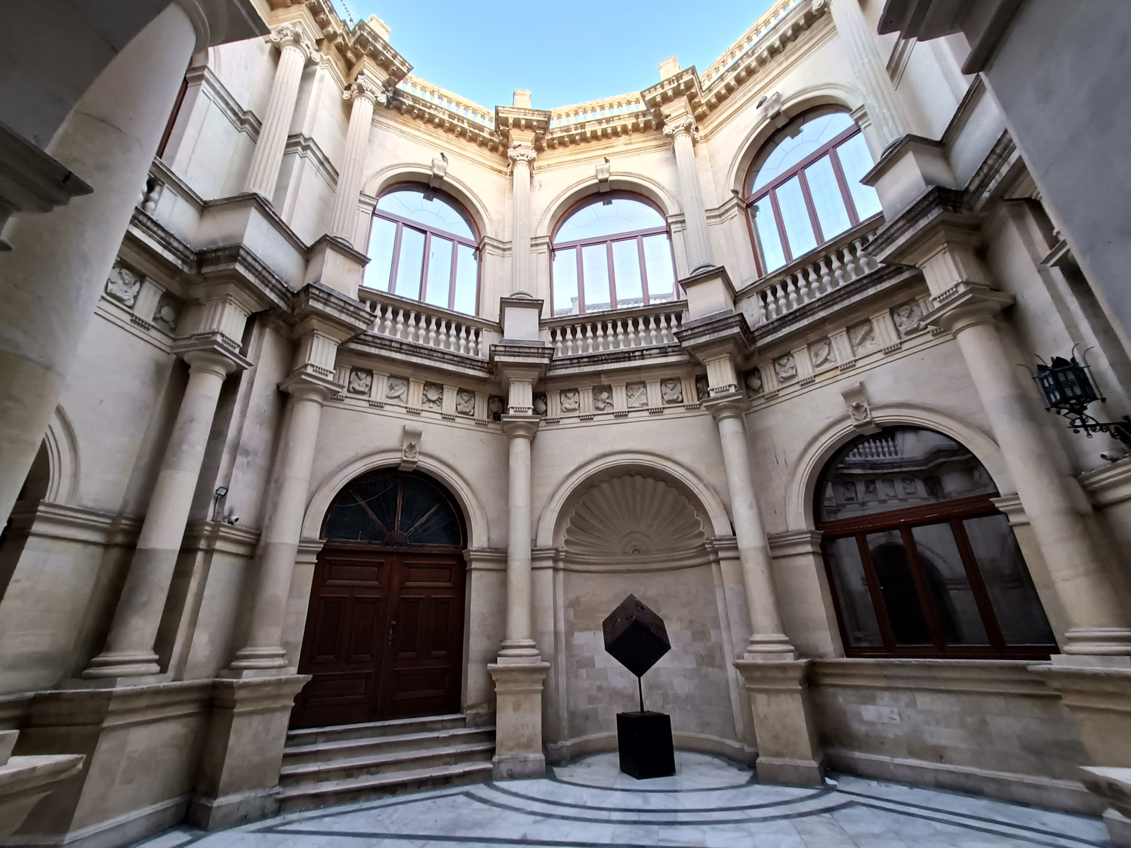
This is the fourth Venetian Loggia built in Heraklion
was located at an important road of that time, the Ruga Maistra, which connected the port to the city center.
The building has two floors,

Slide 8
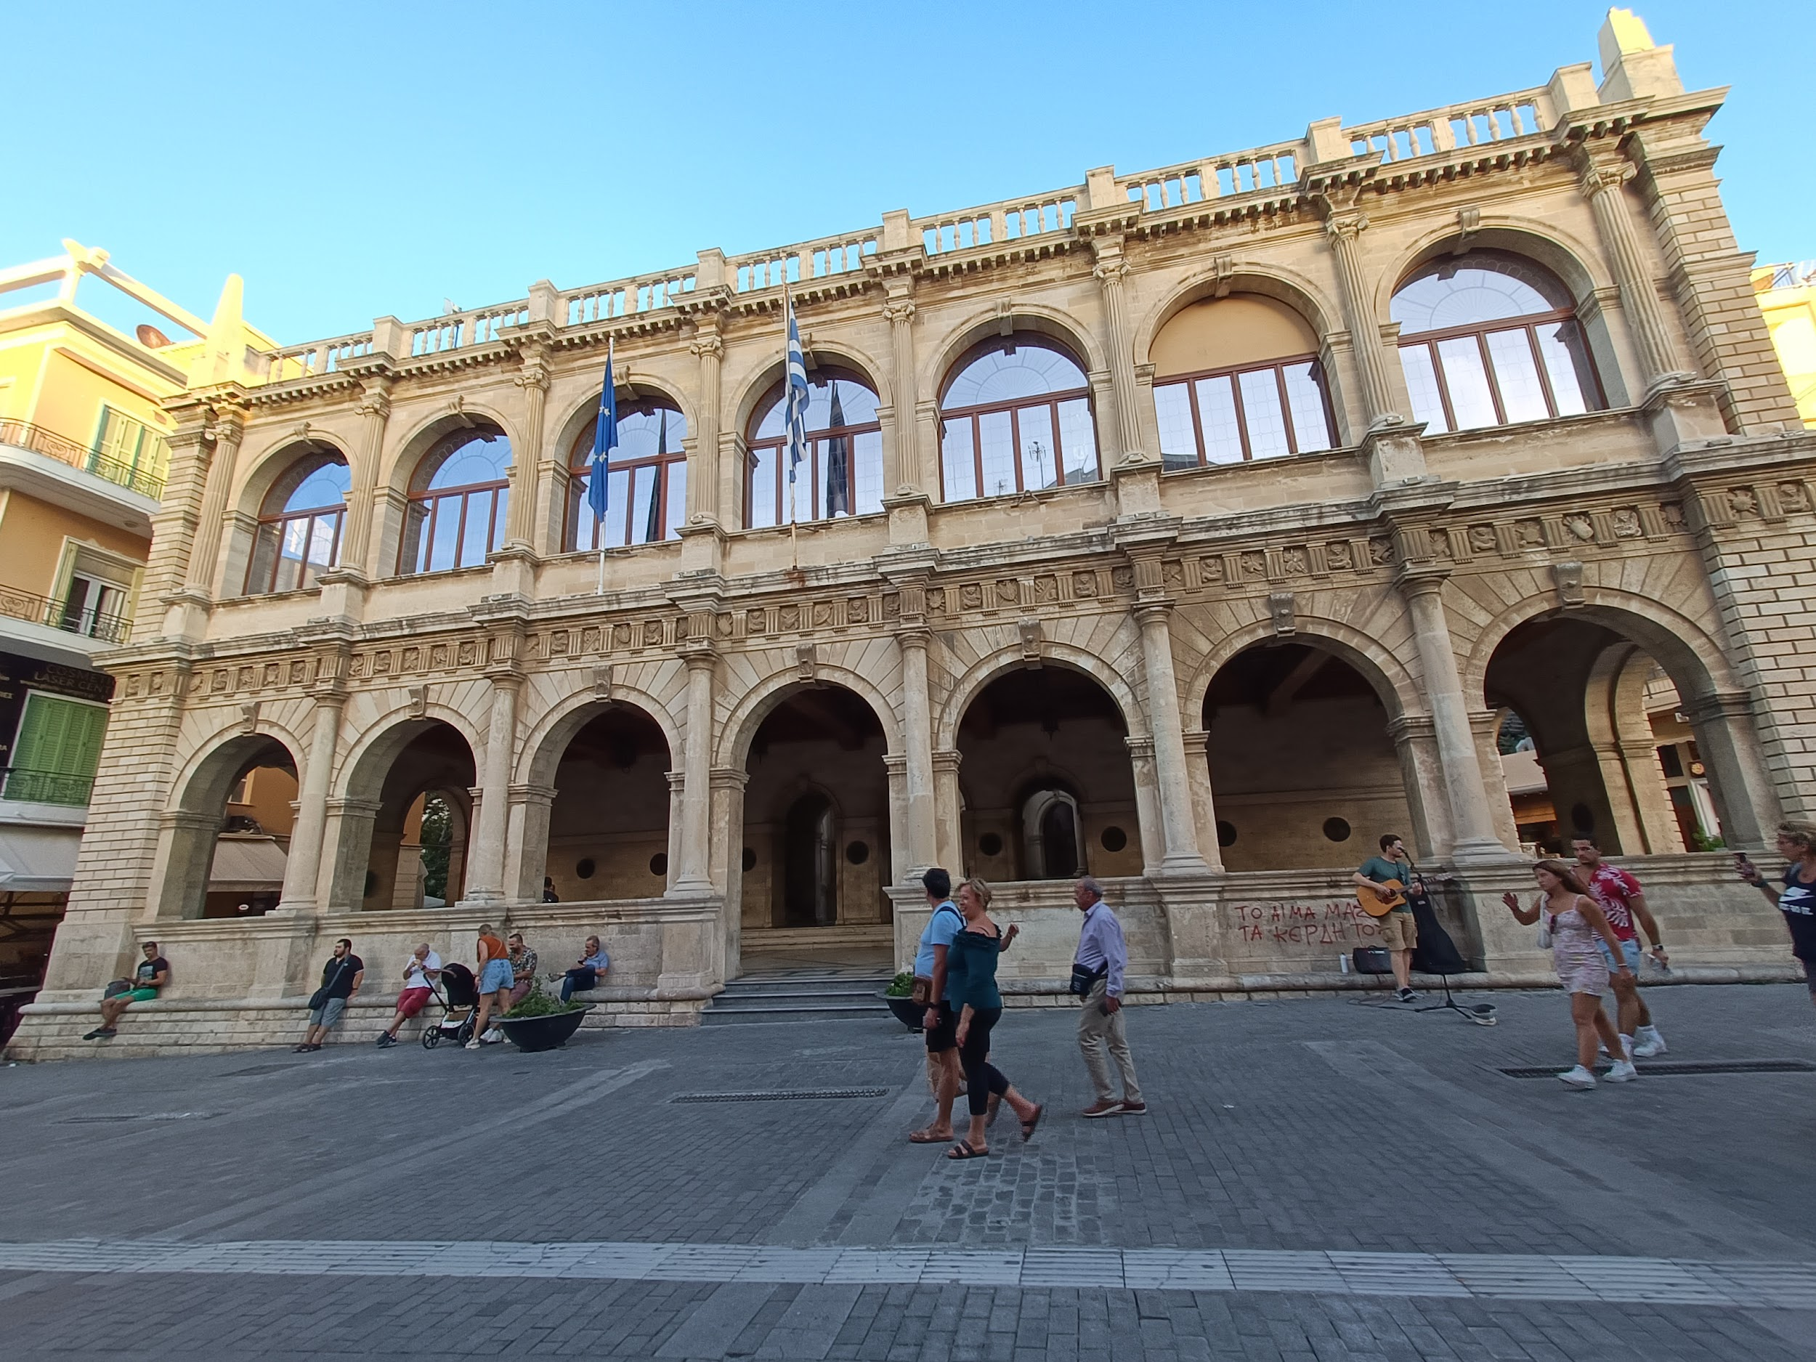
The frieze at the top of the ground floor,
which is an open loft, there
are triglyphs metopes
depicting the lion of St. Mark,
trophies and armors.
It was combining two famous Greek architectural
styles, Doric and Ionic, decorated with columns and
arched openings.

Slide 9
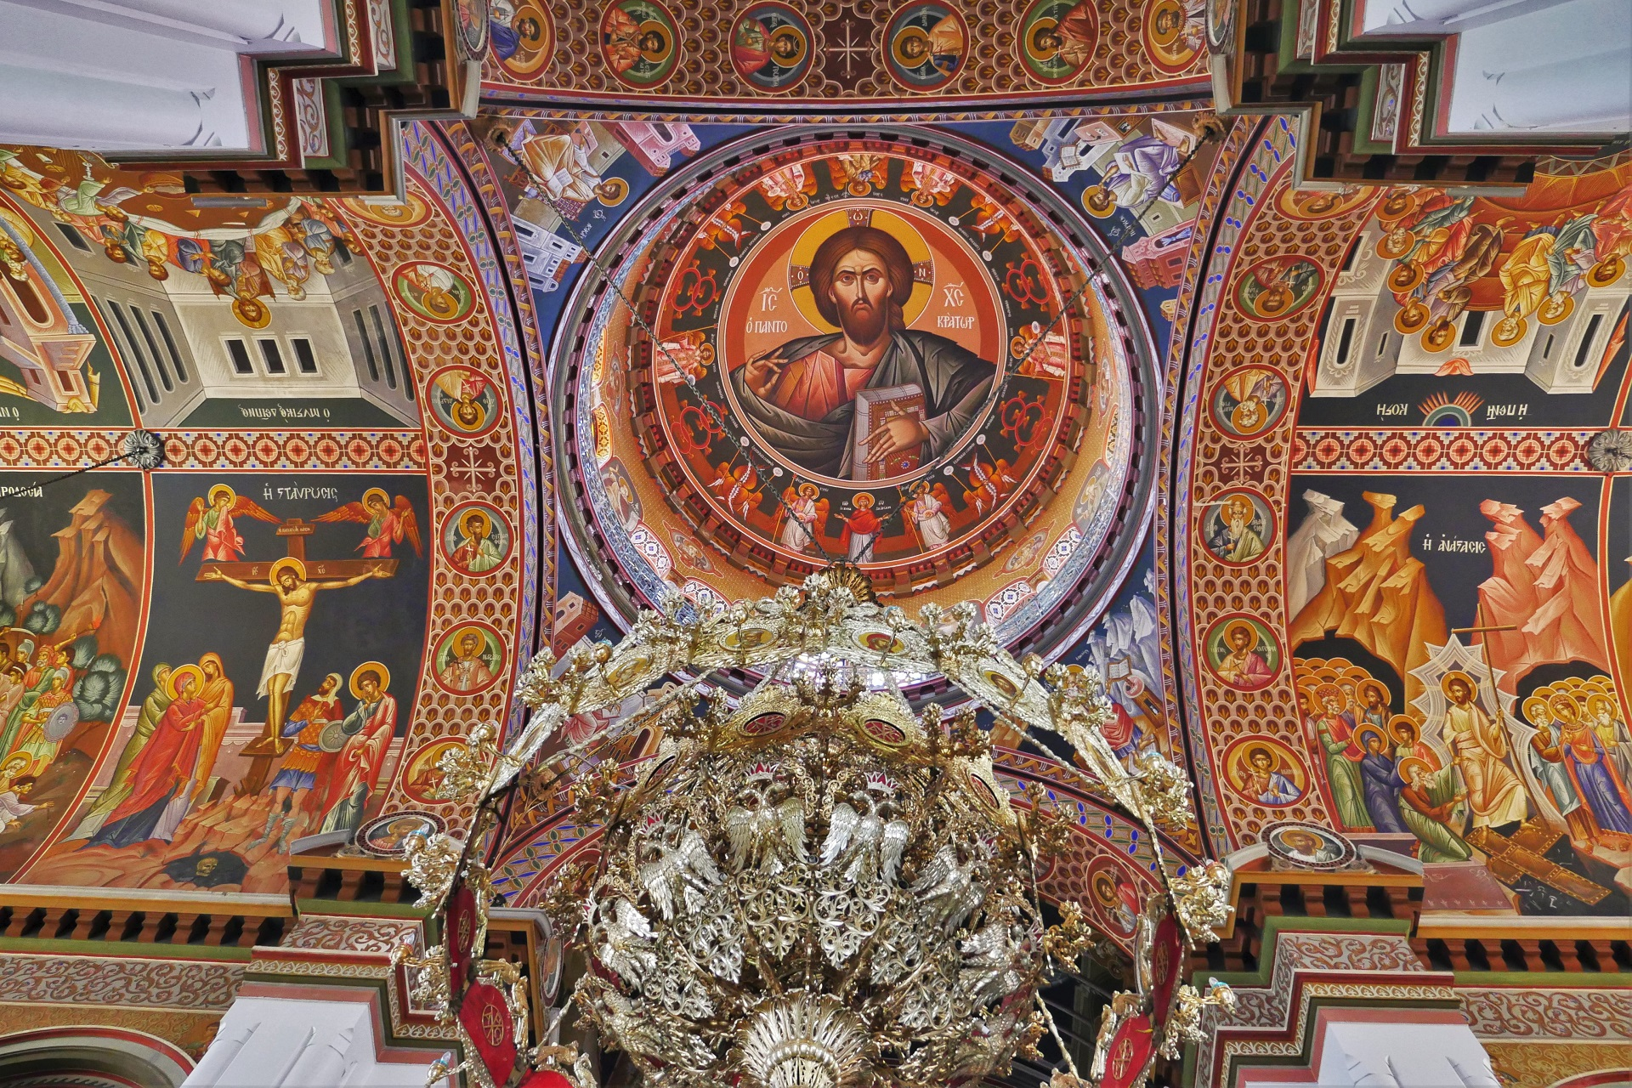
Agios Minas Cathedral
The Agios Minas Cathedral is a Greek Orthodox Cathedral in Heraklion. Ιt is dedicated to Saint Menas the martyr and wonderworker.
It was built from 1862 to 1895.

Slide 10
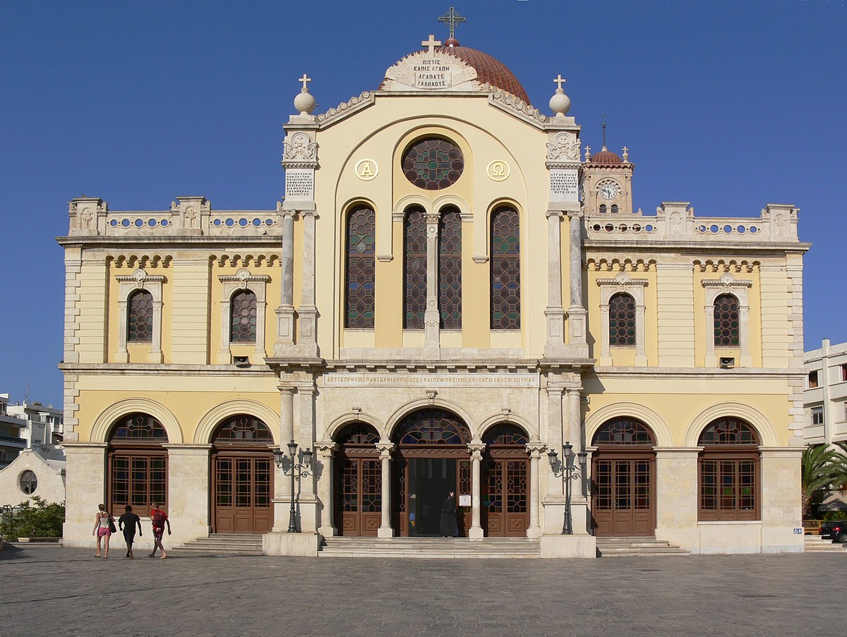
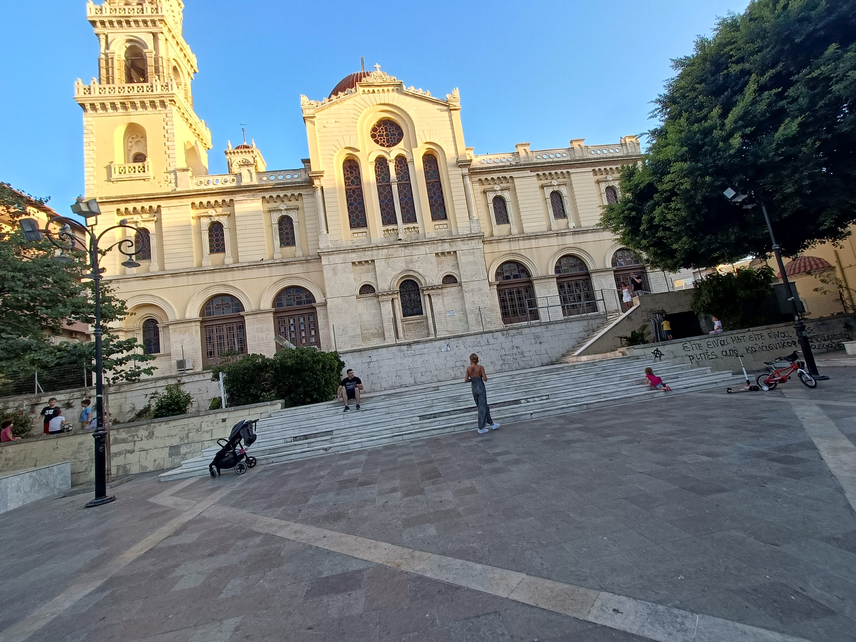
The church has a cruciform architecture with a central dome. It is the largest cathedral in Crete and one of the largest in Greece.

Slide 11
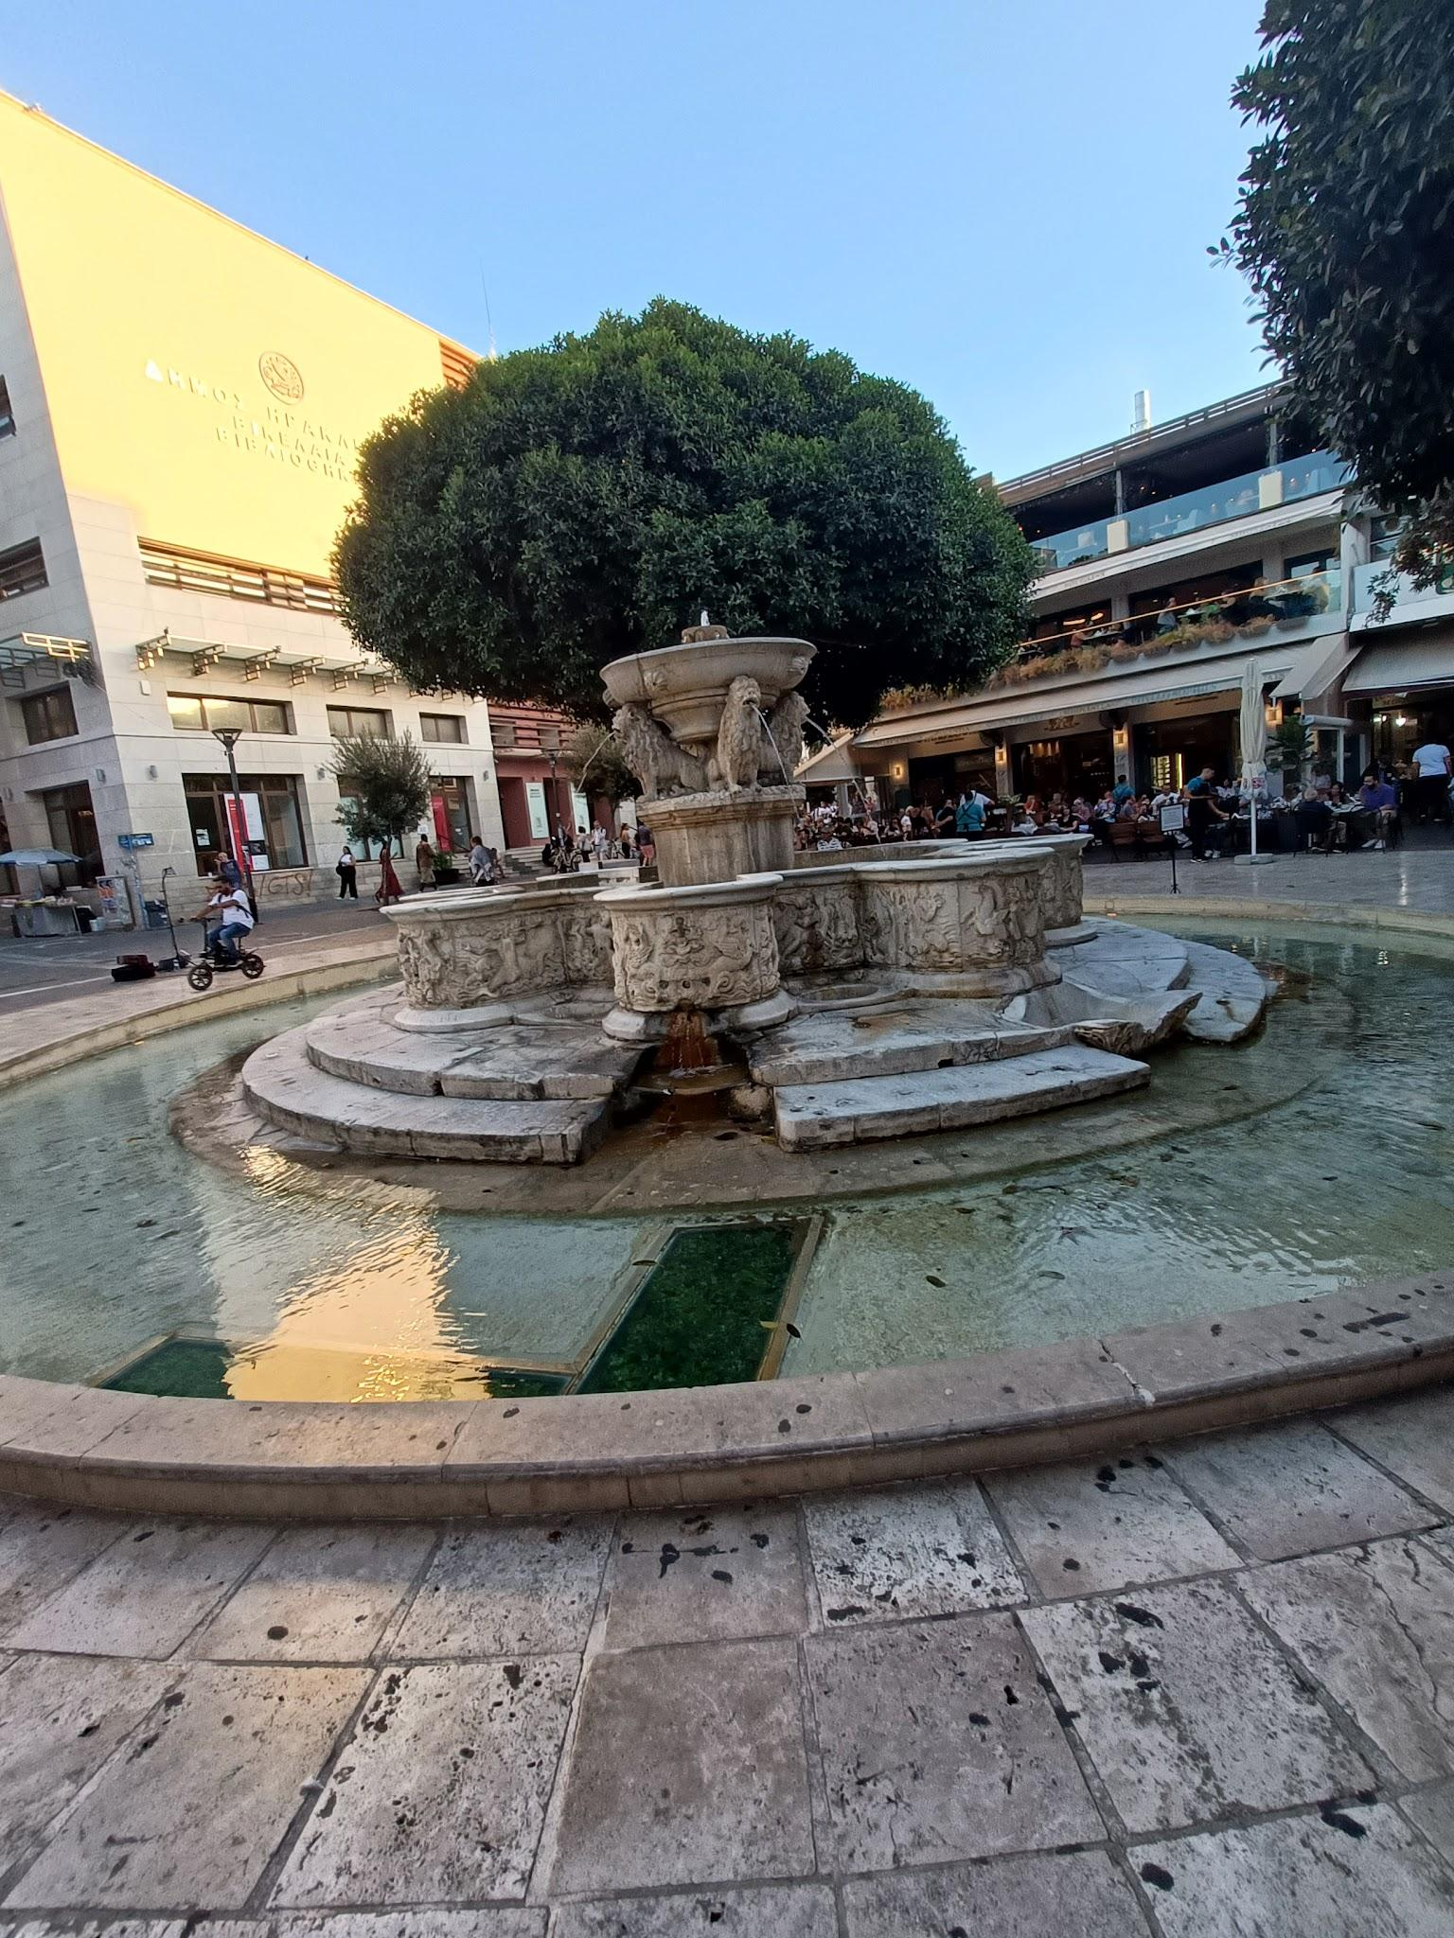
Lions fountain
The Venetian General Provisioner of Candia (Crete and Iraklion in Venetian times) Francesco Morosini ordered and supervised its construction in 1628.
He managed to bring water from the Archanes' springs to the thirsty town of Heraklion through a complicated - for that period - system of pipelines and channels.

Slide 12
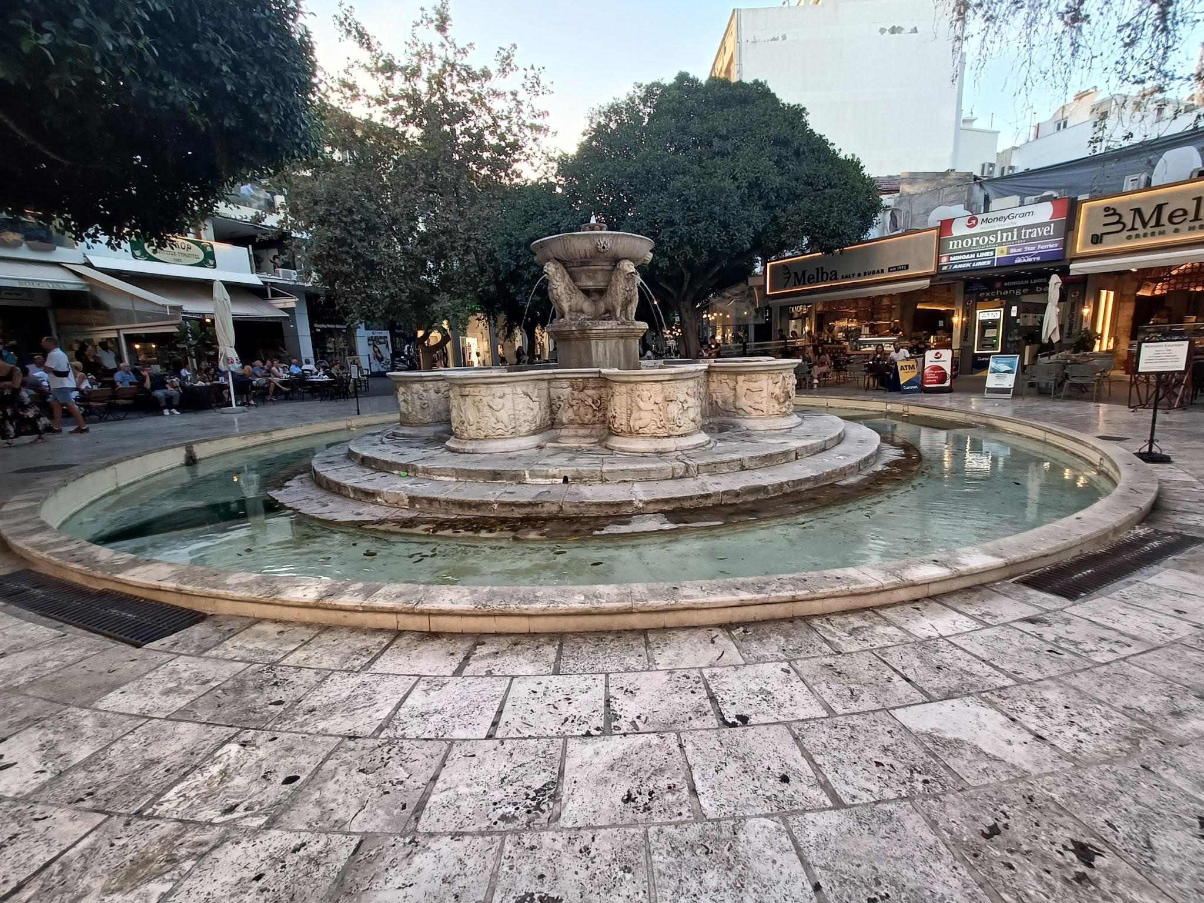
The eight-lobe cistern, which is based on a special stand, is decorated with embossed mythological depictions and maritime figures like tritons, dolphins and various coats of arms, while the water was flowing
from the mouths of
four lions.

Slide 13
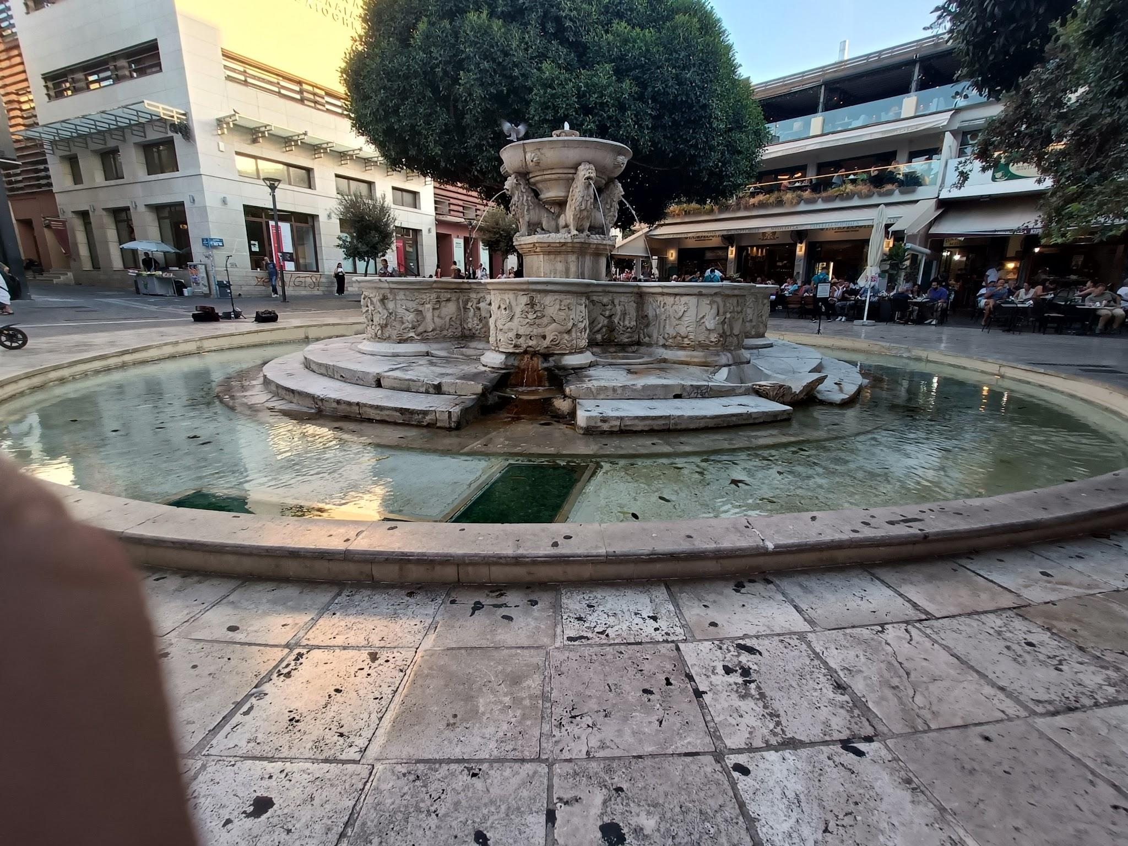
At the very top of the fountain there was a supernatural statue of Poseidon that was standing out but fell probably due to an earthquake.

Slide 14
Knossos
Knossos is a Bronze Age archaeological site in Crete.
It is located on the outskirts of Heraklion, and remains a popular tourist destination.

Slide 15
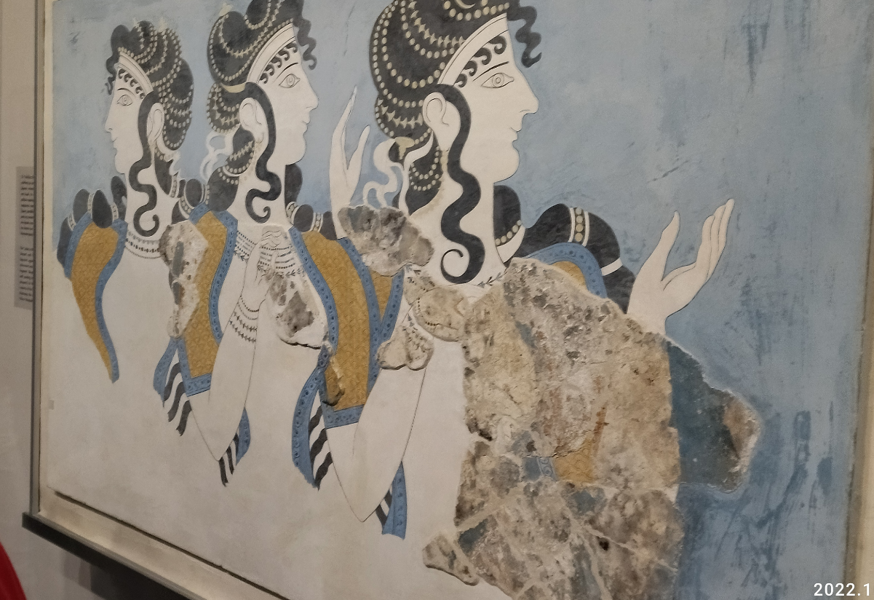
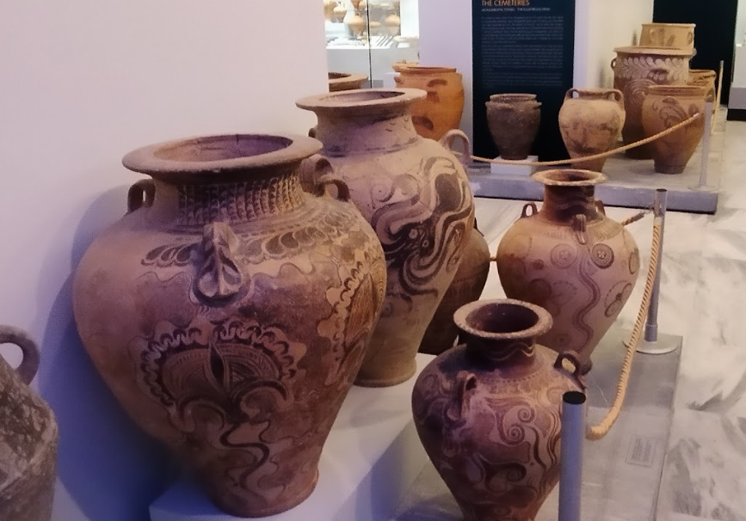
The site was first excavated by Minos Kalokairinos in 1877. In 1900, Arthur Evans undertook more extensive excavations which unearthed most of the palace as well as many now-famous artifacts including the Bull-Leaping Fresco, the snake
goddess figurines, and numerous Linear B tablets

Slide 16
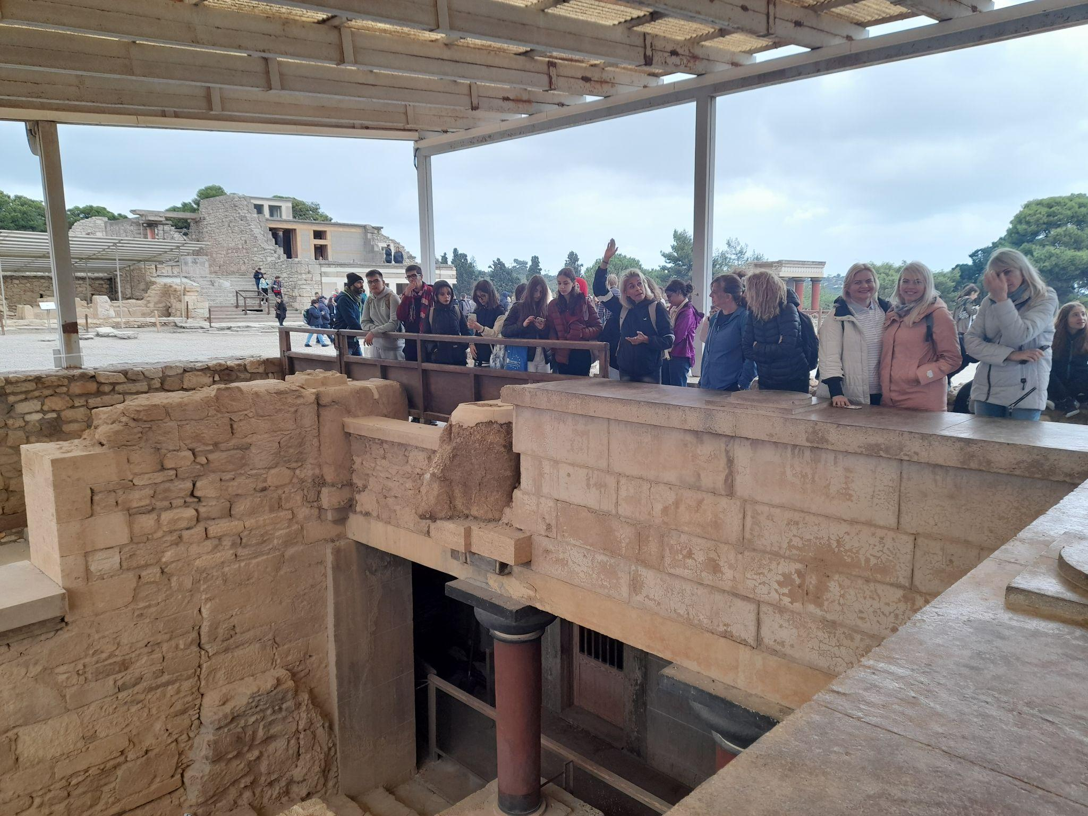
Knossos is dominated by the monumental Palace of Minos. Like other Minoan palaces, this building served as a religious and administrative center rather than a royal
residence.

Slide 17
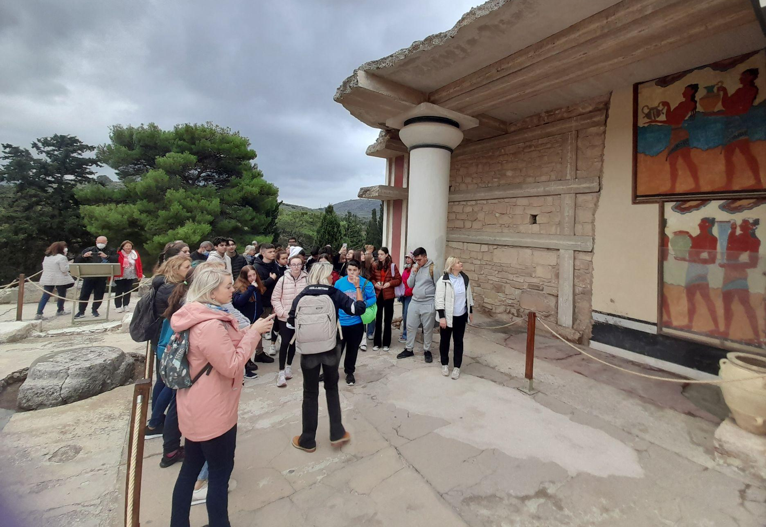
The earliest parts of the palace were built around 1900 BC.
The palace was continually renovated and expanded over the next five centuries until its final destruction around 1350 BC.
Next avatar

Slide 18
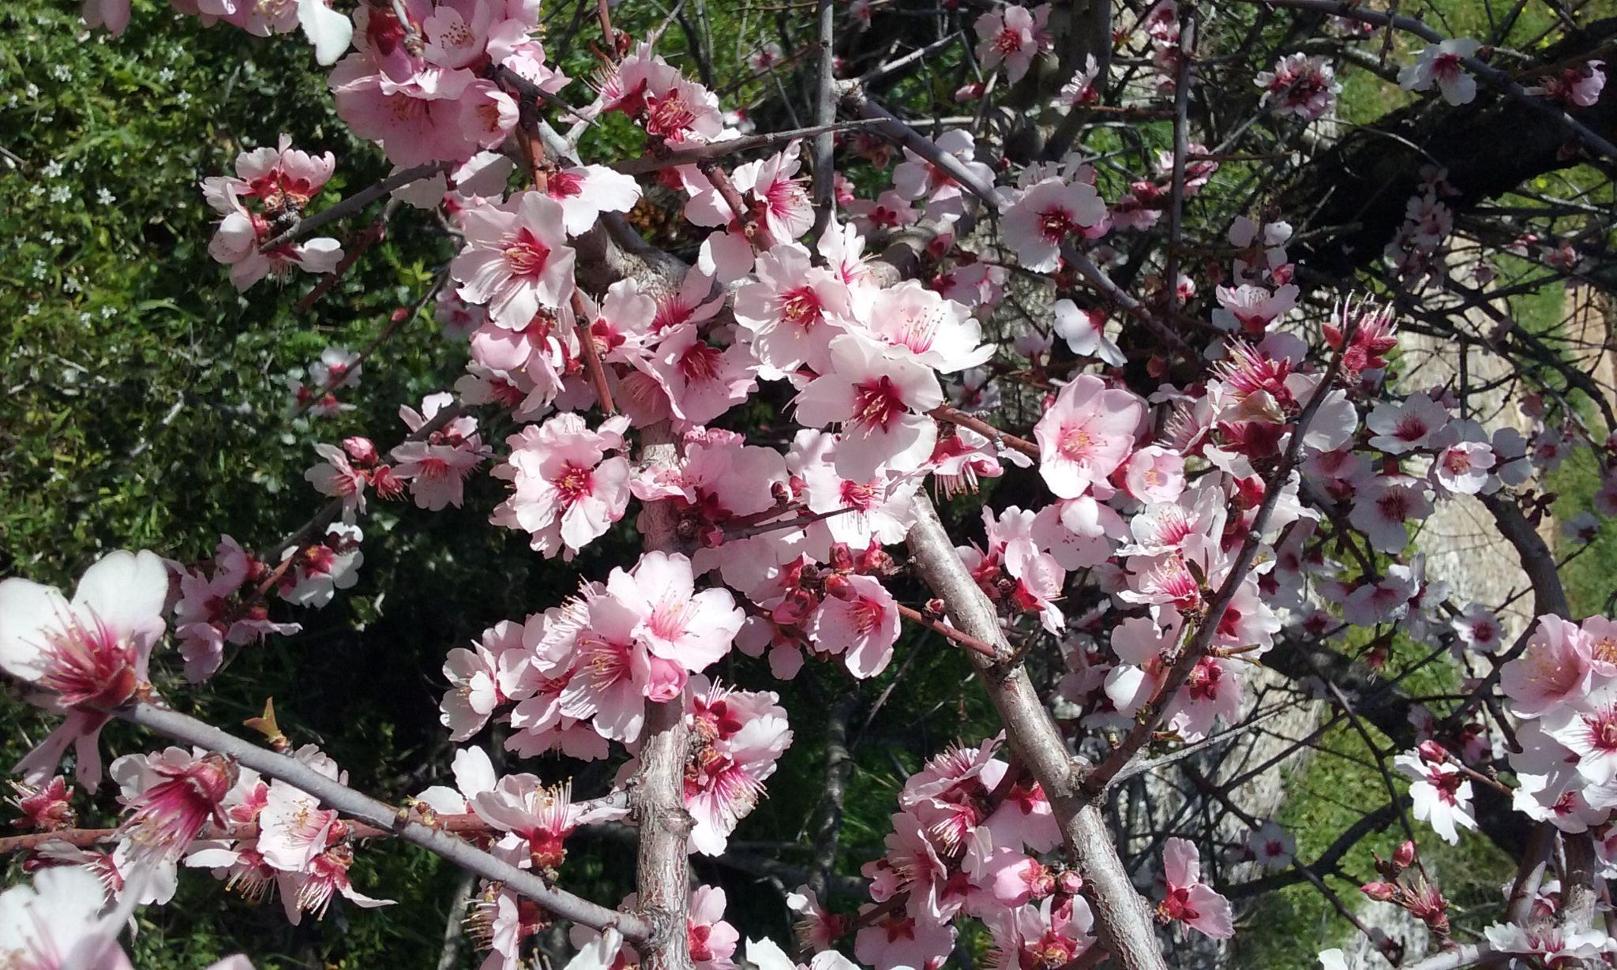
Thank you for your attention!

