Slide 1
Click F5

Slide 2
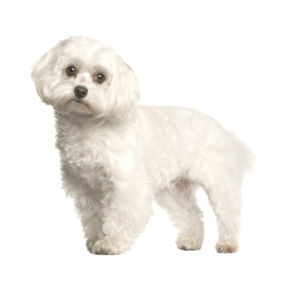
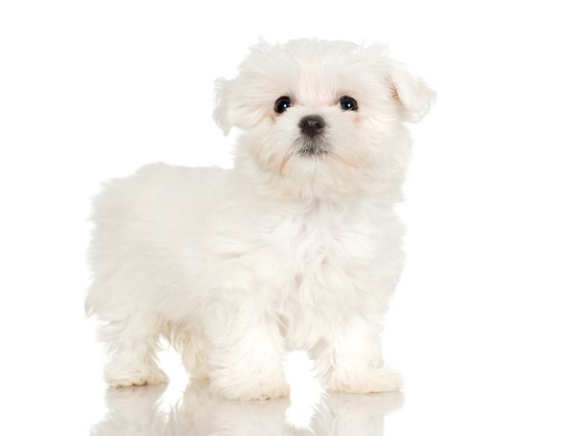
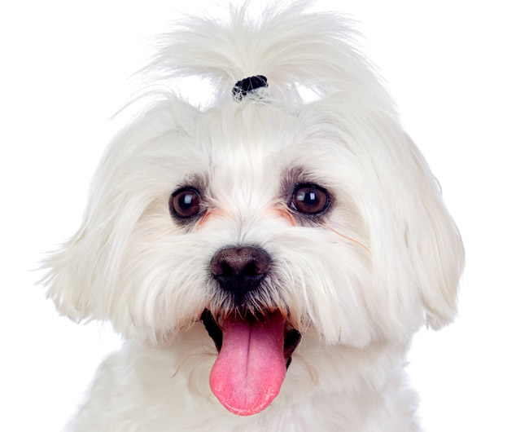
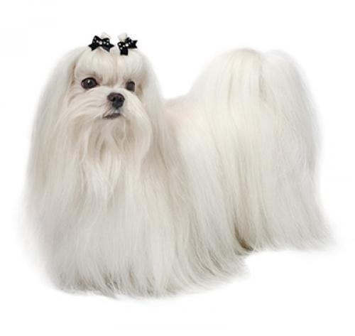
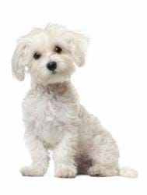
Maltez

Slide 3
Maltez is one of the ancient dog brands in the world

Slide 4
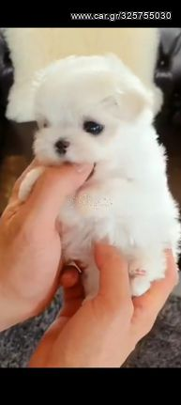
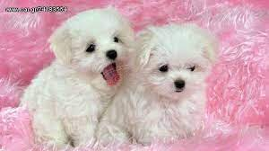
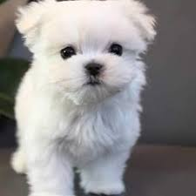
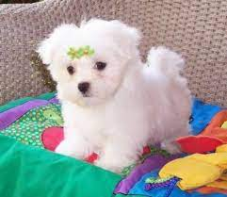
They are only 10 cm

Slide 5
They are considered therapy dogs

Slide 6
Search me :
https://www.youtube.com/watch?v=9IGVAnpfHGo
https://petfan.gr/blog/maltese-b215.html
https://www.ygeiamou.gr/pets/90259/maltez-mikroulis-panexipnos-ke-idanikos-gia-tous-allergikous/

Slide 7
Do you want a pet ? Search me
https://iwantadog.gr/dt_portfolios/maltese/
https://www.xe.gr/zoa/skyloi,77344.html

