Slide 1

Our visit to an Icelandic school

Slide 2
The Icelandic school system
Kindergarten (optional): 1-5 years old
Primary and Secondary (compulsory): 6-16 years old
Upper secondary – College: 16-19 years old
School day
From 8:30 to 13:30 (primary) / 15:00 (secondary)
Lunch at school paid by parents
After school activities until 17:00 paid by parents

Slide 3
The Icelandic school system
In Secondary they can choose 4-6 hours per week:
Sports
Spanish
Knitting sweater
Make-up
Finance
Steel work
Car repairs
180 days of school per year
30-35 lessons per week:
Icelandic Sport
Math Swimming
English Art
Danish Woodwork
Social science Textiles
Science Home economics

Slide 4
The Icelandic school system
1-3 years old: 5 children per adult
4 years old: 8 children per adult
5 years old: 12 children per adult
6-15 years old: 18-25 children in a class
Primary classes have a teacher assistant

Slide 5
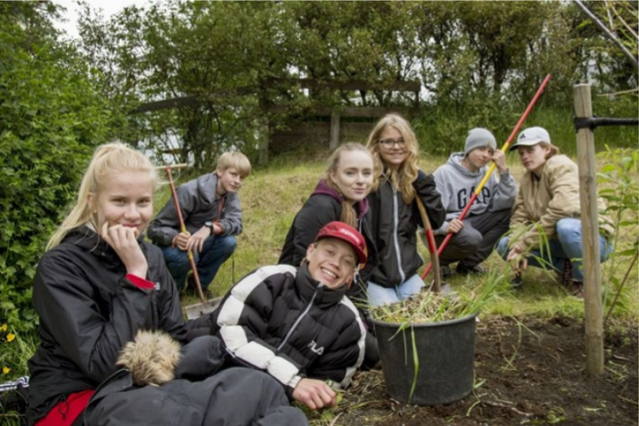
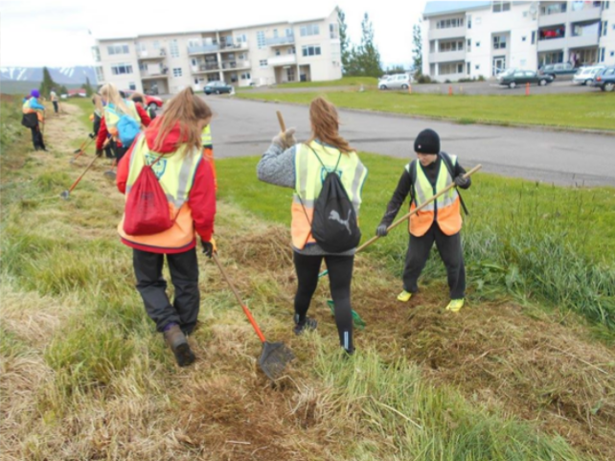
Working school!
Summer jobs for teenagers

Slide 6
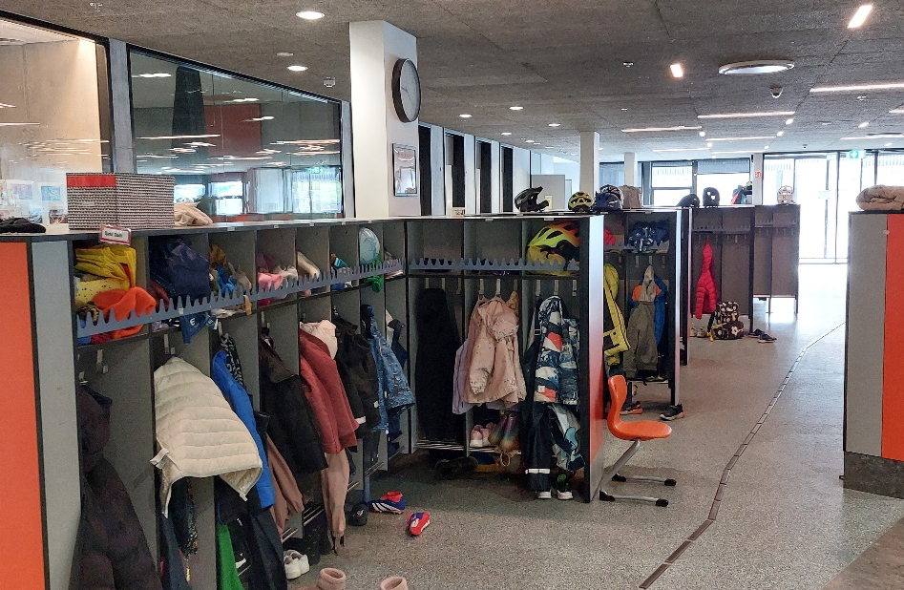
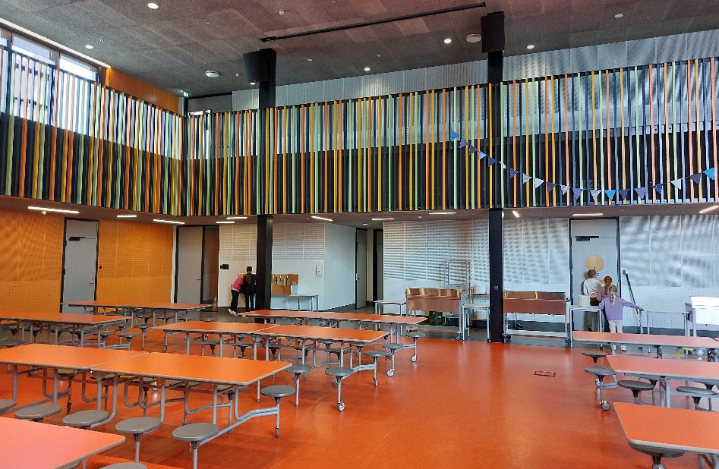

The inside of an Icelandic school
At the school entrance hall …
The lunchroom

Slide 7
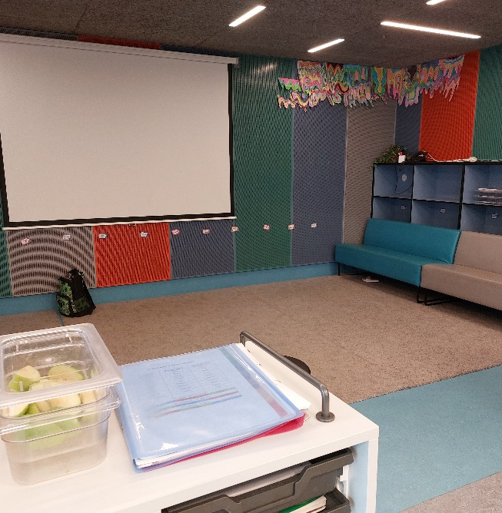
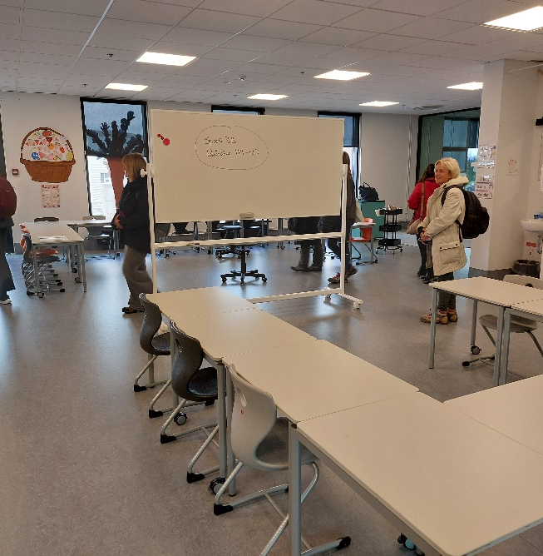
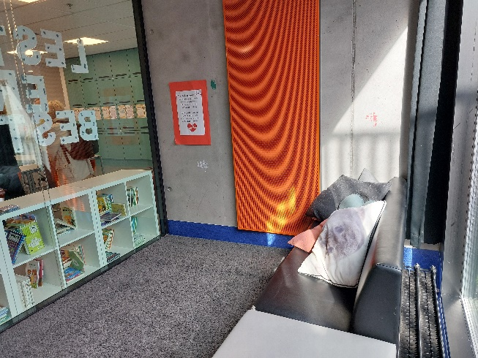
A classroom
The projector corner …
Separate seating arrangements for group work
A quiet corner for students with special needs.

Slide 8
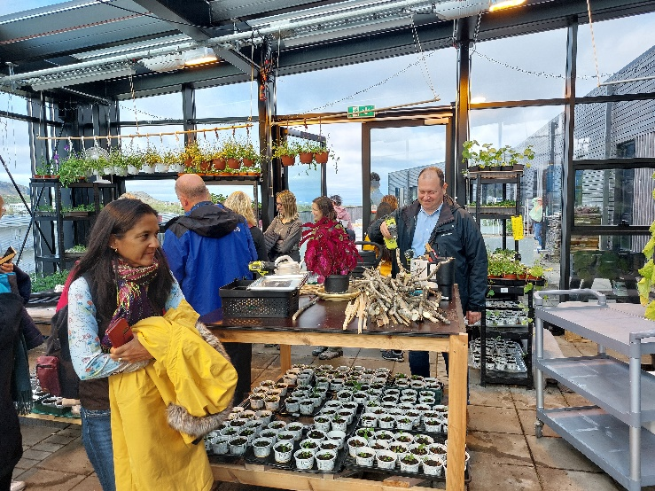
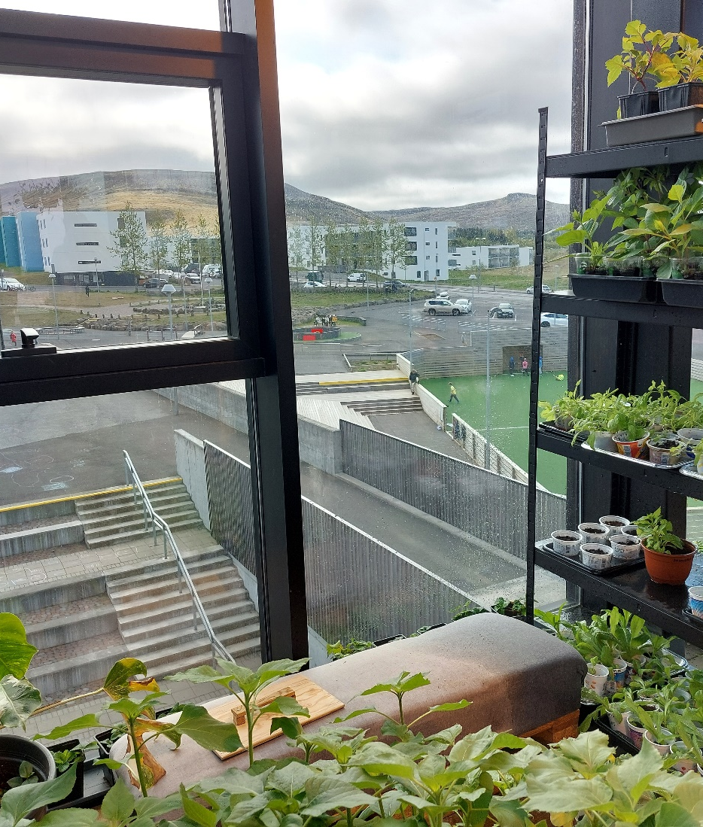
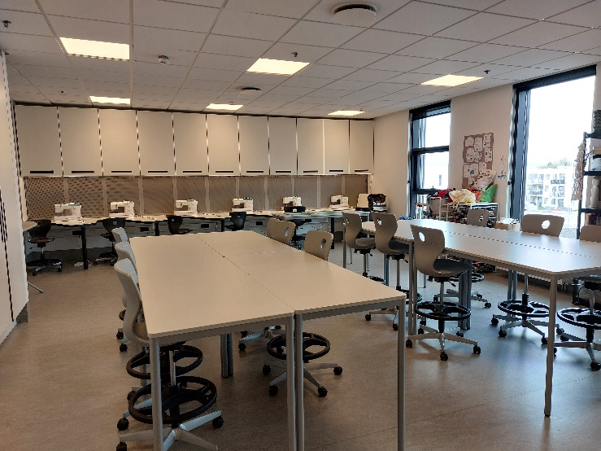
Προσθέστε τίτλο διαφάνειας - 3
The greenhouse
and
the textile classroom.

Slide 9
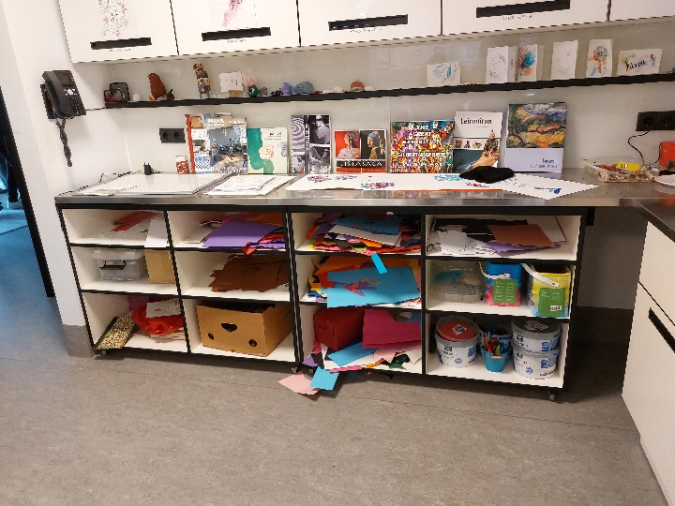
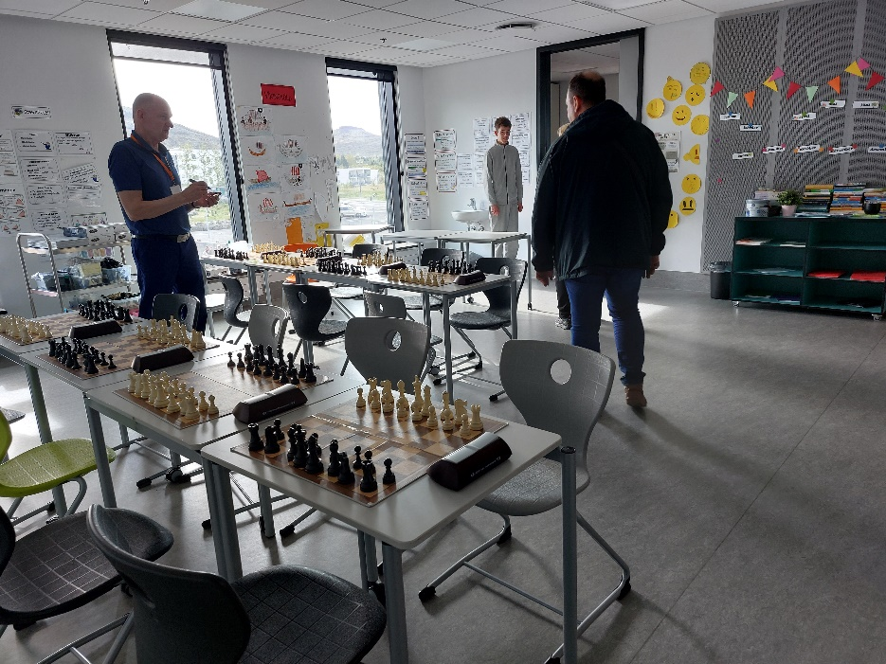
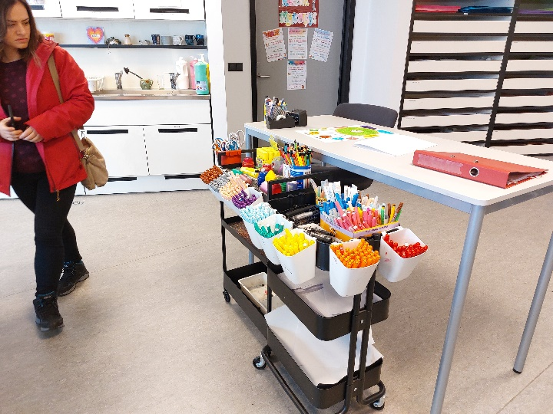
Προσθέστε τίτλο διαφάνειας - 3
The chess classroom
and
the arts and crafts classroom.

Slide 10
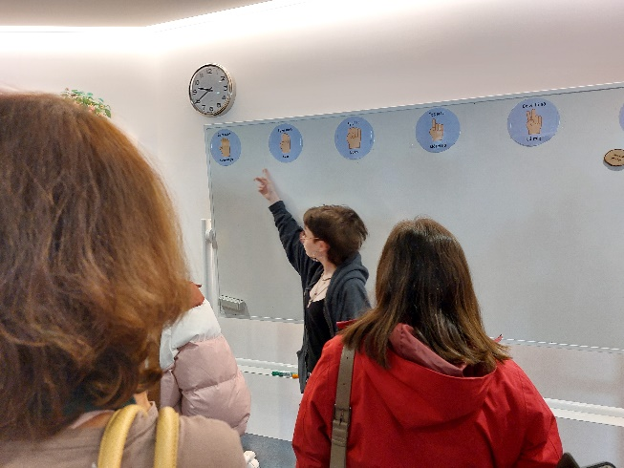
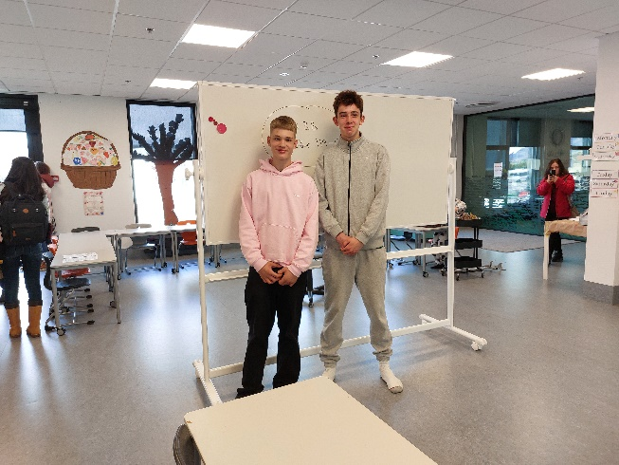
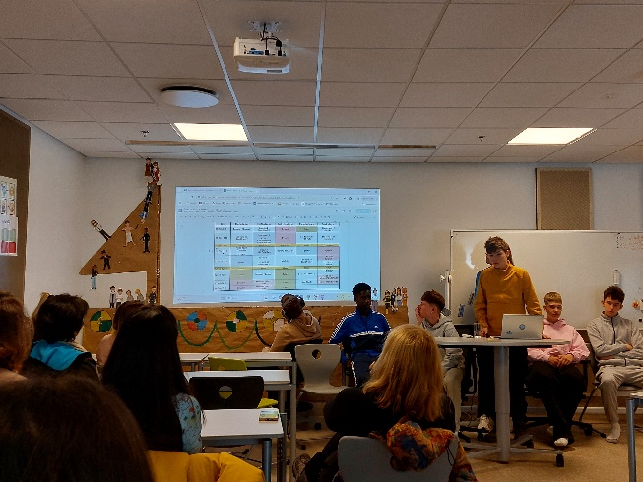
Our guides …

Slide 11
Thank you for your attention!

