Slide 1

ABOUT MYSELF
ANGELIKA MORFINOU

Slide 2
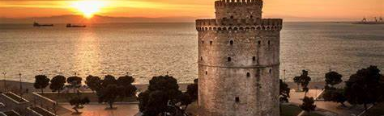
WHERE I LIVE?
I live in Toumba , Thessaloniki

Slide 3
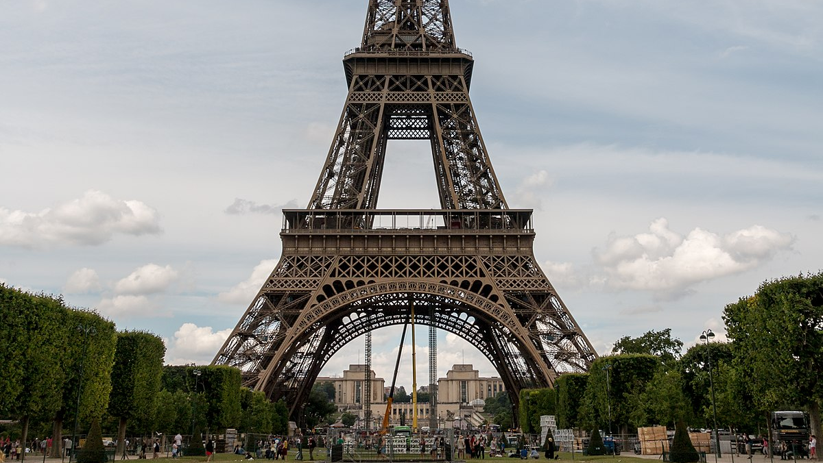
WHAT I LIKE ?
I love dancing.
I like playing outdoors.
I like playing board games
I enjoy listening to pop music.
I love traveling.

Slide 4

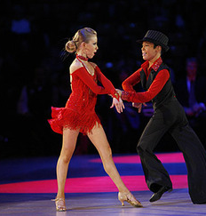
My favourite season is winter because I have my birthday.
My favourite sport is volley because it is fun.
My favourite activity program is Latin because I love it and I am in a contest.

Slide 5
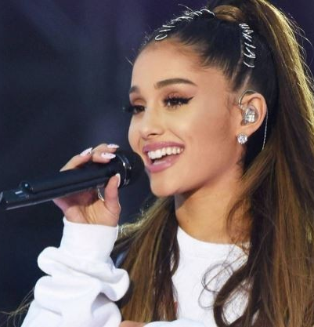
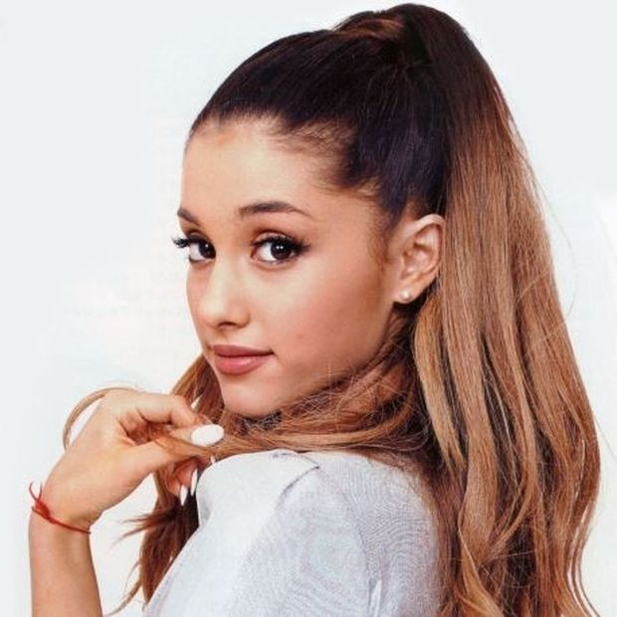
MY FAVOURITE SINGER
My favourite singer is Ariana Grade because I like her voice.
I love her songs.

Slide 6
MY FAVOURITE PLACES
I enjoy going to the concerts.
I like going to the theater.
I love going to the cinema.

Slide 7

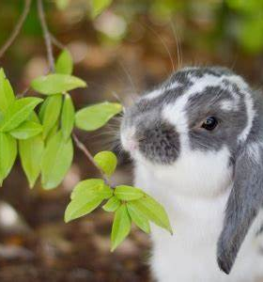
ΤΗΑΝΚ ΥΟU VERY MUCH!!!!!

