Slide 1
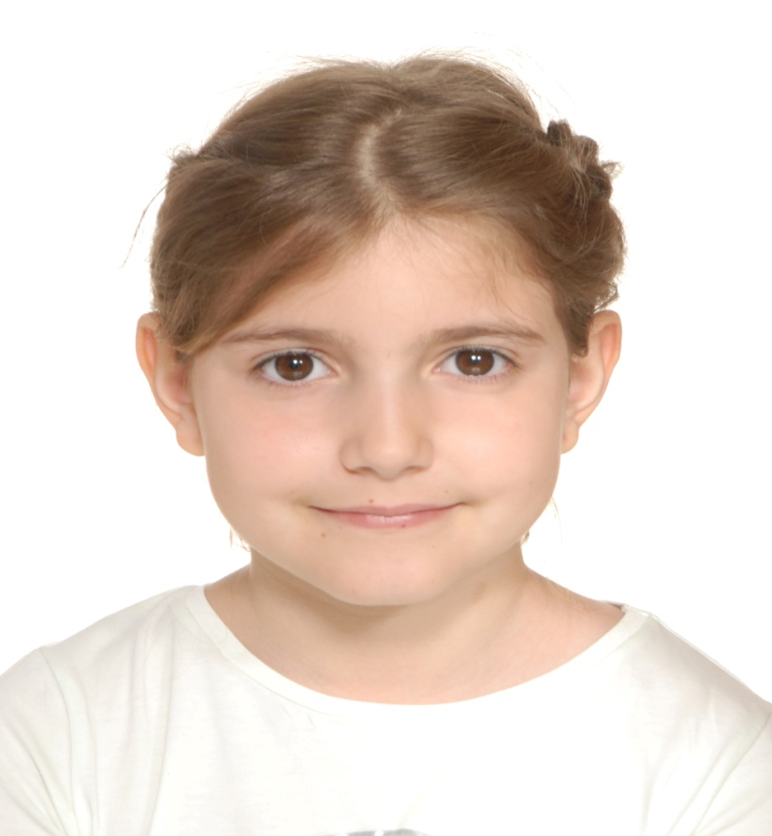
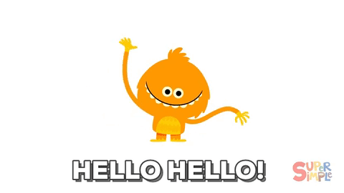
Something about me…
Name: Katia Koupka

Slide 2
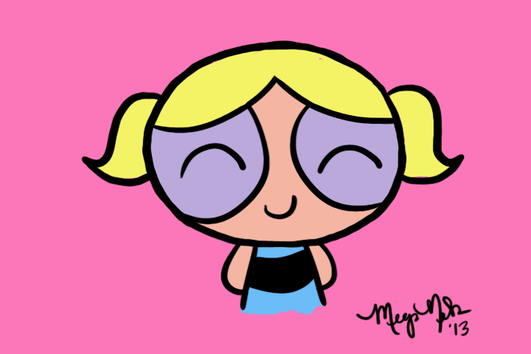
What I look like???
I am normal size
I have got brown eyes and wavy blond hair

Slide 3
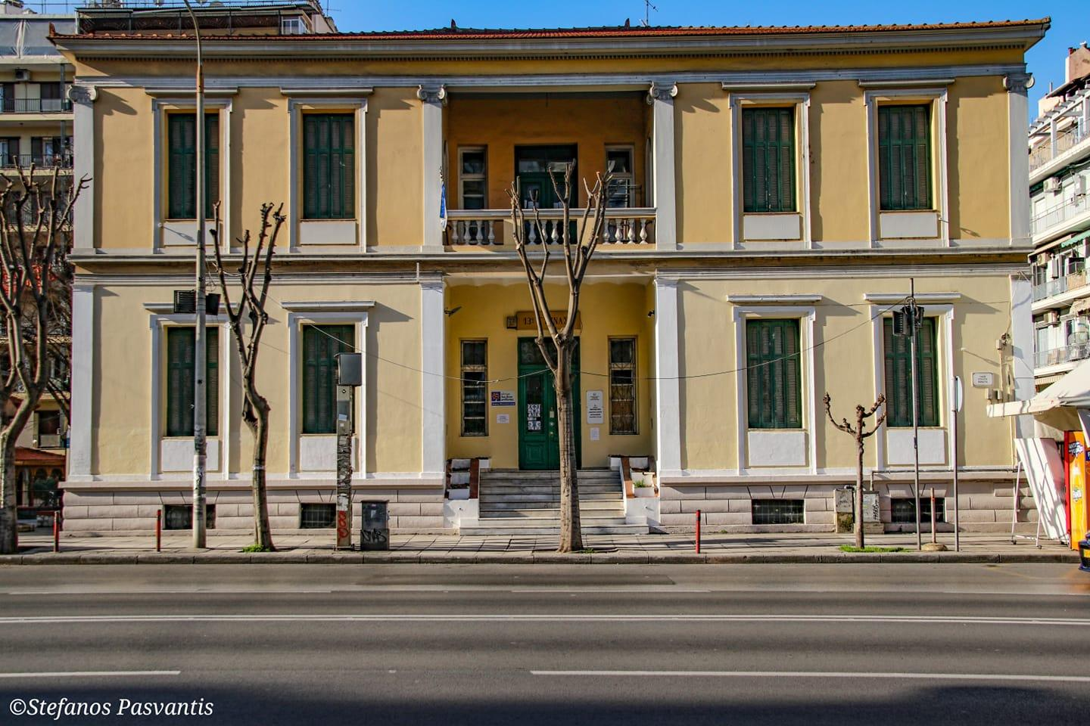
My school is ‘1st primary school of Thessaloniki’.

Slide 4
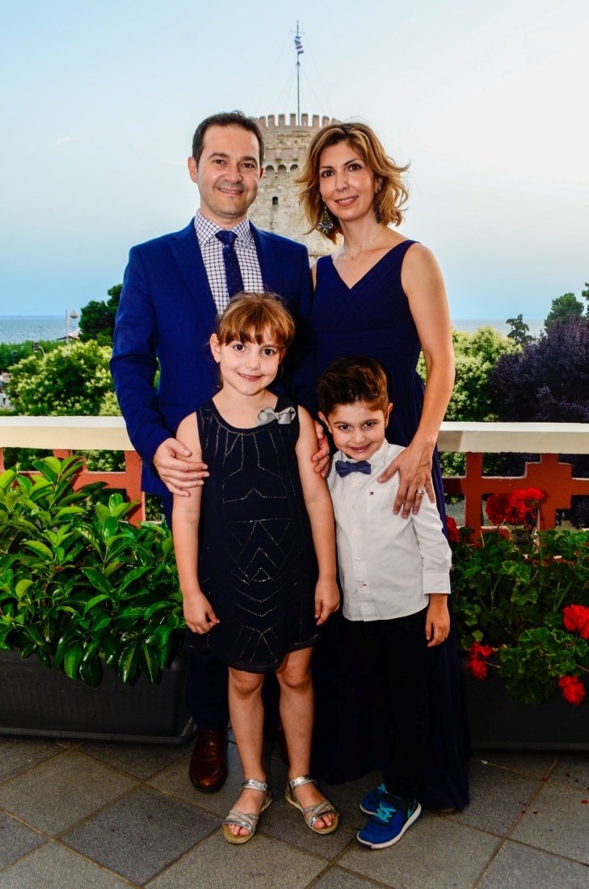
My familly: is my father Michel , my mother Dimitra , my brother Alex and me Katia.

Slide 5
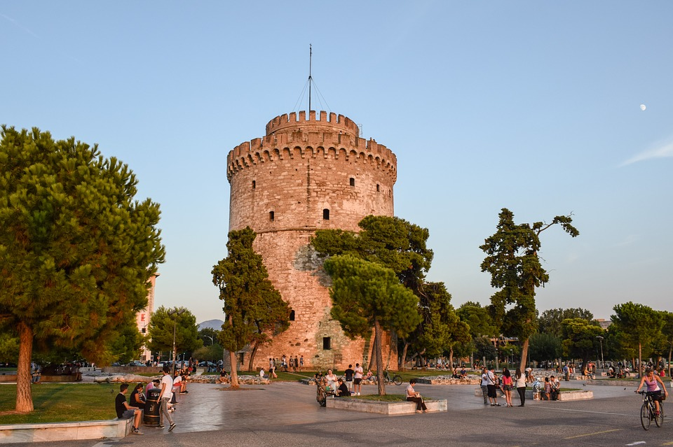
I live in Thessaloniki

Slide 6

My hobbies are:
Drawing
Do arts and crafts
Dancing
Do gymnastics

Slide 7
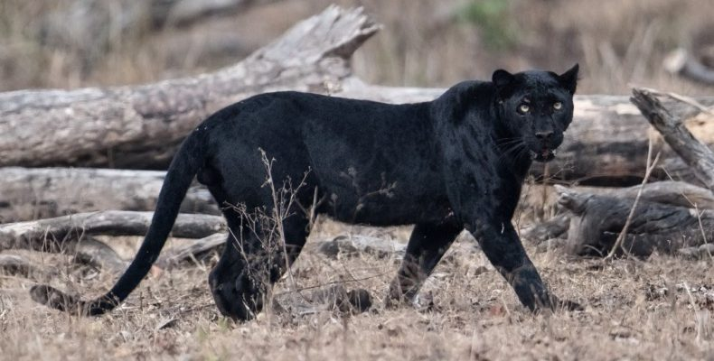
My favourite animal is black panther because he is black !!!

Slide 8


