Slide 1
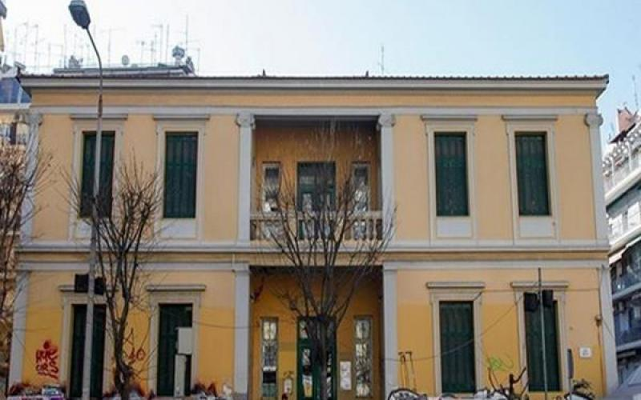
MY PRESENTATION
THANOS LIMOS E’1 2020-2021
1st experimental primary school of Thessaloniki

Slide 2
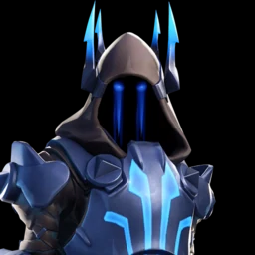
WHAT I LOOK LIKE
I’m little, short and thin
I have grey eyes and blonde hair
I usually prefer wearing athletic clothes
At parties I wear shirts and trousers

Slide 3
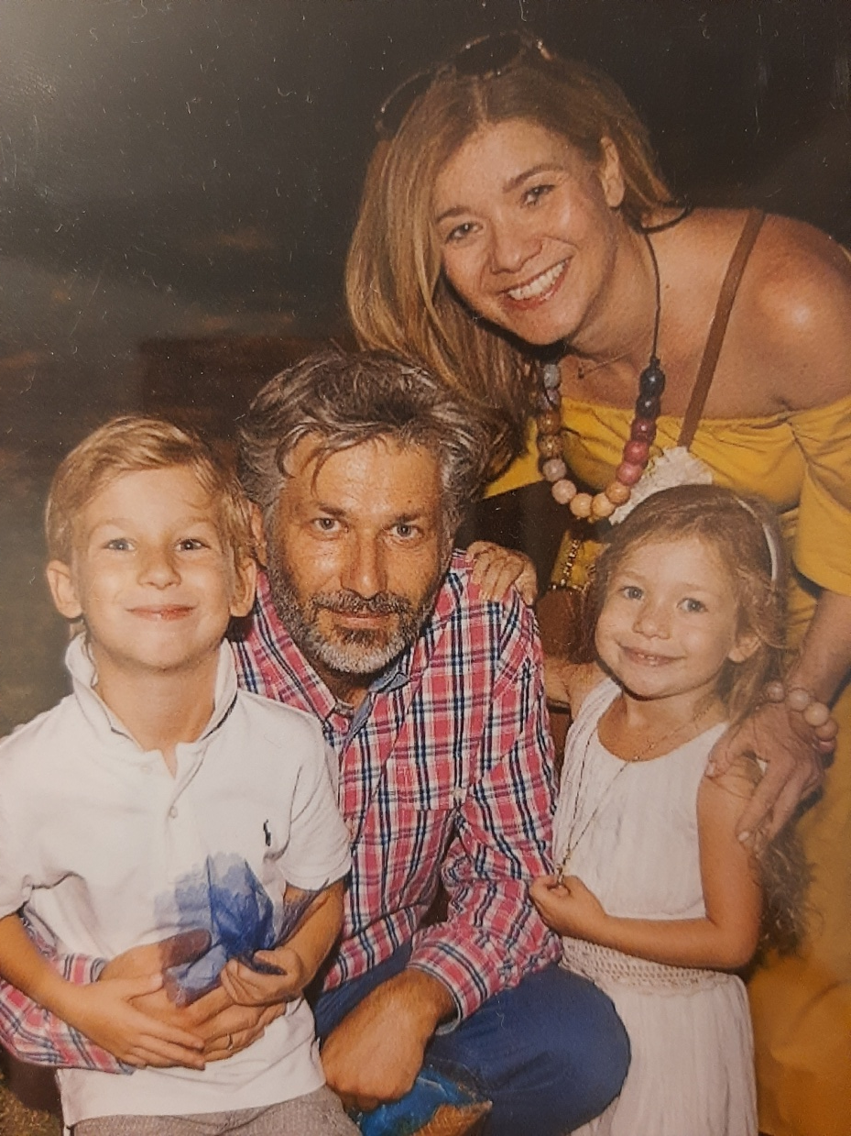
MY FAMILY & I
daddy
sister
me
mummy
I live with my dad, John, my mum, Koula and my sister Dafni
On afternoons we love riding our bicycles and before going to bed we enjoy playing board games!!!

Slide 4
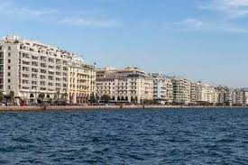
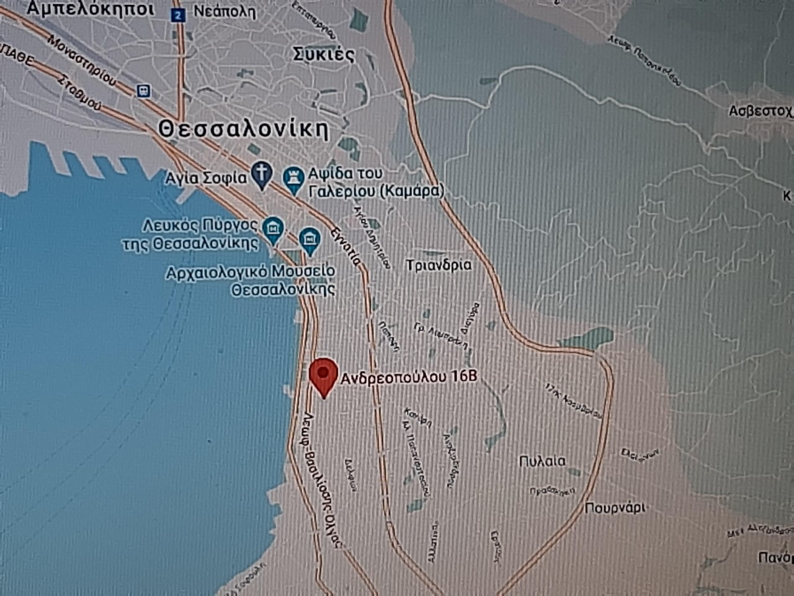
WHERE I LIVE
I live near the center of the second biggest city of Greece. Its name is Thessaloniki and it is situated in northern Greece!!!

Slide 5
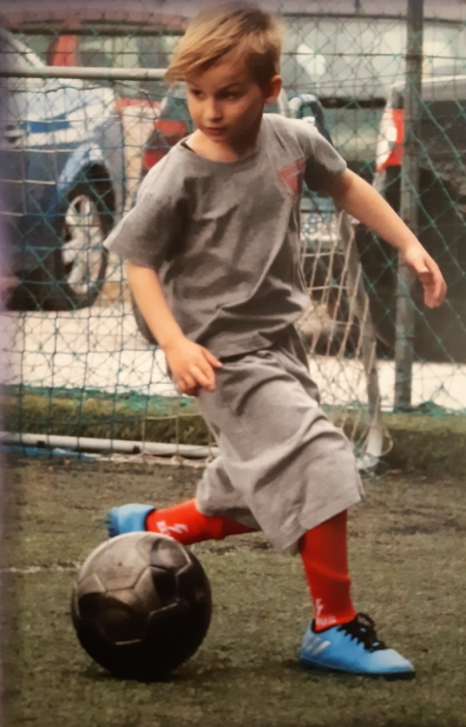
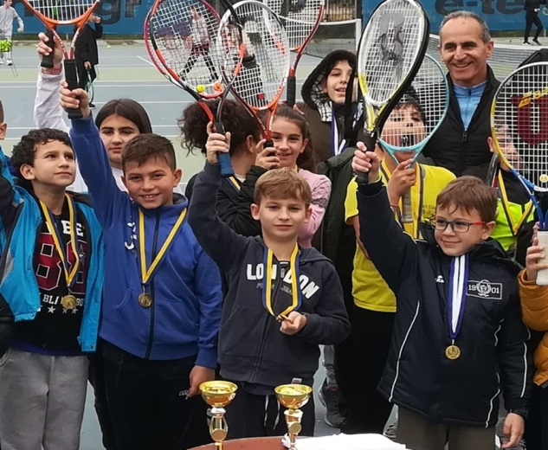
MY HOBBIES
My hobbies are
TENNIS & FOOTBALL because I exercise my body and have fun!!!

Slide 6
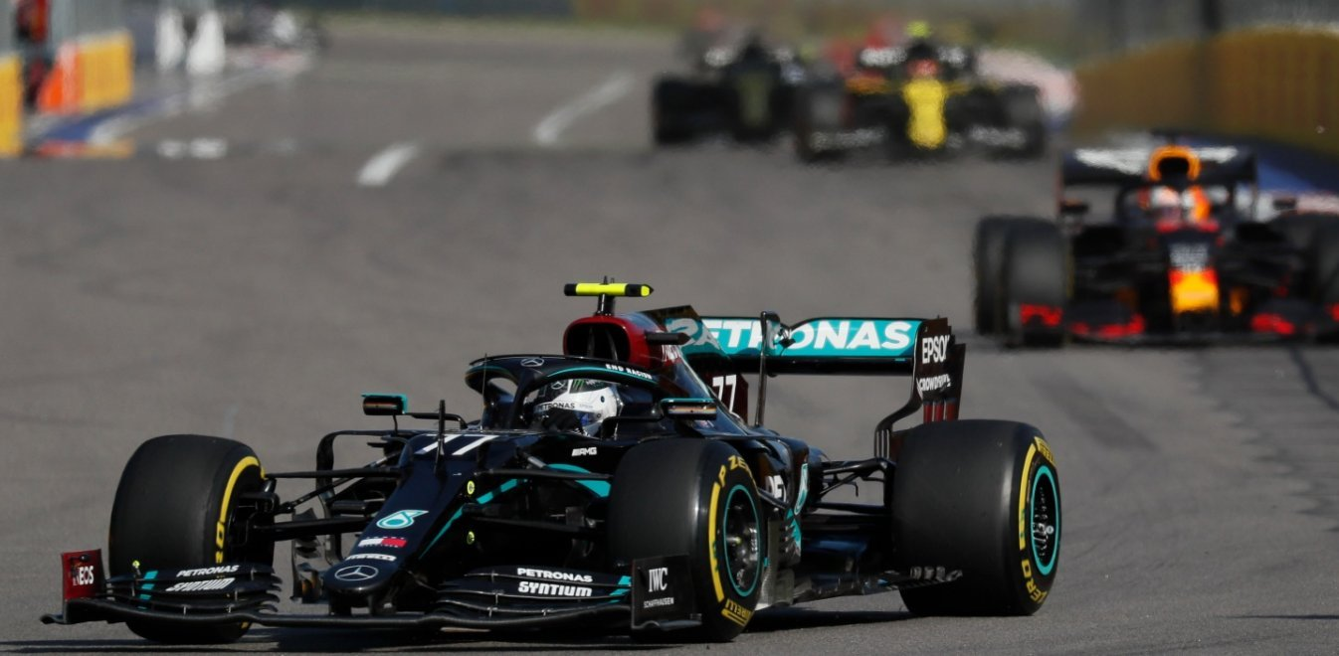
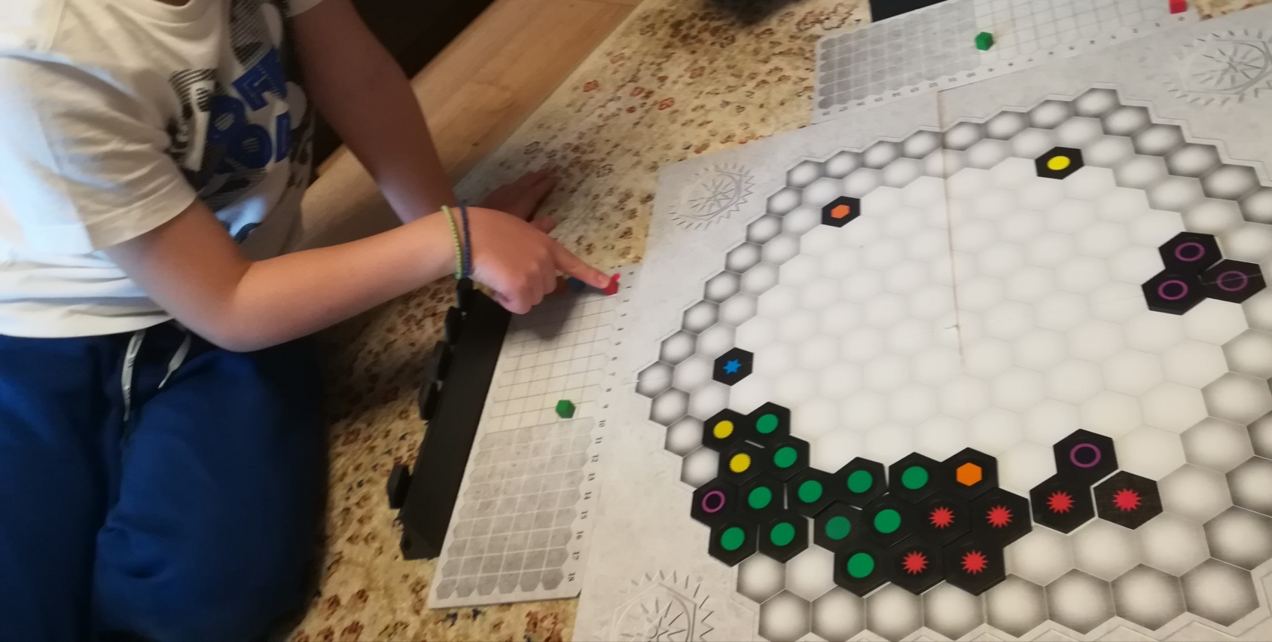
MY FAVOURITE THINGS
I love watching formula1 on TV because I like cars and speed!!!
I enjoy playing board games because I exercise my brain and have fun!!!

Slide 7

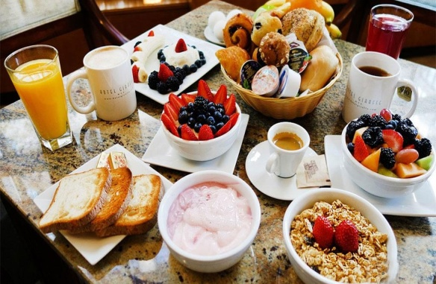
HABITS & DAILY ROUTINES
Every morning from Monday to Friday I wake up at 7 o’clock
I eat a good breakfast, I brush my teeth, I get dressed and I go to school
After school I do my homework at home.
Most afternoons I have ENGLISH lessons or I play TENNIS
Every night before I go to bed, I don’t forget to brush my teeth and read a book

Slide 8


