Slide 1
My presentation
Leonidas markopoulos- e'1 1ST EXPERIMENTAL SCHOOL OF THESSALONIKI

Slide 2
WHAT I look LIKE...
I have short brown hair and black eyes
I have got normal eyes, nose, mouth and ears
I am tall and average build

Slide 3
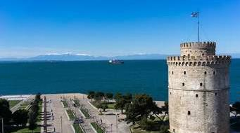
Where do i live...
I live in Ano Poli in the historical Centre of Thessaloniki.

Slide 4

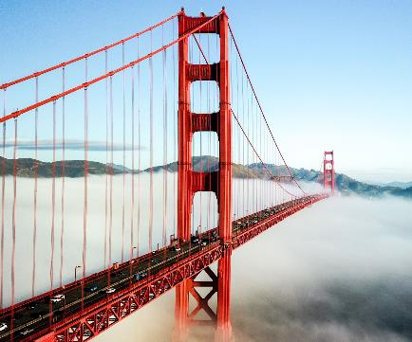
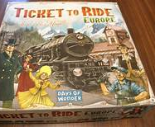
What i like...
I like go outdoors with my friends
I like visiting new places in the world
I love playing board games with my family
I enjoy to read books or comics

Slide 5


What type of clothes i usually wear
I usually wear athletic and casual clothes
I like to feel comfortable with my clothes

Slide 6

My hobbies
I love playing basketball because it have a lot of fun I also like to play with my friends
I enjoy to swim
I like playing the piano because it's relaxing and I like it's voice

Slide 7
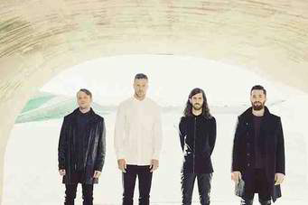
My favorite band
One of my favorite bands and singers are Imagine Dragons because...
I love their songs
I like their voice

Slide 8



My favorite places
I like to go to concerts, to cinema, to theater and I enjoy watching movies with my family

Slide 9

Some more informations about me
Some of my favorite bard games to play is Cluedo, Ticket to ride and Monopoly
One of my favorite movies is Now you see me 2 because it has a lot of fun

Slide 10

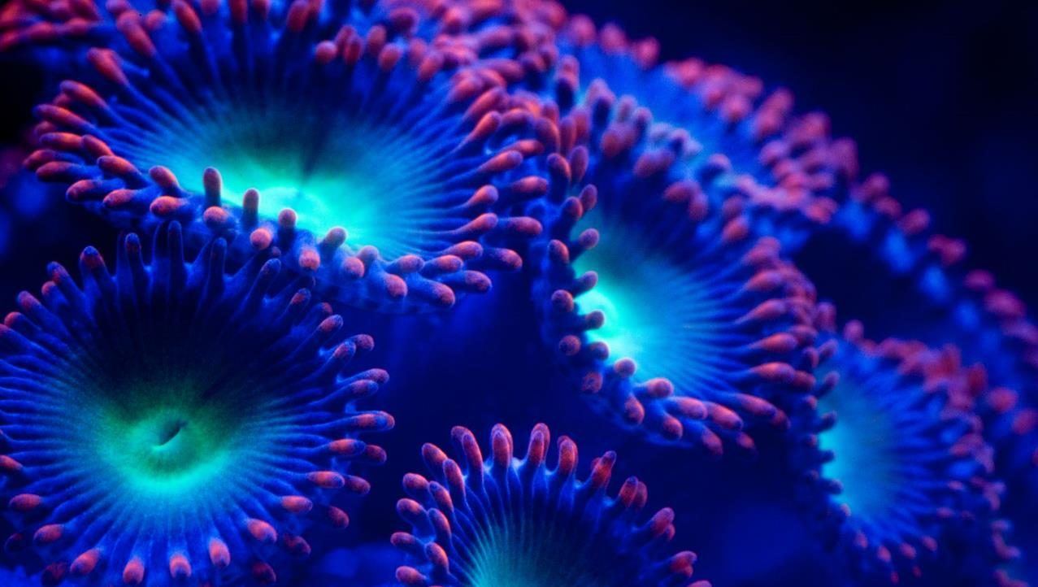

Some more informations about me
My favorite animals are the Jaguar, the Leopard and the Eagle because they are very strong

Slide 11


THANKS FOR WATCHING

