Slide 1
About my Self
DIMITRIS KANARIS

Slide 2
My name is Jim.
I am 10 years old.
I live in Thessaloniki.
I am a student of E ‘1 class.

Slide 3
My favourite sports are swimming and sailing.
My hobbies are robbotics and LEGO constructions.
I love to travel.
I like music
. My favourite singers are Lady Gaga and Ed Sheeran.

Slide 4
I like video games.
I like to eat risotto, carbonara, sushi and chinesse cuisine.
My favourite season is summer, because I like the sea and the ice creams.

Slide 5
I don’t like football.
I hate COVID-19!!!😢
I am afraid of earthquakes.

Slide 6
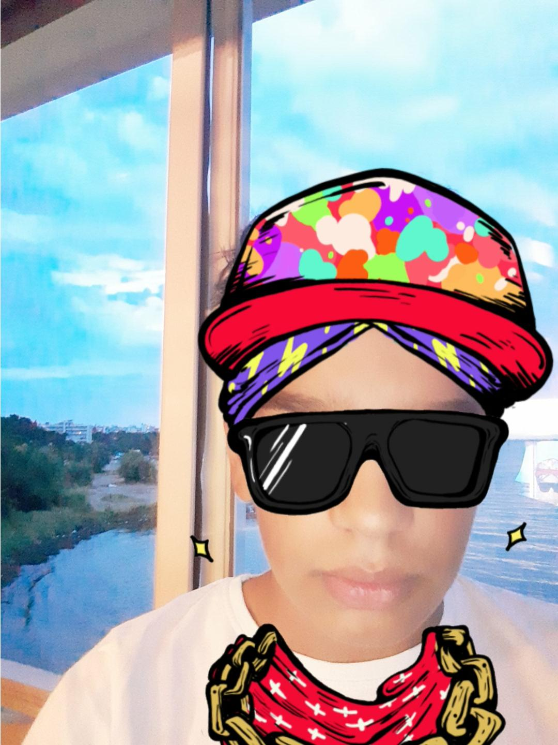
Thank you for watching!!!

