Slide 1
This is me!
Catherine Bisba E’1
2020-2021

Slide 2
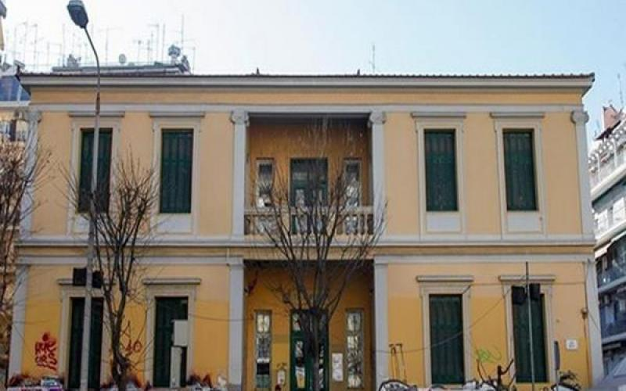
I am…..
My name is Catherine Bisba.
I am a student in the 1st Experimental Primary School of Thessaloniki.
There are four people in my family: my dad Thanasis, my mum Helen and my brother John and me.

Slide 3
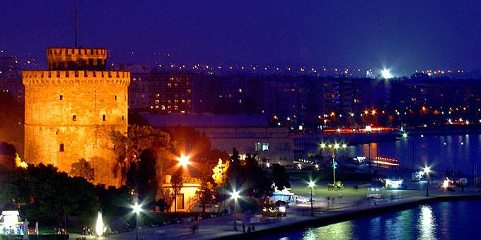
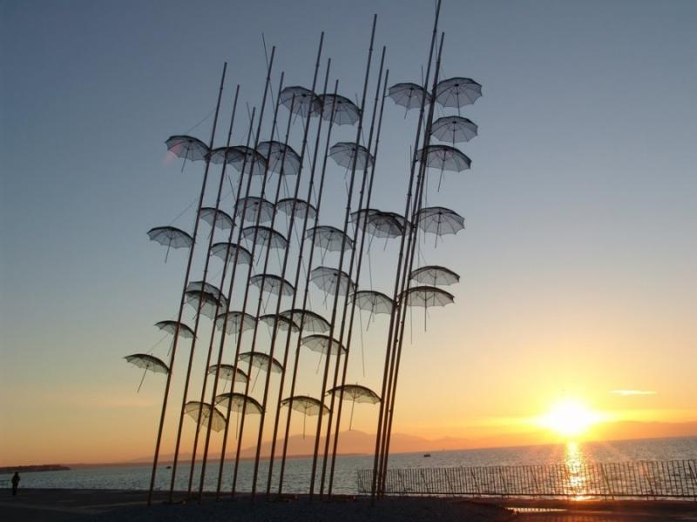
I live…..
I live in the centre of Thessaloniki, near the institution Papafi.

Slide 4
What I look like….
I am medium height.
I’ve got long brown hair and brown eyes.
I am brunette.

Slide 5
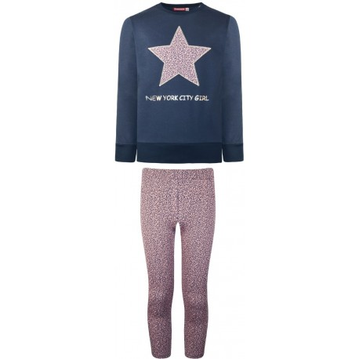
What kind of clothes do I usually wear?
I usually wear casual and comfortable clothes.

Slide 6
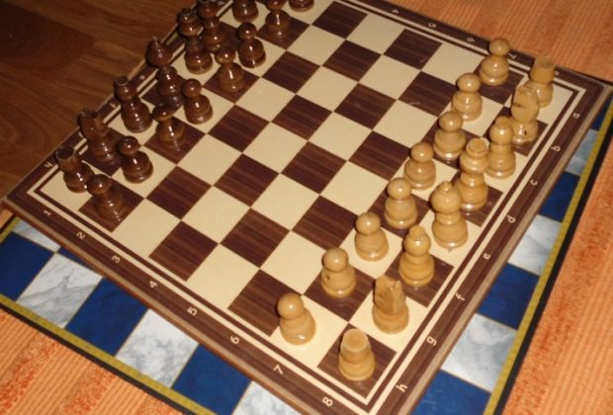
My hobbies…..
I play chess three times a week
I read books.
I usually do rollers at weekends.
I like drawing pictures because it’s relaxing and makes me feel good.

Slide 7
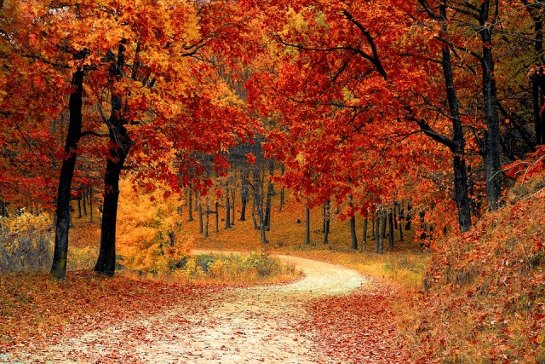
My favourite things…..
My favourite season is autumn because it’s my birthday and my name day.
I enjoy playing board games because I play with my family.

Slide 8
Daily routines…..
I get up at seven o’clock in the morning every weekday.
I go to school at half past seven.
After school, I eat my lunch and then I do my homework.
In the afternoon, I play with my brother.
I go to bed at ten o’clock, before I go to bed I watch T.V. with my family.

Slide 9

Thanks for watching!

