Slide 1
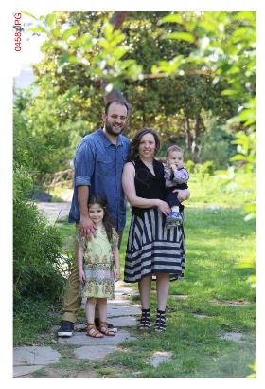
This is me !
My name is Nefeli . My school is 1o PEIRAMATIKO SCHOOL THESSALONIKI and family is mum Anneta ,dad George and brother Konstantinos.

Slide 2
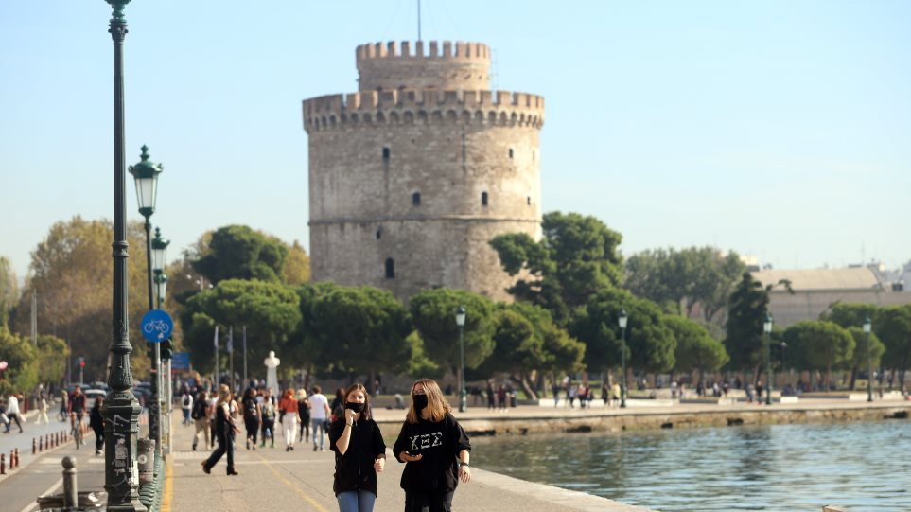
I live in THESSALONIKI .

Slide 3
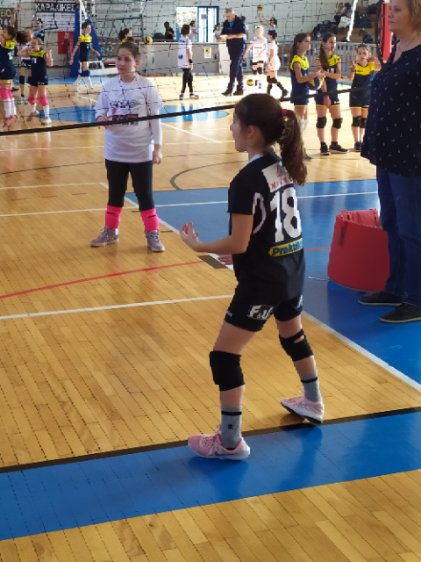
I like football and volleyball.

Slide 4
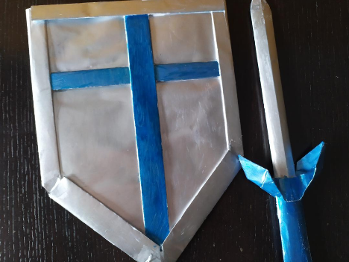
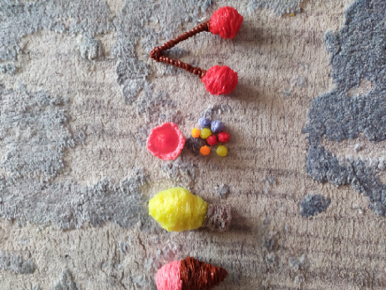
My favourite thing is origami and 3D pen.

Slide 5


