Slide 1
About myself
Alexandros Tarasidis E’2 2020-21

Slide 2
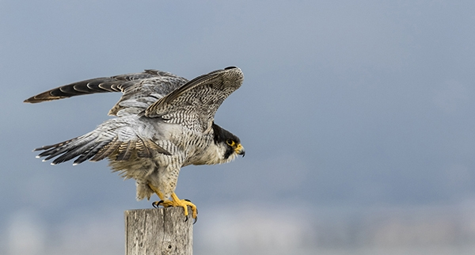
General information
My name is Alex, I’m 10 years old. My favorite color is orange, because it’s the most beautiful color at my opinion. My favorite animal is Peregrine falcon, because it’s the fastest of all animals (390 km/h). My favorite food is burger. My school is 1st experimental primary school of Thessaloniki.

Slide 3
Some more info
Every morning I get up at 7:30 am and I usually return back home at 4:30 pm.
As a hobby I do roller-skating and swimming.
I am the taller kid in my class.
I wear shoes No 40.

Slide 4
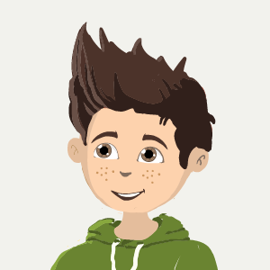
How I look like
I’m tall, with short, brown hair.
I wear casual clothes, such as T-shirts with stamps and long, comfortable sweatpants.

Slide 5
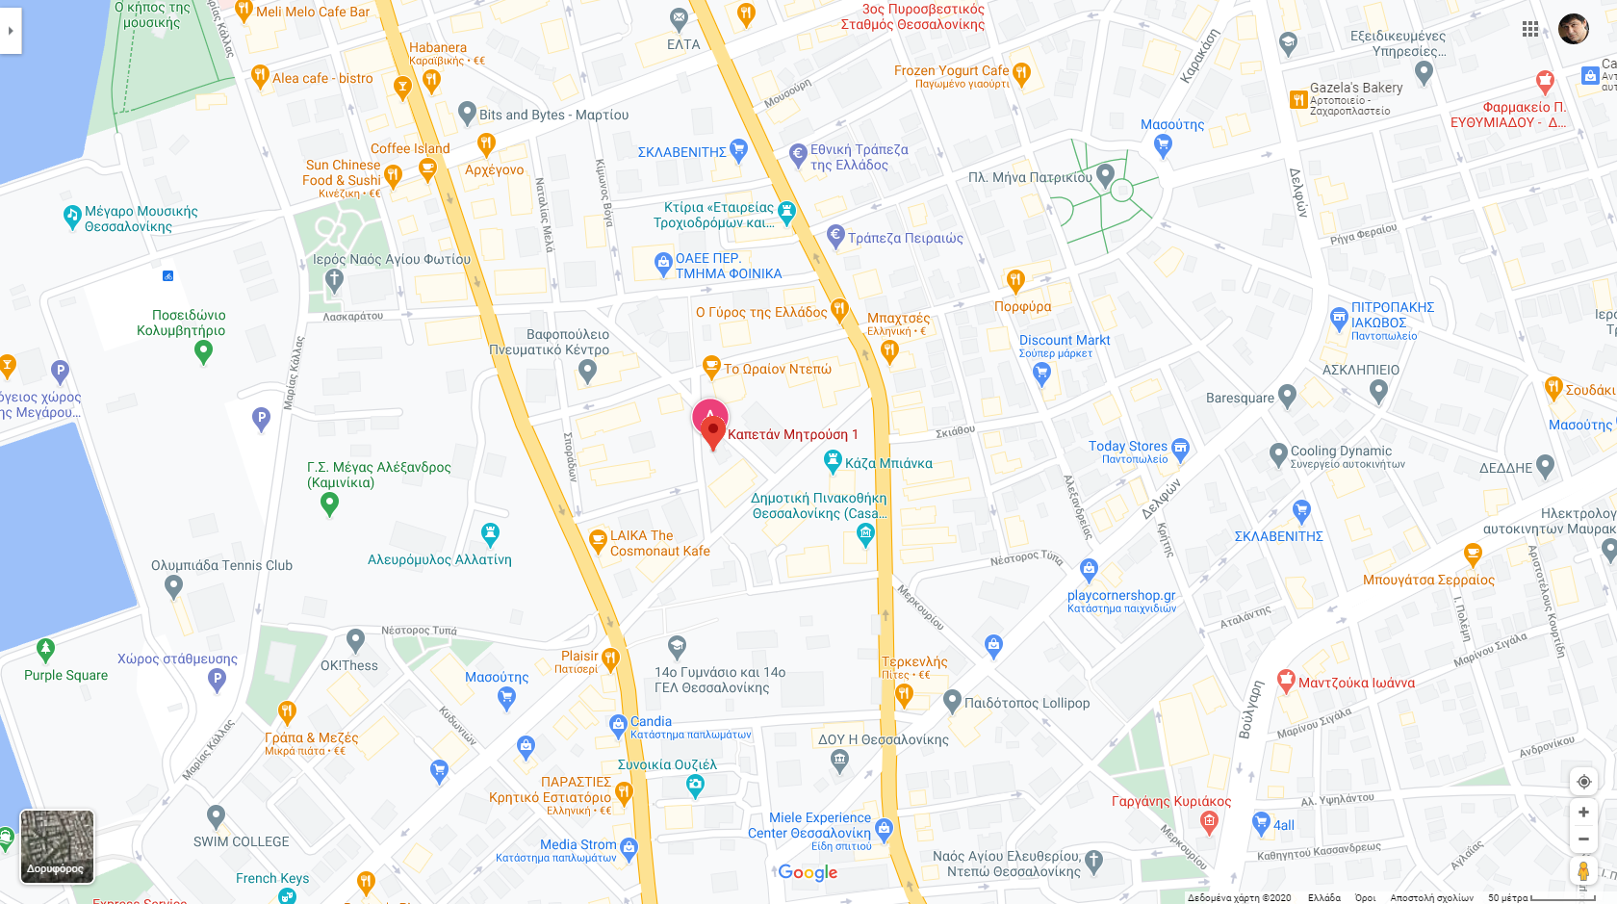
Where I live
I live in Depot (near Kalamaria), in eastern Thessaloniki.

Slide 6
About myself
Alexandros Tarasidis E’2 2020-21

