Slide 1
THIS IS ME
NIKOLAS BAKIRTZIS
1ST EXPERIMENTAL SCHOOL OF THESSALONIKI
2020-2021

Slide 2
WHAT I LOOK LIKE
I AM TALL
I HAVE BLUE EYES
I WEAR GLASSES
I HAVE BROWN HAIR

Slide 3
WHAT I WEAR
I USUALLY WEAR JUMPSUITS
I LIKE WEARING JACKETS

Slide 4
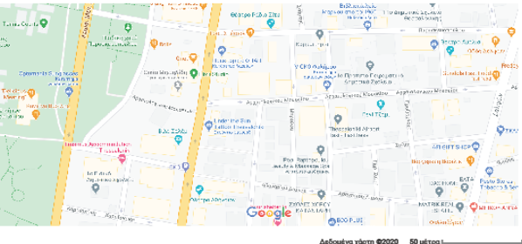
WHERE I LIVE
I LIVE IN THESSALONIKI

Slide 5
MY HOBBIES
I LIKE BASKETBALL
I LIKE ROBOTICS
I LIKE GAMING

Slide 6



THE END
THANKS FOR WATCHING

Slide 7
THIS IS ME
NIKOLAS BAKIRTZIS
1ST EXPERIMENTAL SCHOOL OF THESSALONIKI
2020-2021

