Slide 1


Slide 2
This is me!
ATHINA PAHINI 2020-2021

Slide 3
Hi
Hi!
My name is Athina, I am 9 years old and I am a student of the 1st Experimental Primary School of Thessaloniki.
I go to the 5th Grade and I am going to talk to you about myself.

Slide 4
HERE’S WHAT I LOOK LIKE … 🤓I have got long brown hair and brown eyes. 🤓I am a brunette. 🤓I am quite short 🤓I am bit thin 🤓I am average build.

Slide 5

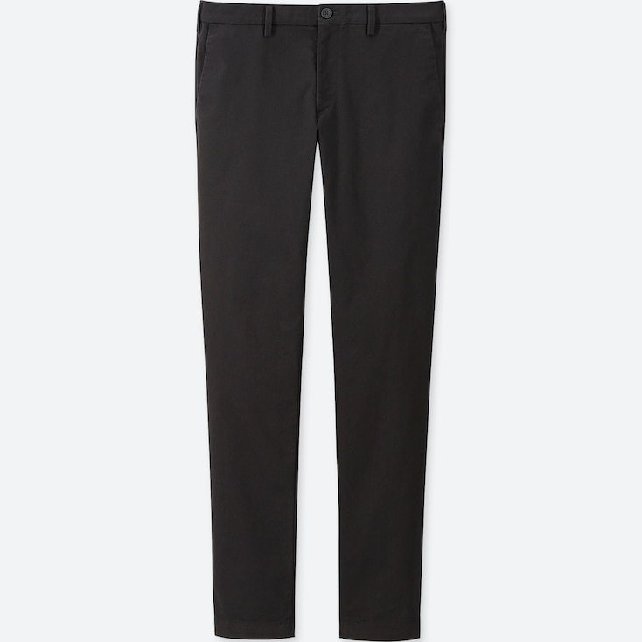
What I wear...
I usually wear casual clothes, such as T-shirts with trousers 👕🩳
🩳
👕

Slide 6
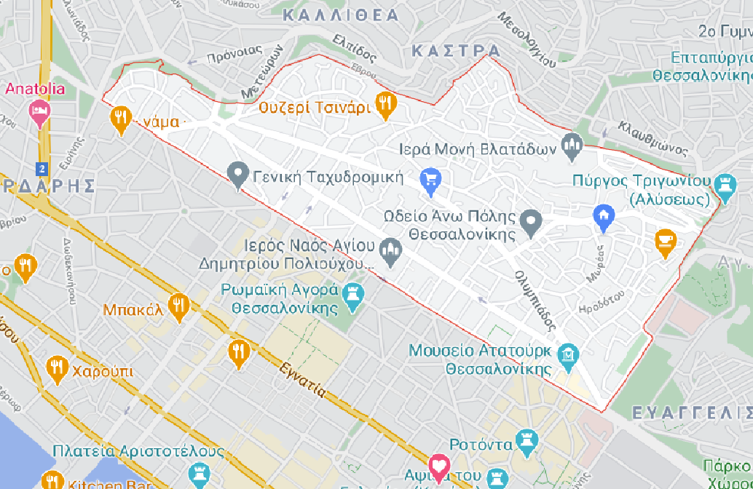
I live in Ano Poli, in northern Thessaloniki.

Slide 7

I enjoy reading books because it makes me relax.
I like travelling because I am visiting new places.
I enjoy drawing because I am having a good time.
I love playing Lego because it’s fun.
Notes:
ΣΗΜΕΙΩΣΗ: Για να αλλάξετε εικόνες σε αυτή τη διαφάνεια, επιλέξτε μια εικόνα και διαγράψτε τη. Στη συνέχεια, κάντε κλικ στο εικονίδιο "Εισαγωγή εικόνας" στο πλαίσιο κράτησης θέσης για να εισαγάγετε τη δική σας εικόνα.

Slide 8

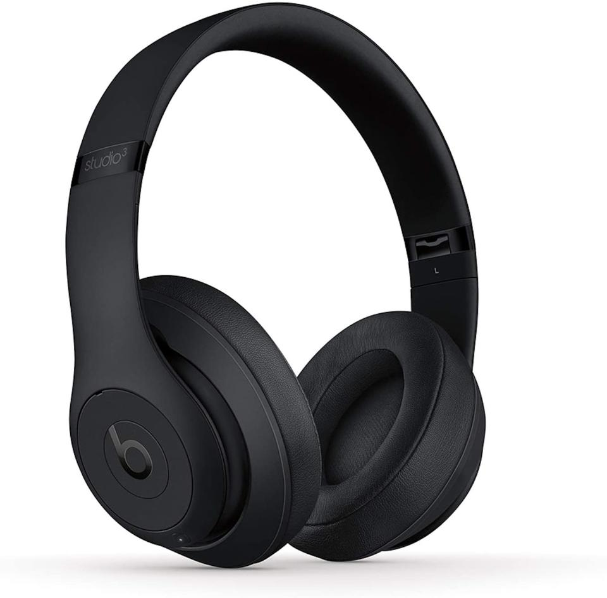


I enjoy listening to music because it is relaxing and fun.
I like playing the piano because it s as sa a s a as a is fun.

Slide 9
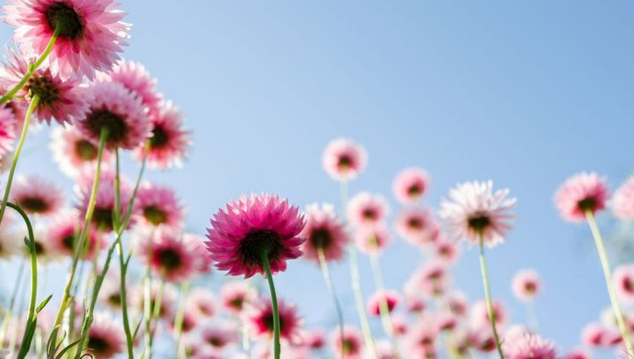
Thanks for watching!!!

Slide 10
This is me!
ATHINA PAHINI 2020-2021

