Slide 1
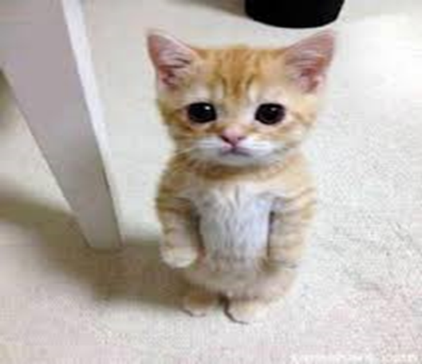
THIS IS ME
Erasmia Sdoukou
First Experimental school of Thessaloniki
2020-2021

Slide 2
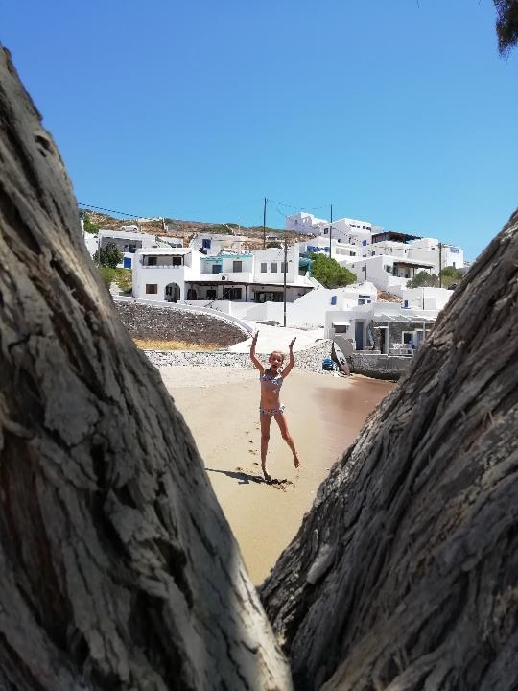
Who am I ???
My name is Erasmia and I am ten years old. I go to the first Experimental school of Thessaloniki.

Slide 3
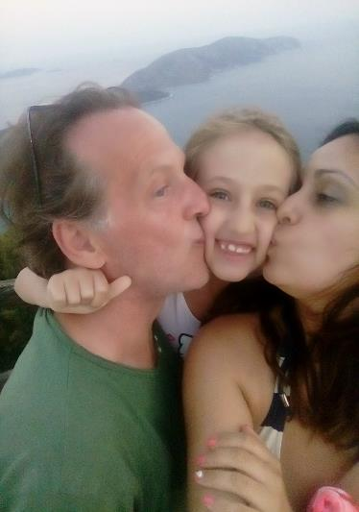
MY FAMILY!!!
We are lucky too!!!
My family is not big, I don’t have brother or sister, but I have two heroes: my mom and my dad. I am soooo lucky.

Slide 4
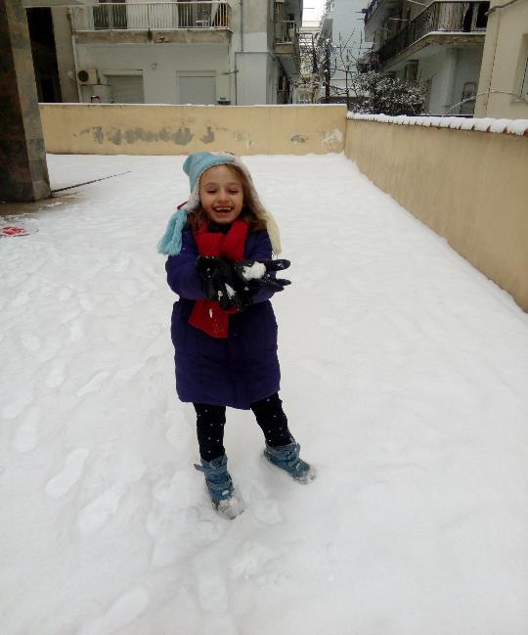
Where I live??
I live in Athanasiou Diakou 8 in Thessaloniki

Slide 5
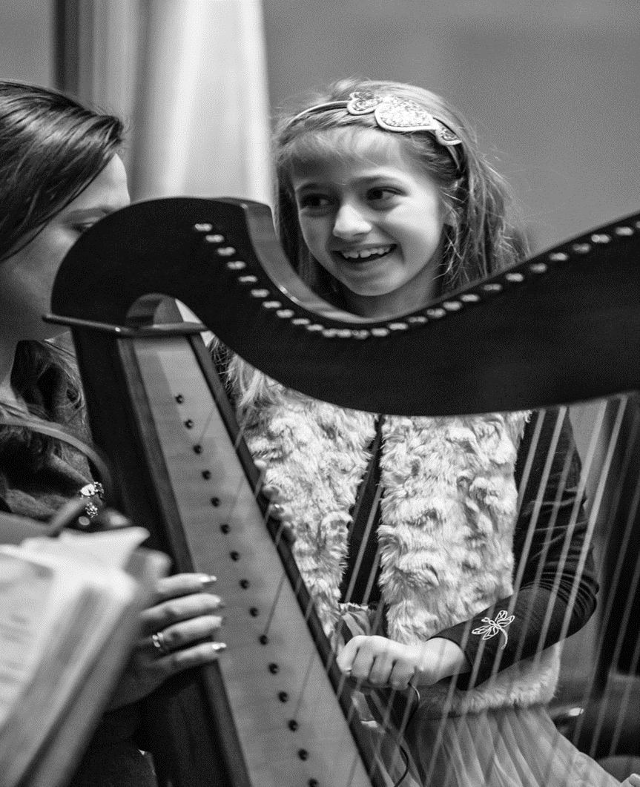
MY HOBBIES
My hobbies is playing the harp, making origami, making crafts, dancing and singing

Slide 6
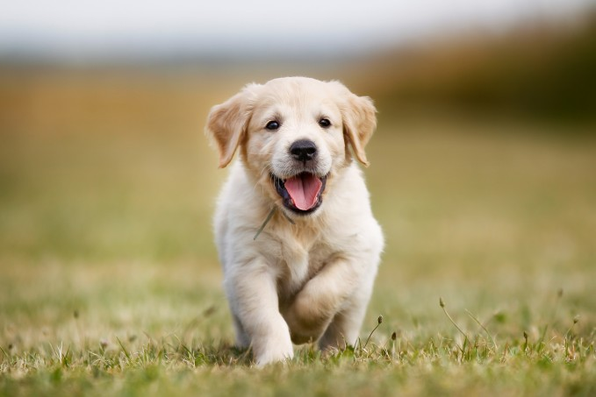
I like puppies!!

Slide 7

THANKS FOR WATCHING

Slide 8
THIS IS ME
Erasmia Sdoukou
First Experimental school of Thesalloniki
2020-2021

