Slide 1
This is me
John Trantos
2020 -2021

Slide 2
My famyly
I have seven first cousins ​​and four second cousins
I am john and I go to the 1st Experimental school of Thessaloniki.
There are 4 people in my family: my mum, my dad, my twin brother and me. Also I have one grandpa and two grandmas. I have seven first cousins ​​and four second cousins and many uncles and aunts.

Slide 3
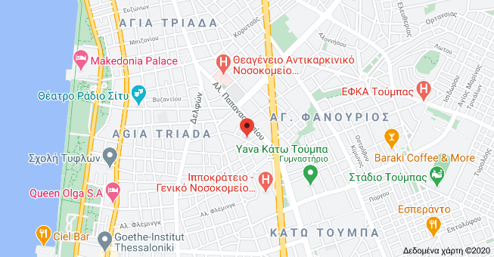
Where I live
I live in Asklipiou 7A near Ippokratio Hospital in Thessaloniki.

Slide 4
hobbies
My hobby is swimming because I swim for 7 years and I swim in YMCA. First, I swam in Star swimming pool, then with the team of PAOK and now in YMCA . I swim with Chris and Alex. Another hobby is cycling because Ι like bikes and the last one is hiking because I like mountains.

Slide 5
what i like to do in my free time
I like playing games, watching TV and doing various sports outside the home.
I do not like traveling by car because once we were stuck in the sand. We pushed the car, but the car did not move. In the end, when we called the police, they told us to get a phone call, to the roadside assistance and when we got it they told us that there was someone with a tractor nearby, so he pulled us with the tractor and took the car off the sand and we went home.

Slide 6
My favorite season
My favorite season is winter because I like playing with the snow and making a snowman.

Slide 7
This is me
John
2020 -2021

