Slide 1
Who am I
Nefeli Palaiopoulou

Slide 2
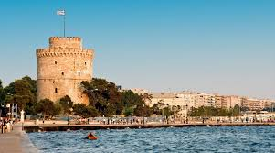
Who am I
I am Nefeli ,I’m 10 years old and I live in thessaloniki.

Slide 3
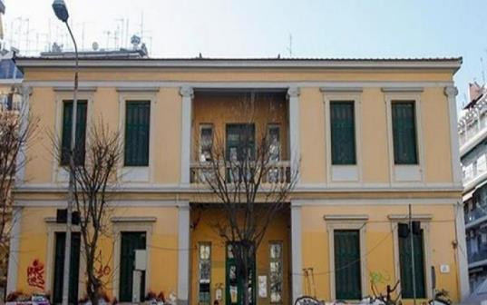
My school
My school is the first experimental primary school in Thessaloniki.

Slide 4

I like…
Singing because I love it
To serf in the net because it makes me relax
Dancing because I feel free
Making crafts because it is relaxing
Sports because I feel cool

Slide 5
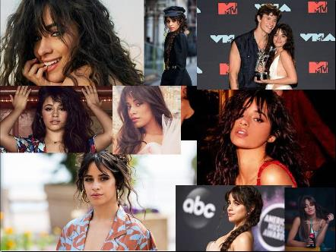
My favorite singer is
Camila Cabello
because I like her voice
and ALL her songs.
Senorita
Havana
My oh my …

Slide 6
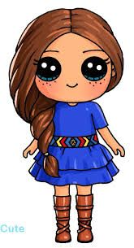
What I look like
I have long brown hair,blue eyes,big ears. I usually wear casual clothes but I like wear and strange clothes too.

Slide 7

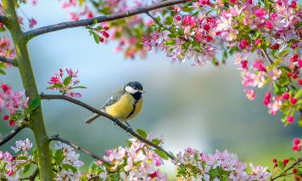

Favorite
My favorite season is spring becayse it is my birthday and I like the flowers…
My favorite day is Friday for various reasons.

Slide 8
Who am I
Nefeli Palaiopoulou

