Slide 1
English
Panagiotis Takianos
E2

Slide 2
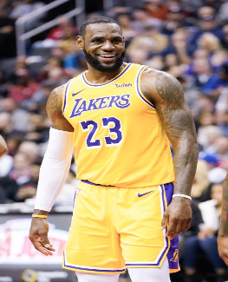
What I like
I like watching basketball matches and I like going to the museum

Slide 3
What I like wearing at school
I like wearing a T-Shirt and a pair of trousers at school

Slide 4
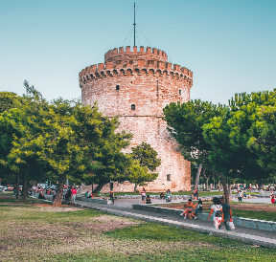
Where I live?
I live in Thessaloniki, at Sikies

Slide 5
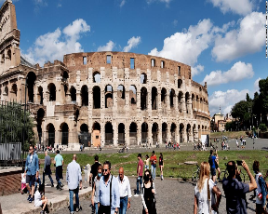
Where I have travelled
I have travelled to Italy

Slide 6
How my day goes
I'm eating breakfast, reading, relaxing and playing basketball

Slide 7
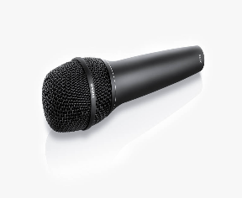
What I dislike
I dislike singing and dancing

Slide 8
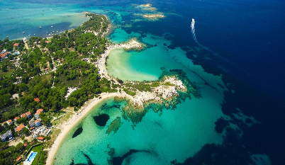
Where I'm going for holidays
I'm going to my cottage at Chalkidiki

Slide 9
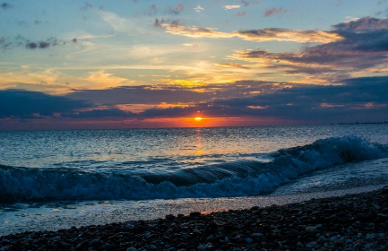
Where I prefer to go
I prefer going at the sea

Slide 10
My favorite season
My favorite season is summer

Slide 11
My favorite music
My favorite music is trap

