Slide 1
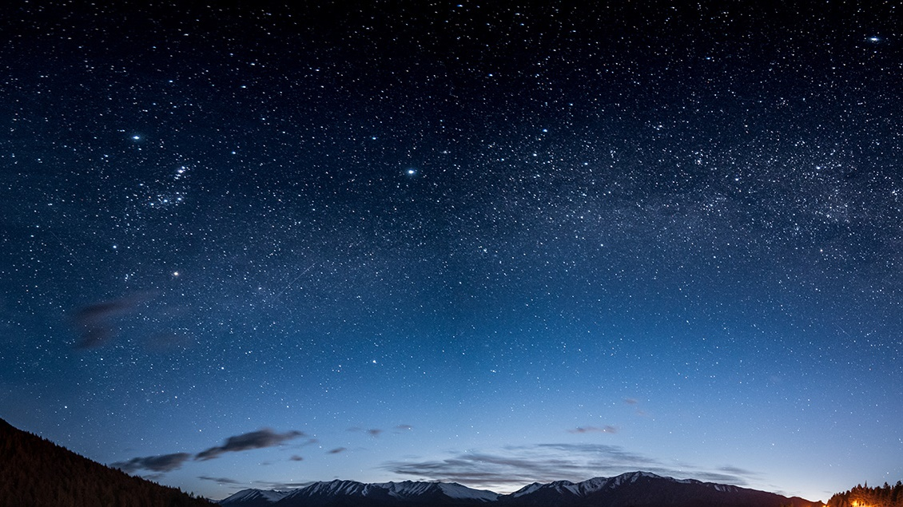
My presentation
Sofia markopoulou
1ST experimental school of thessaloniki

Slide 2
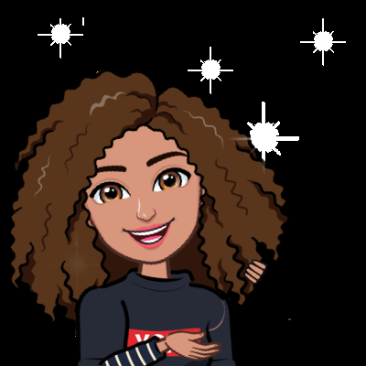
This is me
I am a student in the 1st Experimental school in Thessaloniki.

Slide 3
What i look like....
I have got curly hair and brown eyes.
I am not delicate i am normal and i am tall.

Slide 4


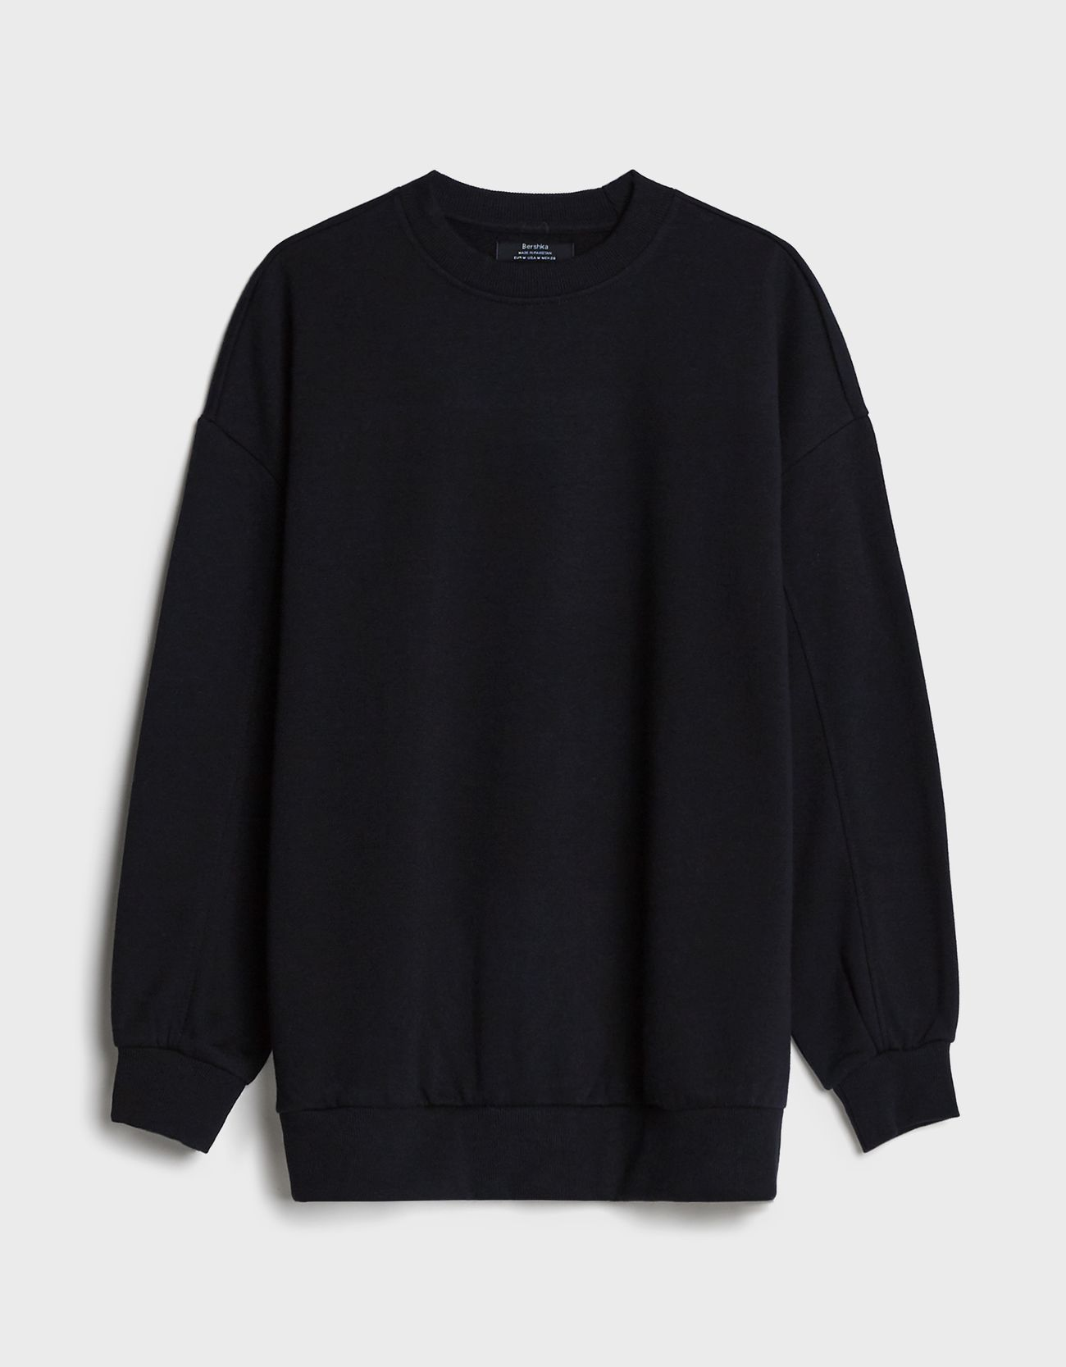
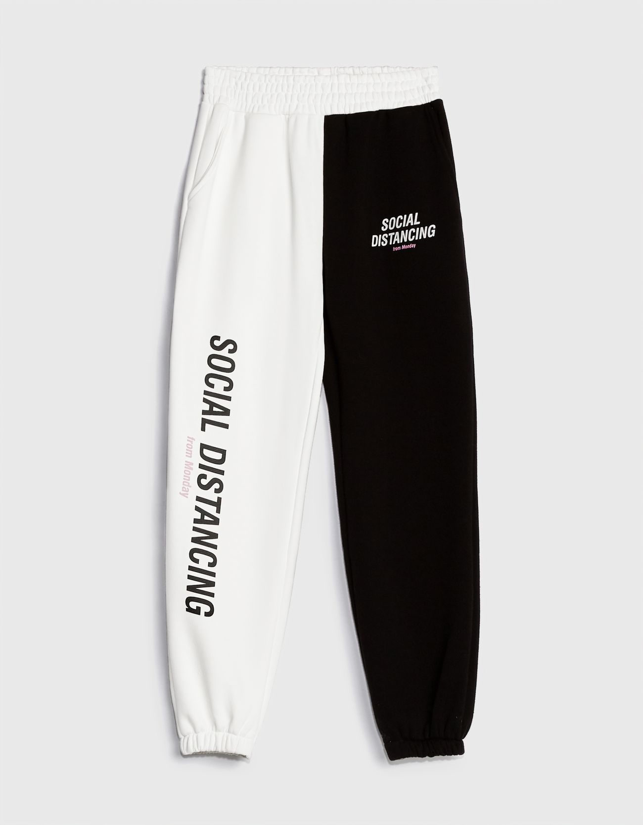
What i wear?
I usally wear casual clothes.
Such as trackuits with T-shirts.

Slide 5
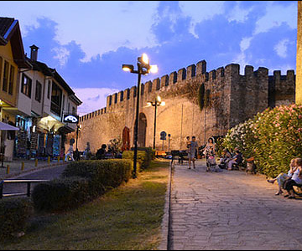
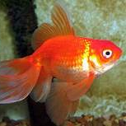
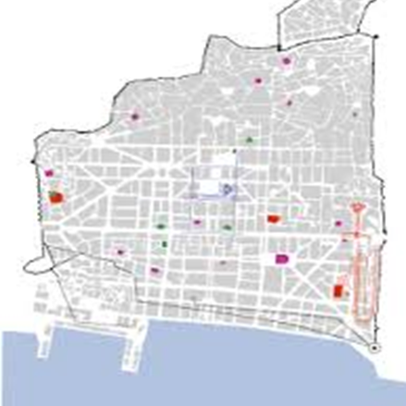
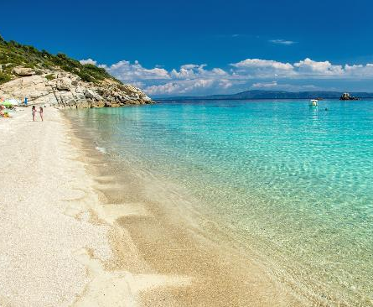
Some more informations about me
●I live in Ano Poli in the Historical Centre of Thessaloniki.
My favorite place is Armenistis camp sight because there I have a lot of friends and always I have a great time.
I have one brother and two goldfish.

Slide 6
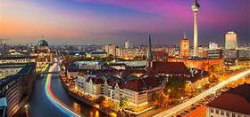
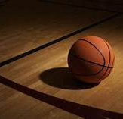
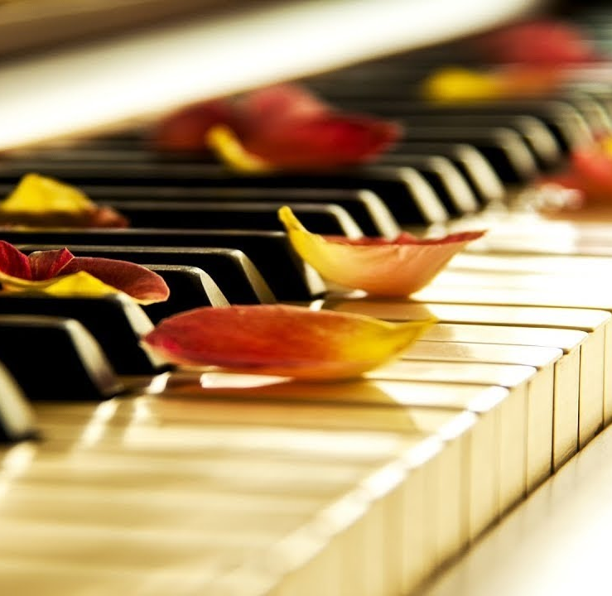
What i like
I like travelling. I have been to the Berlin. Because it is interesting.
I love play the piano. I playing piano every day. Because it is relaxing.
I enjoy basketball.

Slide 7
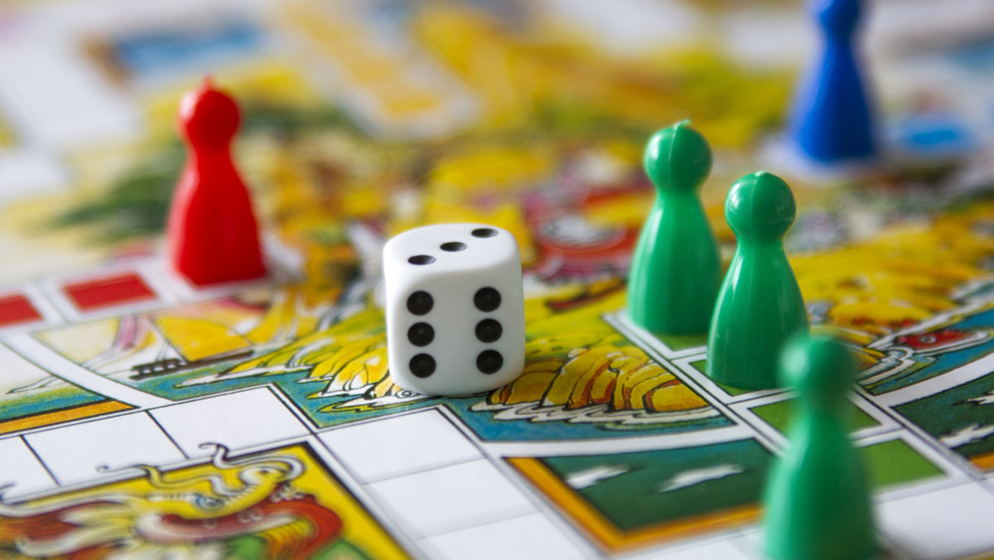

What i like {συνεχια}
I like movies.I don't have favorite movie.
And i enjoy playing board games.

Slide 8

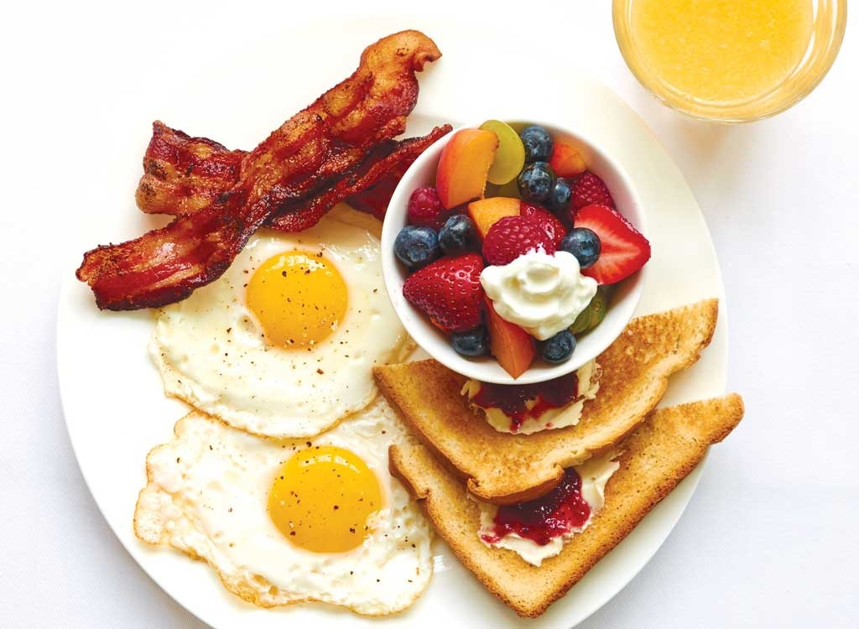
My daily routine
Every morning i get up at seven o'clock.
I eat my breakfast and then i brush my teeth.
I put on my clothes and i go to school.

Slide 9
My presentation
Sofia markopoulou
1ST experimental school of thessaloniki

