Slide 1
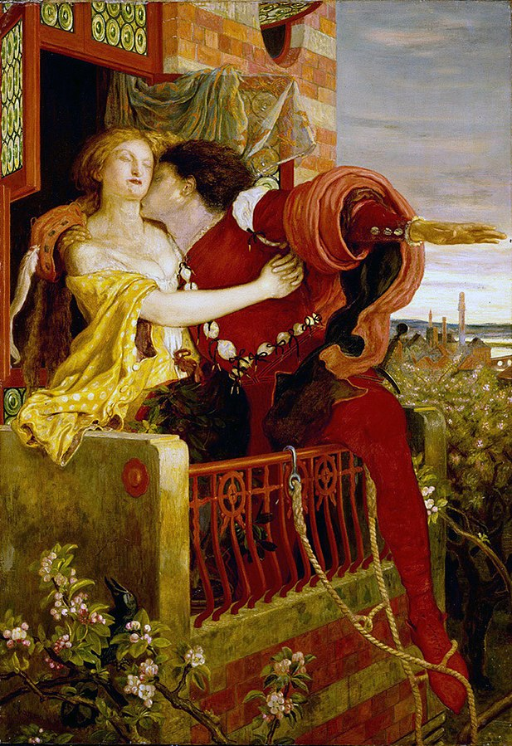
Romeo and Juliet
Date: Saturday 11th April 2020
Time: 21:00 p.m.
Place: National Theatre

