Slide 1
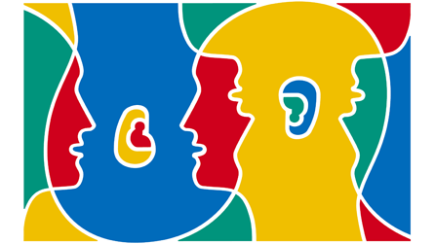
European Day Of Languages

Slide 2
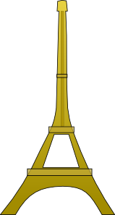
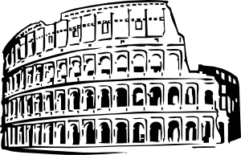
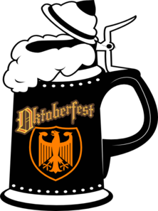
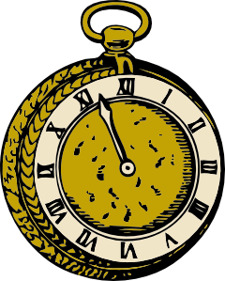
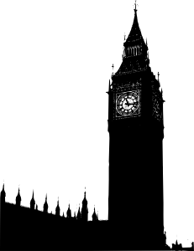
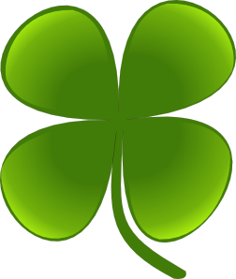
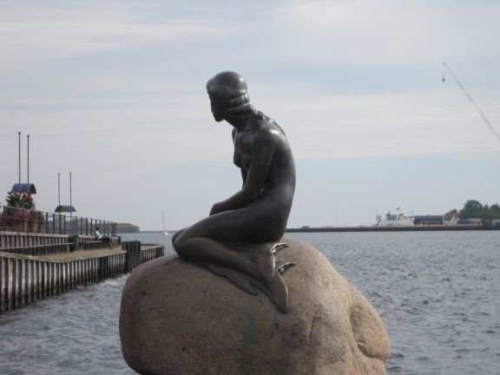
Can you match the symbol to the country?
The Eiffel Tower _ _ _ France
Oktoberfest beer _ _ _ Germany
The Colosseum _ _ _ Italy
A Greek column _ _ _ Greece
A watch _ _ _ Switzerland
Big Ben _ _ _ England
A bull _ _ _ Spain
A shamrock _ _ _ Ireland
Tulips _ _ _ The Netherlands
Mermaid _ _ _ Denmark

Slide 3
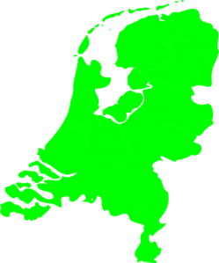
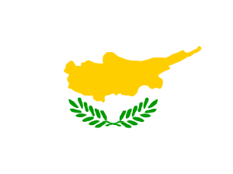
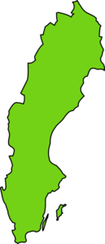
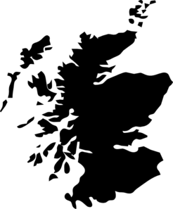
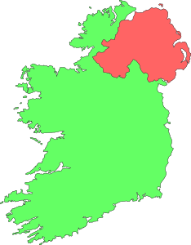
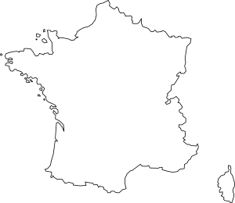
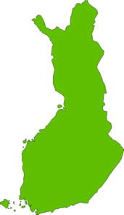
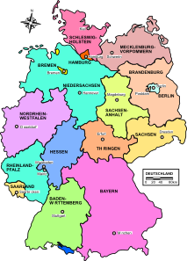
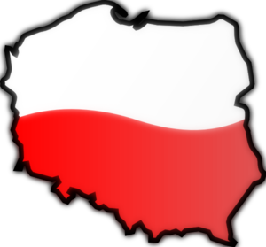
Match the outline to the country
Sweden
The Netherlands
Cyprus
Ireland
France
Scotland
Finland
Poland
Germany
People say the silhouette of Finland is like a dancing Spanish lady. Can you see it?

Slide 4
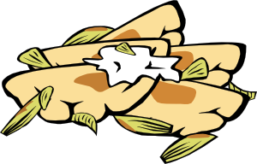
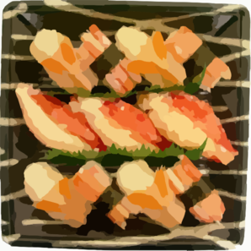
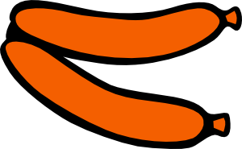
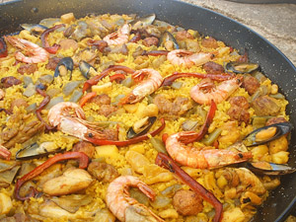
Can you match the food with its country?
Pizza = Italy
Croissant = France
Pierogi = Poland/Slovakia
Raw fish = Sweden/Norway
Bratwurst sausage = Germany
6) Paella = Spain

Slide 5
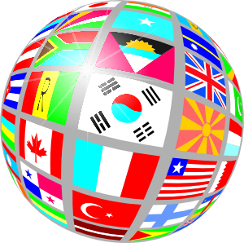
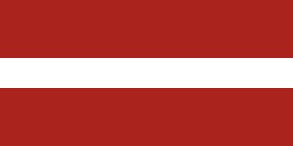
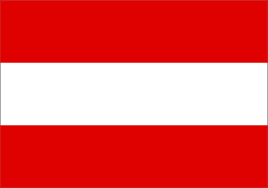
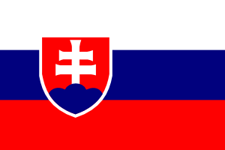
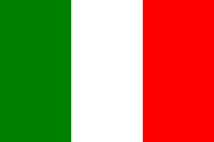
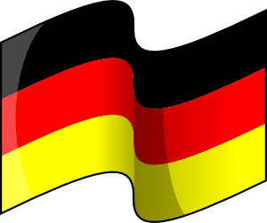
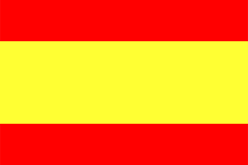
Can you match the flags to their countries?
1. Latvia
2. Austria
3. Slovakia
4. Italy
5. Germany
6. Spain

Slide 6
Match up the capital city to its country
Paris
Berlin
Vienna
Bratislawa
Warsaw
Prague
Budapest
Helsinki
Stockholm
Finland
Austria
Hungary
France
Poland
Czech Republic
Sweden
Germany
Slovakia

Slide 7
Add the missing letters to make up the European languages
En_l_ _ _
Fr_n_ _
G_rm_ _
S_a_i_ _
Po__u_u_ _ _
D_ni_ _
Ru_ _ ia_
H_ _ g_r_ _ _
I_al_ _ n
P_l_s_
11) Ro_an_ _ _
12) Du_ _ h
13) W_l_ _
14) Cast_l_ _n
15) F_nn_s_
16) G_e_ _
17) G_ _ lic
18) Sw_ _ is_
19) Cr_ _ t _ _
20) Ic_l_ _ _ i_
21) Ir_ _h
22) M_lt_s_
23) Sl_v_k
24) Tu_k_ _ _
25) N_rw_g_ _ _
26) Sl_v_n_ _ _
27)L_t_n
28) C_e_ _
29) Est_n_ _ n
30) Serb_ _ _

Slide 8
How many did you get? Here they are.
English
French
German
Spanish
Portuguese
Danish
Russian
Hungarian
Italian
Polish
11) Romanian
12) Dutch
13) Welsh
14) Castilian
15) Finnish
16) Greek
17) Gaelic (Scottish)
18) Swedish
19) Croatian
20) Icelandic
21) Irish
22) Maltese
23) Slovak(ian)
24) Turkish (in N.Greece)
25) Norwegian
26) Slovenian
27)Latin (in the Vatican)
28) Czech
29) Estonian
30) Serbian

