Slide 1
My Presentation
Joanna Kemitzopoulou

Slide 2
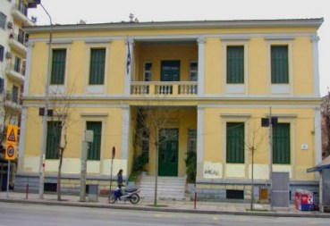
I am a student of 1st Experimental School of Thessaloniki

Slide 3
What I look like- My clothes
I am short and slim. I am brunette and I have brown eyes.
I usually wear casual, comfortable and colorful clothes.

Slide 4
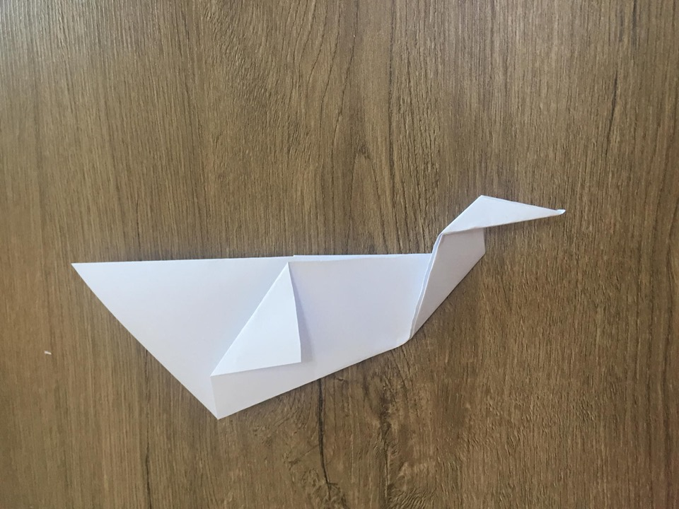
Hobbies
I like dancing.
I love taking photos.
I enjoy cooking.
I like painting.
I love swimming.
I enjoy playing the piano.
I love doing origami.

Slide 5
Routine
Every day from Monday to Friday I wake up at 7:00. I eat a little breakfast, I brush my teeth, I wear my clothes and I go to school.
Every Tuesday and Thursday I have English class .

Slide 6
Free time
In my free time I like doing handicrafts. I also love reading books and playing board games.

Slide 7
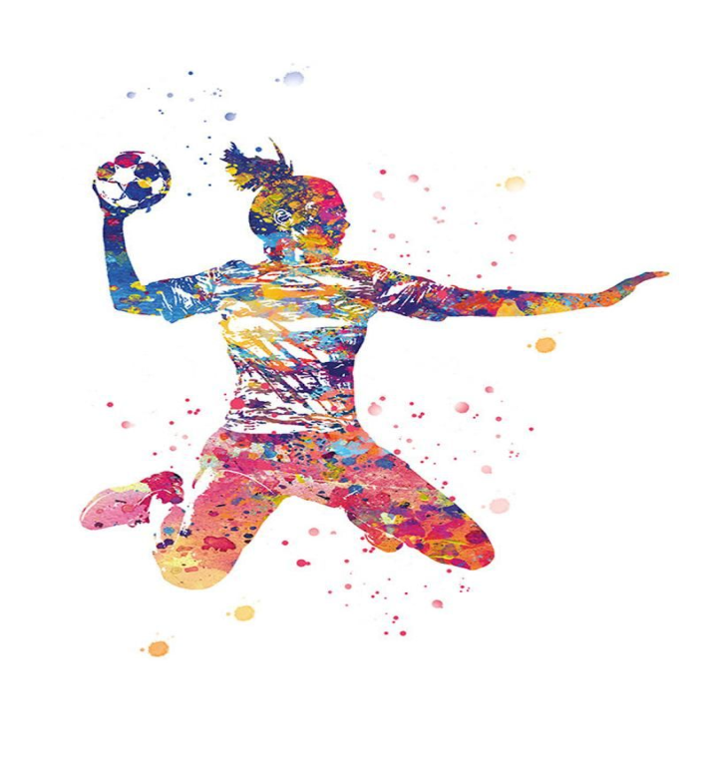
My favorite season is summer because I can swim in the sea!
My favorite sport is handball because it is fun!

Slide 8
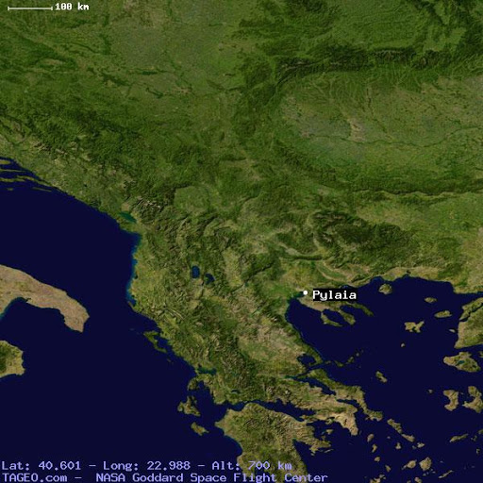
Where I live
I live in Pylaia, in eastern Thessaloniki.

Slide 9
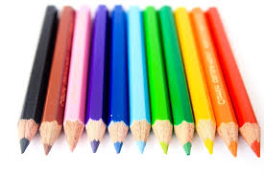
Thanks for watching!!!

