Slide 1
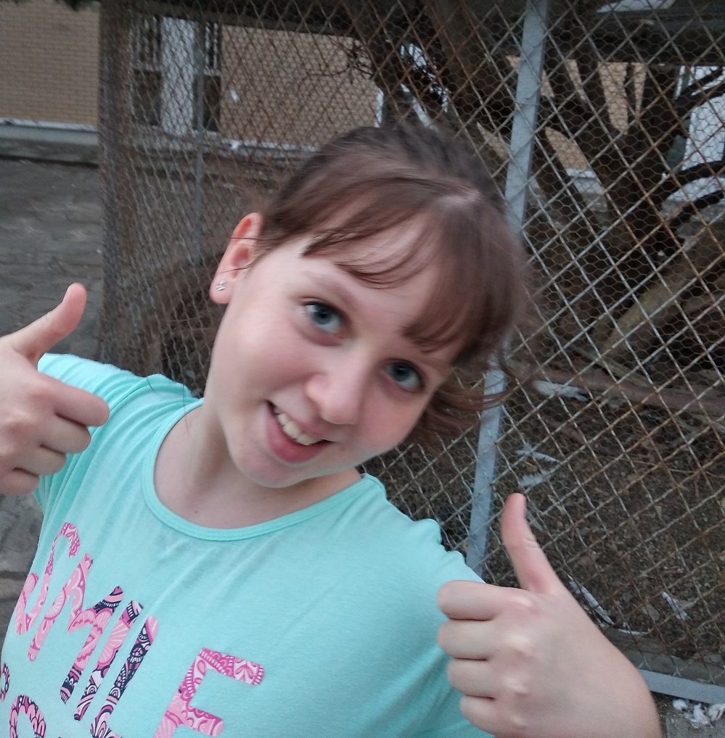
This is me!
Nefeli Kikini E’1
I am 10 years old.
I have blue eyes.
My hair is brown.
I have medium height and
regular weight.

Slide 2
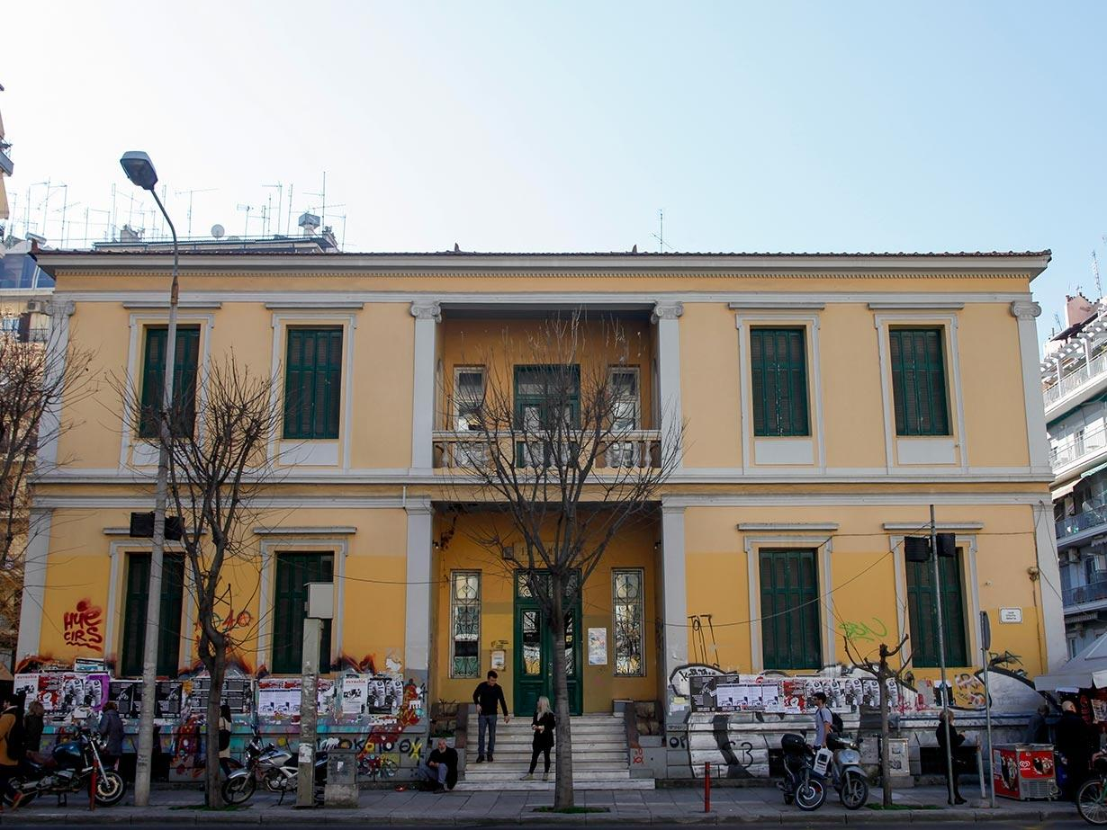
I am…
…a student on the 5th class in the First Experimental School in Thessaloniki (Ηousekeeping School of Thessaloniki).

Slide 3
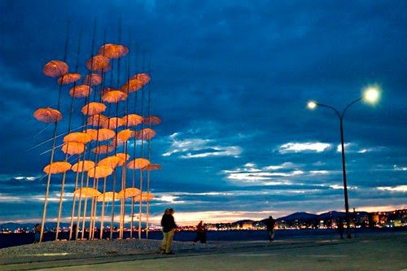
Where I live…
I live in the center of Thessaloniki, near the sea.

Slide 4
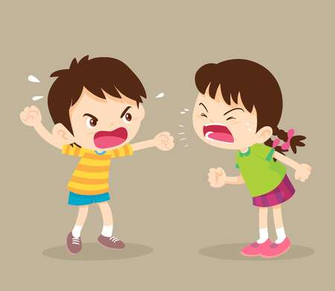
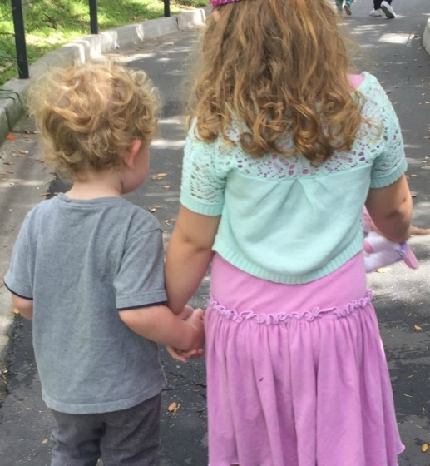
What I like?
What I hate?
I hate argue with
other kids.
I like singing.
I enjoy spending my time
with my brother.
I am not fond of playing
football.

Slide 5
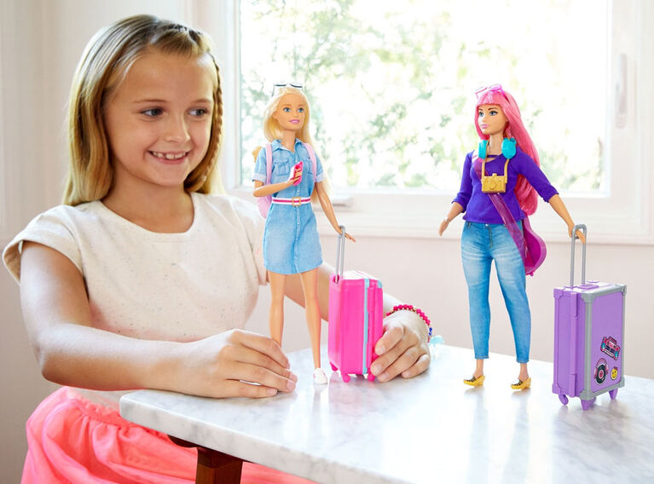
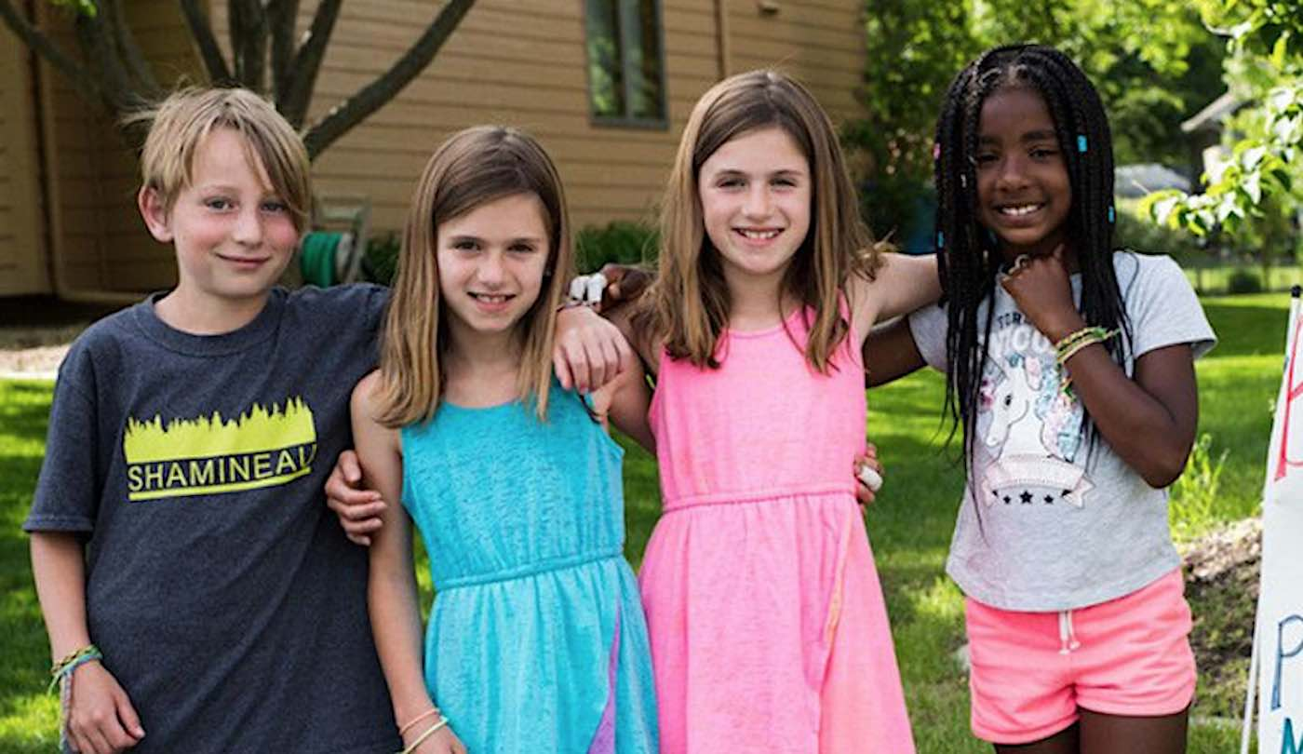
My hobbies…
I love playing with
my dolls.
I love spending time
with my friends.
I love going outdoor with
my family.

Slide 6
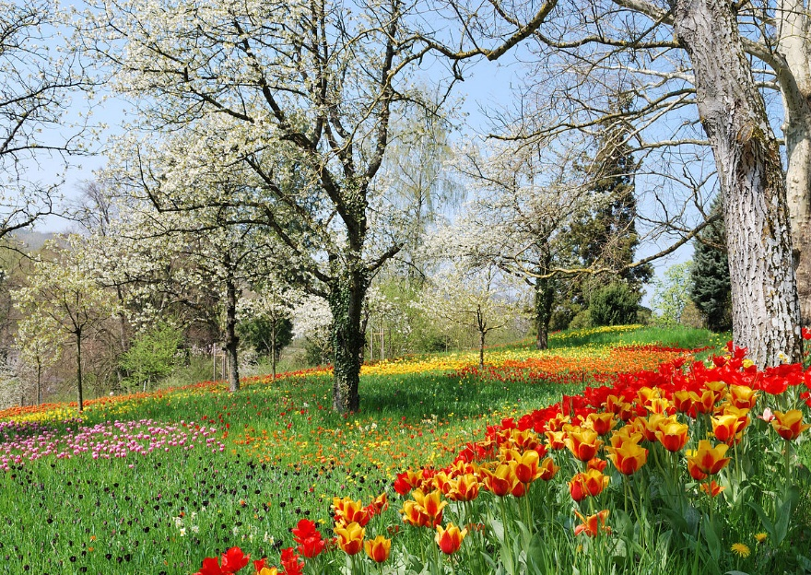
My favorite things…
My favorite season is spring because the weather is good and
the flowers have bright colours.
My favorite TV series is
“Lucky and Spirit”.
My favorite place is my grandparent’s house,
because they have a big garden and many fruit trees.

Slide 7
I have finished with me
… who is next??
…..Thank you for watching!!

