Slide 1
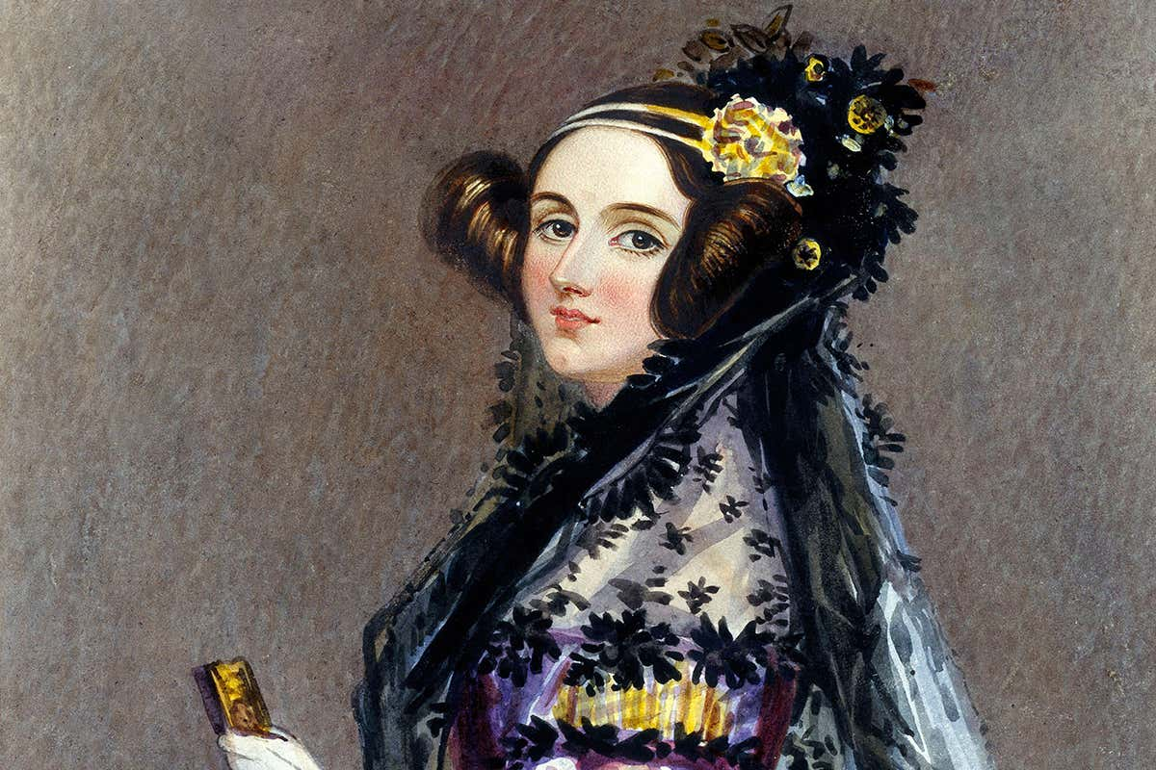
Ada Lovelace
The first computer programmer
England
10th December 1815 - 27th November 1852

Slide 2
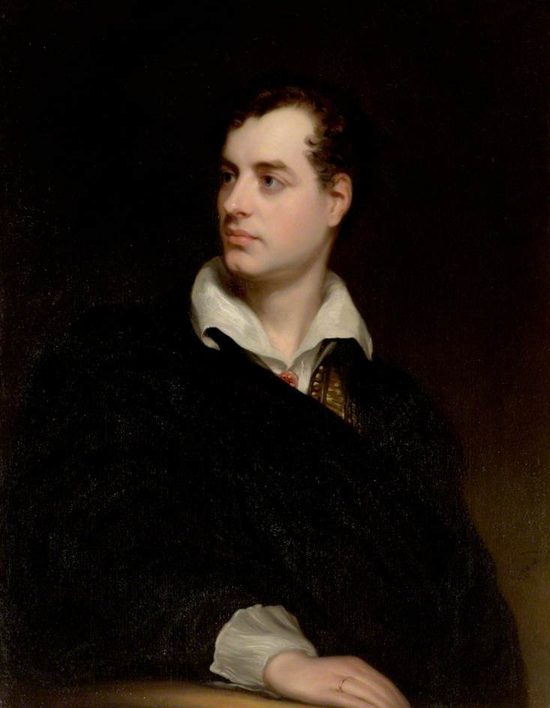
Augusta Ada Byron was the daughter of the famous poet Lord Byron and Lady Annabella Byron.
Her father left the family a few weeks after her birth and she never saw him again. He died in Greece when she was 8 years old.
Her mother insisted that her daughter have tutors to teach her maths and science.
Lord Byron

Slide 3
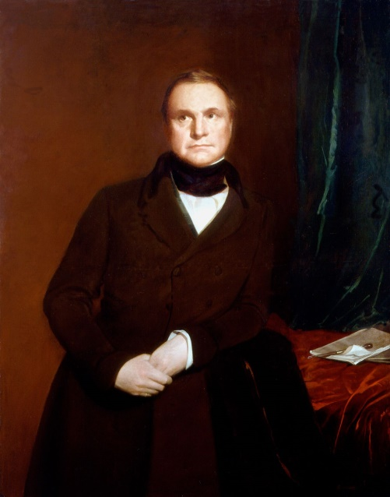
At the age of 17, she met Charles Babbage, who invented the first computer.
In 1835, Ada married William King, who became the Earl of Lovelace, making her the Countess of Lovelace. They had three children.
Charles Babbage
After their marriage, she continued to work with Babbage.

Slide 4
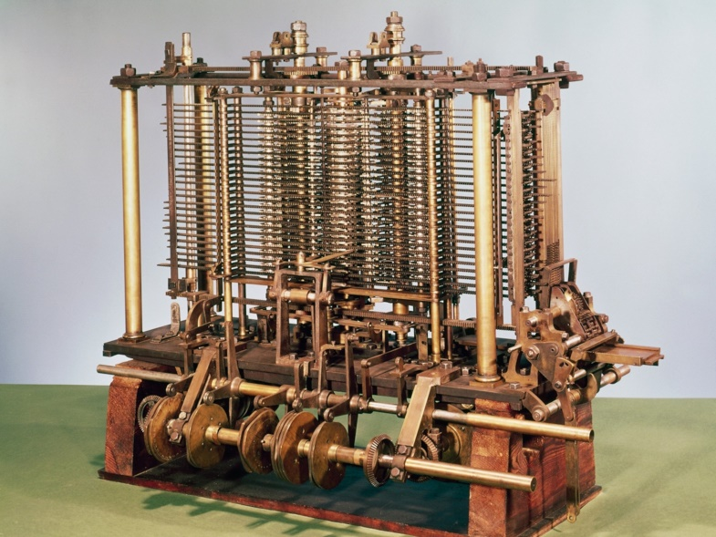
In 1843, he was developing the Analytical Engine and asked Ada to translate French text into English.
Ada translated the text and added her own notes.
In these notes she compared the design of the Analytical Engine to how weaving machines worked.
She imagined that the engine could follow patterns, or codes, not only to calculate numbers, but to form letters, too.
This is a very basic explanation of computer programming.
Analytical engine

Slide 5
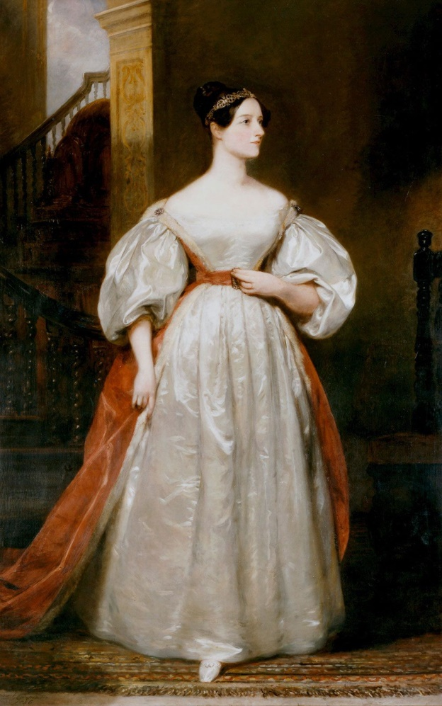
In 1953, her notes were republished in a book about digital computing that showed how computers work by following patterns.
In the 1970s, the computer language ADA was named after her.
The second Tuesday in October has become Ada Lovelace Day, on which women of science, technology, engineering and mathematics are honoured.

Slide 6
https://www.britannica.com/biography/Ada-Lovelace
https://kids.nationalgeographic.com/history/article/ada-lovelace
https://www.mpg.de/female-pioneers-of-science/Ada-Lovelace#:~:text=Her%20scientific%20work%2C%20which%20is,computer%20programme%20in%20the%20world.
Βιβλίο «20 σπουδαία κορίτσια που άλλαξαν τον κόσμο», Εκδόσεις Διόπτρα
Aglaia Nikoli Στ’2

