Slide 1
Auguste and Louis Lumière
Auguste and Louis Lumière invented the cinema

Slide 2
Information about the two inventors
Auguste and Louis Lumière were brothers. Auguste was born in 19 of October in 1862. His brother Louis Lumière was born in 5 of October in 1864. The Lumière brothers were born in Besançon, France, to Charles-Antoine Lumière (1840–1911) and Jeanne Joséphine Costille Lumière, who were married in 1861 and moved to Besançon, setting up a small photographic portrait studio where Auguste and Louis were born. They moved to Lyon in 1870, where son Edouard and three daughters were born. Auguste and Louis both attended La Martiniere, the largest technical school in Lyon. Their father Charles-Antoine set up a small factory producing photographic plates, but even with Louis and a young sister working from 5 a.m. to 11 p.m. it teetered on the verge of bankruptcy, and by 1882 it looked as if they would fail. When Auguste returned from military service, the boys designed the machines necessary to automate their father's plate production and devised a very successful new photo plate, 'etiquettes bleue', and by 1884 the factory employed a dozen workers. Louis Lumière died in Bandol, France, on June 6, 1948. Auguste died in Lyons on April 10, 1954.
Πηγή: https://en.wikipedia.org/wiki/Auguste_and_Louis_Lumi%C3%A8re

Slide 3
The invention ( the cinema )
Inspired by Thomas Alva Edison's kinetoscope, the brothers set out to developan improved film projection system. In February 1895, they took out a patenton their cinÄmatographe, an apparatus that not only took pictures but also later projected them. Using a claw movement that advanced the frames of the film 12 times per second, the cinÄmatographe projected still images on a screen separated by moments of blackness. The images lingered on the viewer's retina, and the viewer thus perceived a moving image. The Lumières described their invention as having "scientific curiosity, but...no commercial future whatsoever." Public opinion soon proved them wrong. On December 28, 1895, in front of a paying audience at the Grand Cafe in Paris, the brothers staged a twenty-minute program of ten films, including one ofa train as it entered a station, moving straight toward the camera. The filmcreated panic in the audience; several women are said to have fainted. The event has gone down in history as the first public cinema performance. Withinfive years of the invention of the cinÄmatographe--during which time theLumières promoted it throughout Europe--motion pictures were being made in every developed country in the world. The Lumières continued toinnovate film technology. In Paris in 1900, they demonstrated their Photorama, which was a 360í panoramic projector. Thirty-five years later, theyintroduced their stereo-cine process, which was based on the principle of anaglyphics. As pioneers of color photography, the Lumières came up with the firstcommercially successful method of creating a color photograph on a single plate. Their autochrome process, patented in 1907, involved covering a special photographic plate, patented in 1904, with small grains of potato starch dyedgreen, red, and blue and then applying a thin film of panchromatic emulsion (i.e., emulsion equally sensitive to all colors). The exposure was made through the glass side of the plate through the dyed starch grains. After it was exposed, the plate produced a transparency composed of small dots of color. Since these dots were too small for the human eye to detect as separate, they gave the appearance of mixed colors.
The Lumières' process had its drawbacks. It produced transparencies rather than actual photographs, and the transparencies had to be projected ontoa screen or viewed through a hand-held viewer. The density of the potato starch made the transparencies dark and grainy, and prints made from them were of poor quality. Also, the autochrome plate required a very long exposure--about 40 to 60 times longer than the best black-and-white plates. Despite its limitations, the Lumières' autochrome process paved the way for the commercial success of color photography. It remained one of the most popular methods for color photography until the 1930s, when subtractive color processes replaced it.. Πηγή: http://www.madehow.com/inventorbios/36/Auguste-Lumi-re-and-Louis-Lumi-re.html

Slide 4
How their invention influence the world
Their invention of the cinema influended the world a lot. From then and after almost every person in the world visited he cinema and now it has became a very popular way to have fun and relax!!

Slide 5
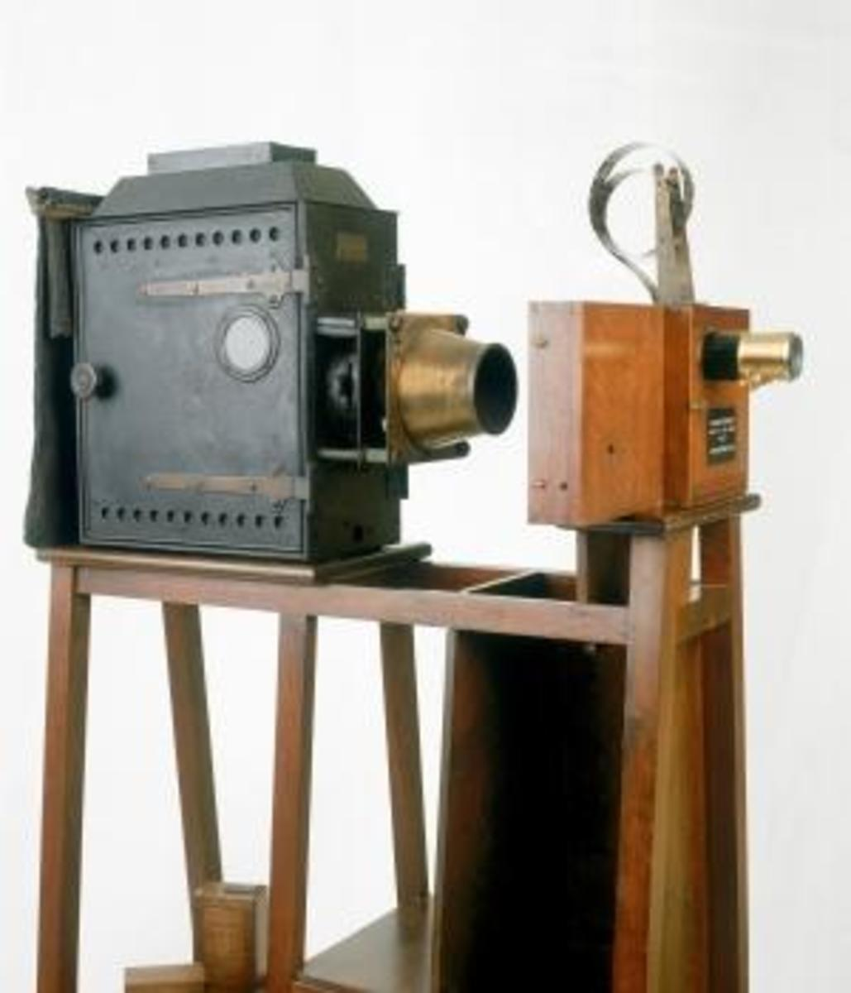
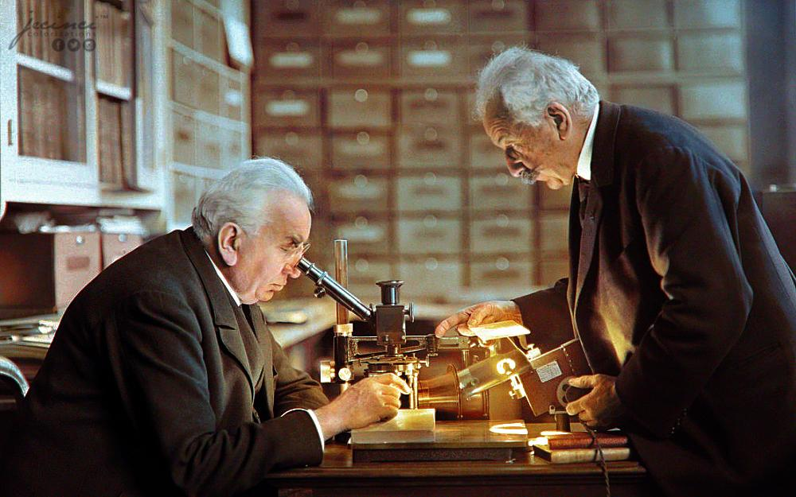
Photos

Slide 6
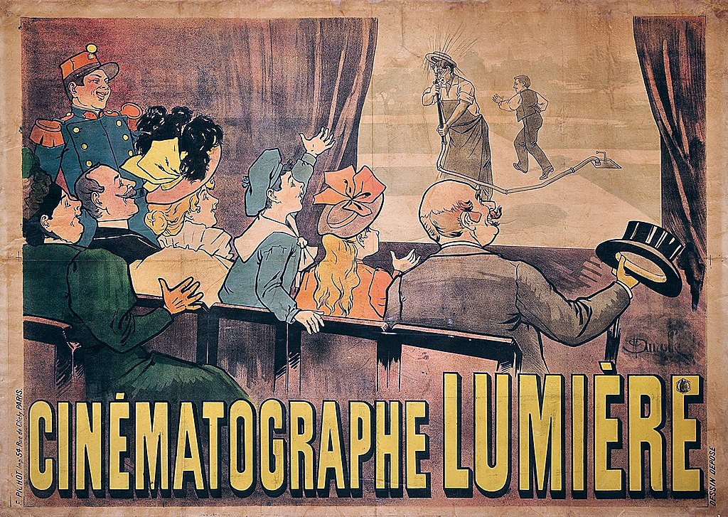
The first cinema ( photo )

