Slide 1
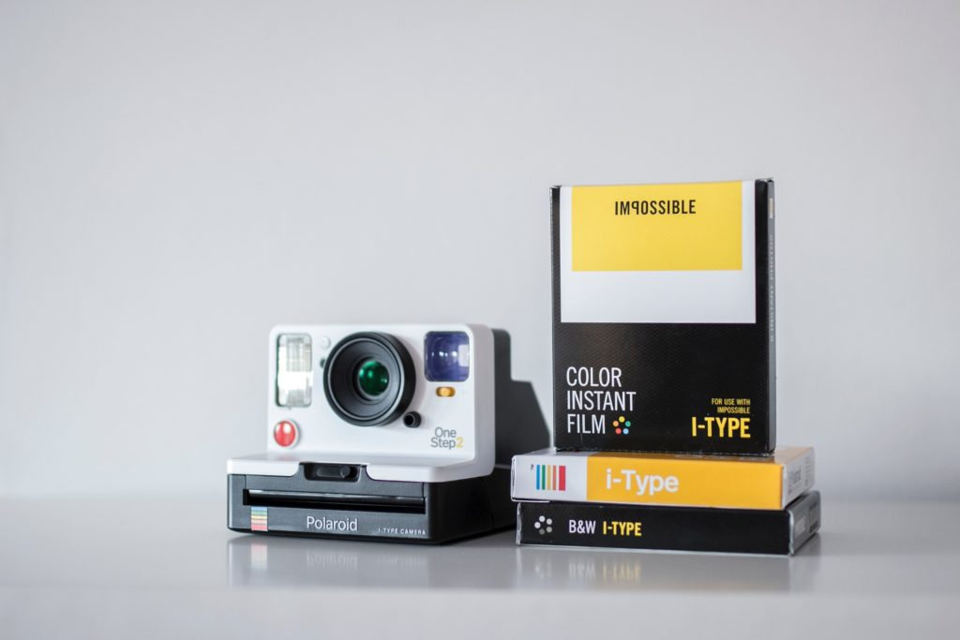
Edwin Land Inventor of Polaroid camera
Georgia Spiliotopoulou

Slide 2
Edwin Land was an American physicist who invented the first instant camera in 1932. Edwin Land was born in Connecticut USA.
He was a very good student in high school and graduaded in the class of 1927 with honors.
He studied physics (optics) at Harvard University. There he invented the first filter of polarizing light.

Slide 4
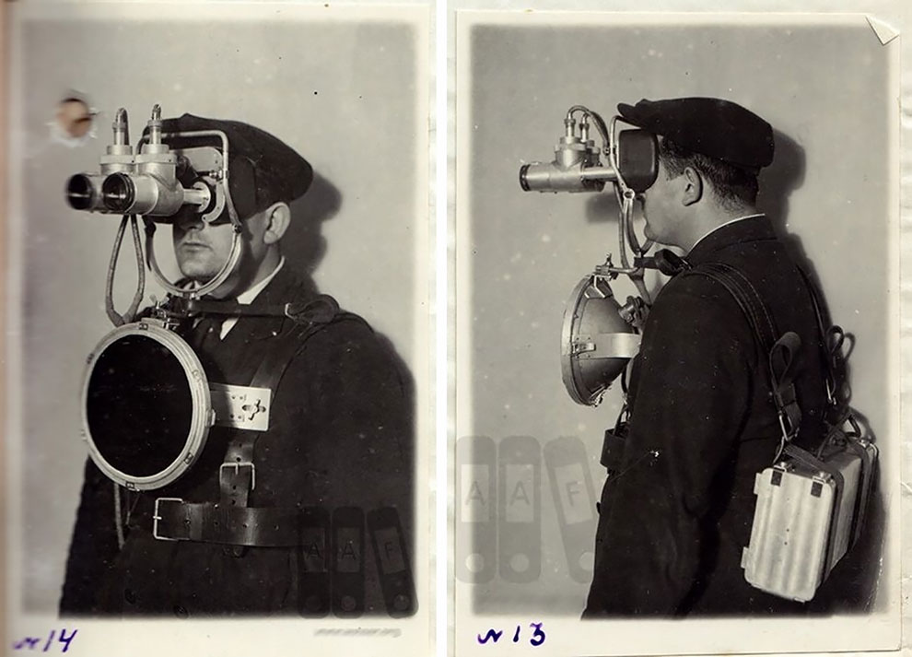
He developed his creation at 1940 when he worked on night-vision goggles for the military when he was a soldier and used the polaroid film with a viewing system that could help detect enemies. For this he got the National Modern Pioneer Award!

Slide 5
In 1943 during family holidays, his youngest daughter Valerie asked him why the camera couldn’t produce a photo immediately.
When Land returned to his laboratory, he developed the film (Polaroid film) and the printer. The image was ready in about 60 seconds!

Slide 6
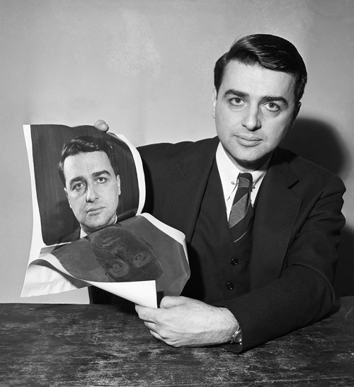

Slide 7
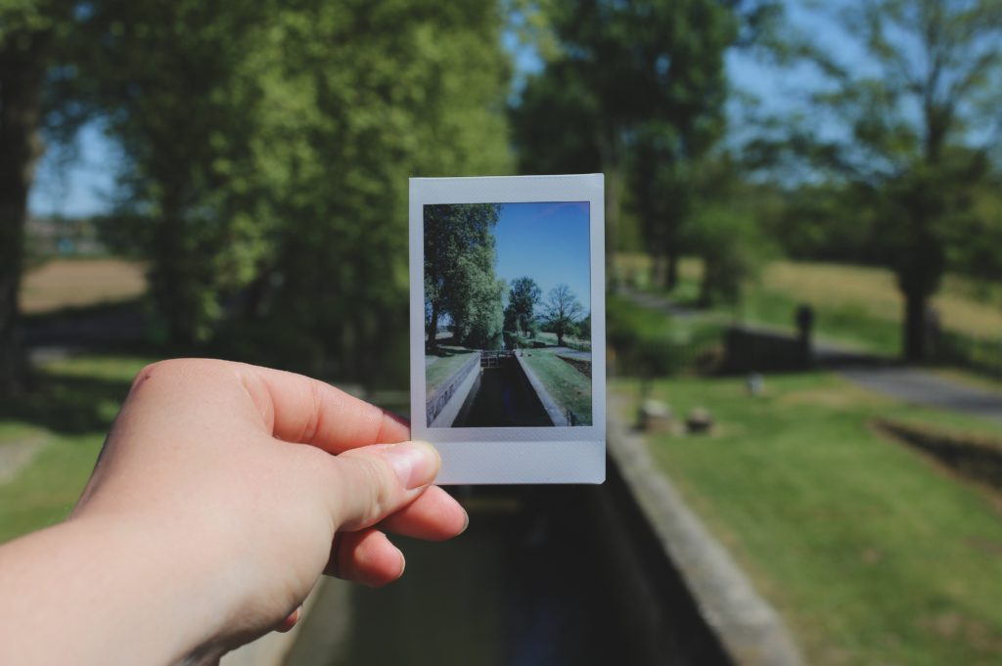
His invention influenced the whole world because before that photographers had to wait between two hours and a week for their photos to be developed and they didn’t know if the photos were good!

Slide 8
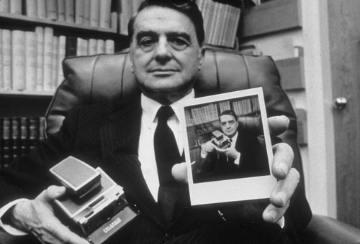

Slide 9
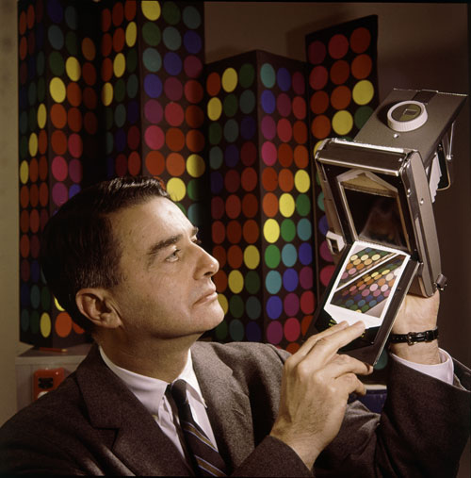
Land’s Polaroid Camera became very popular and it was sold out on the first day!

Slide 10
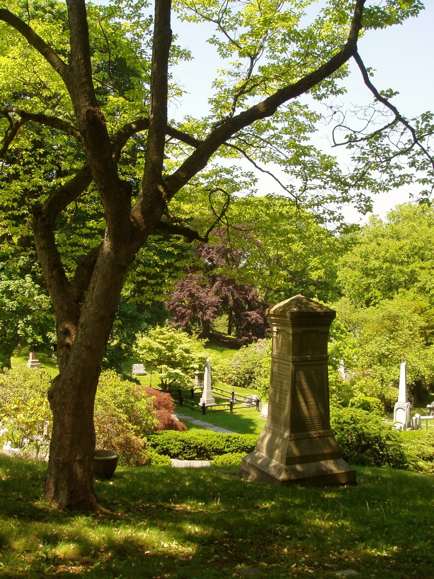
Land died in 1991, in Cambridge Massachusetts at the age of 81.
Land’s family, his wife and two daughters, Jenifer and Valerie buried him in Mount Auburn Cemetery.

Slide 11
