Slide 1


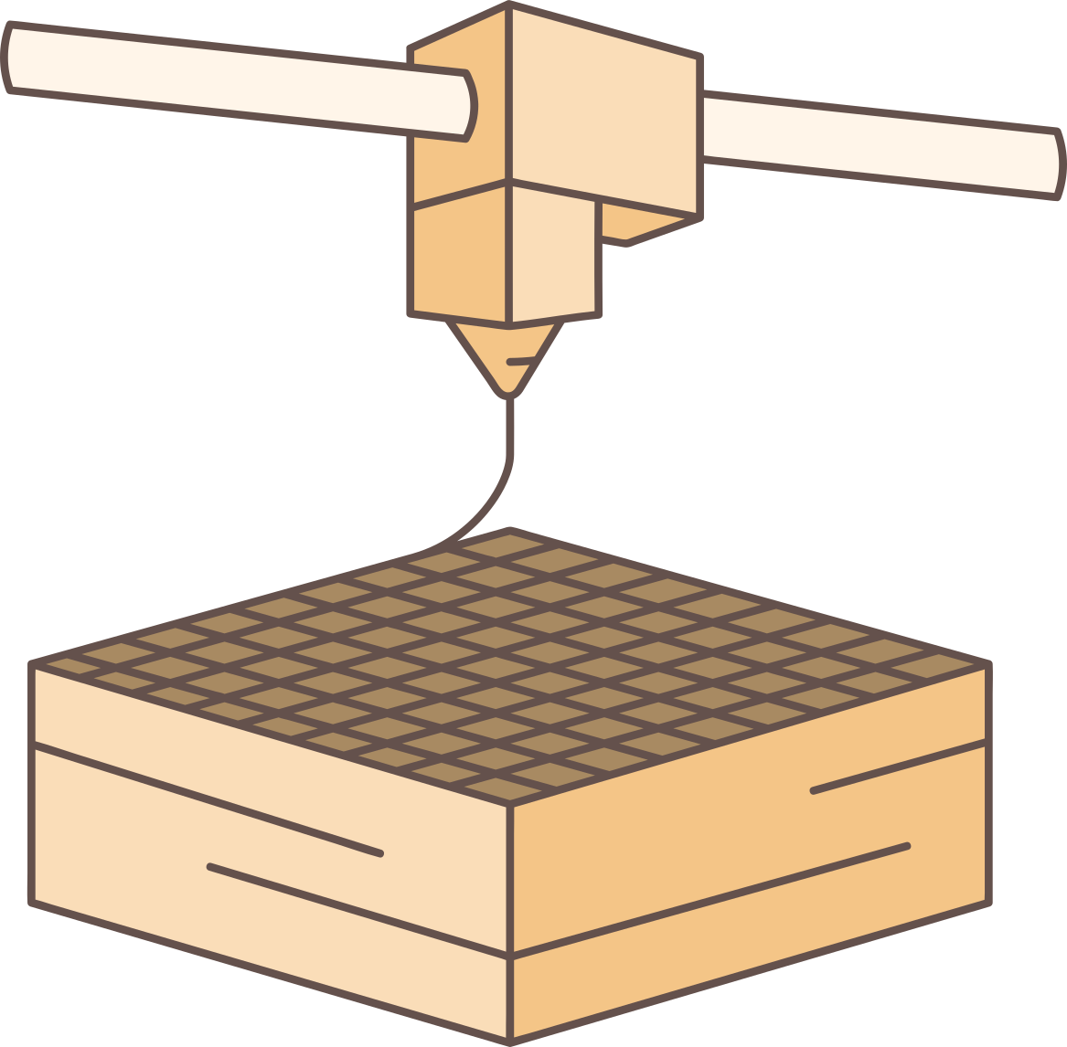
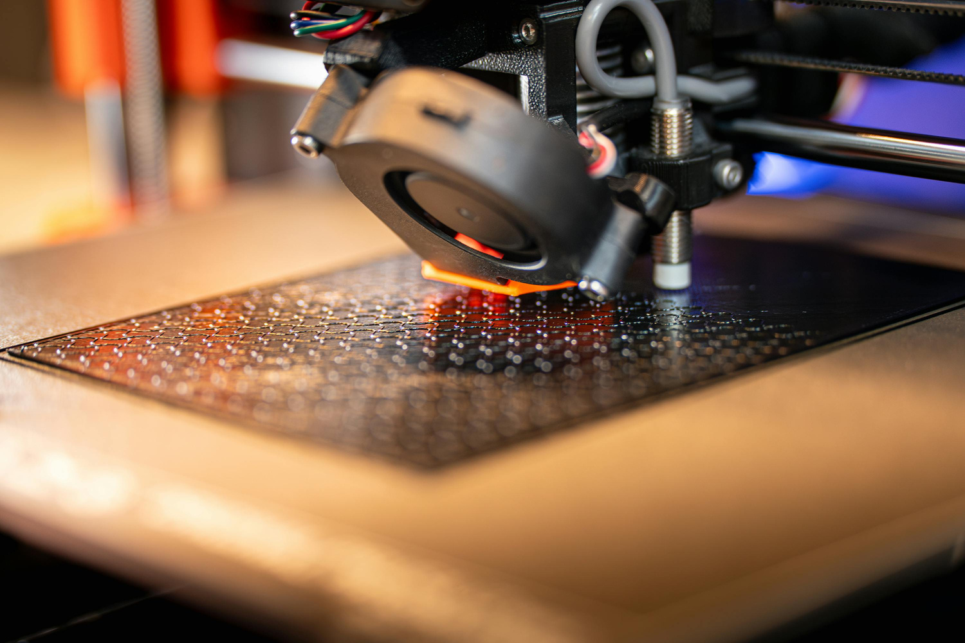
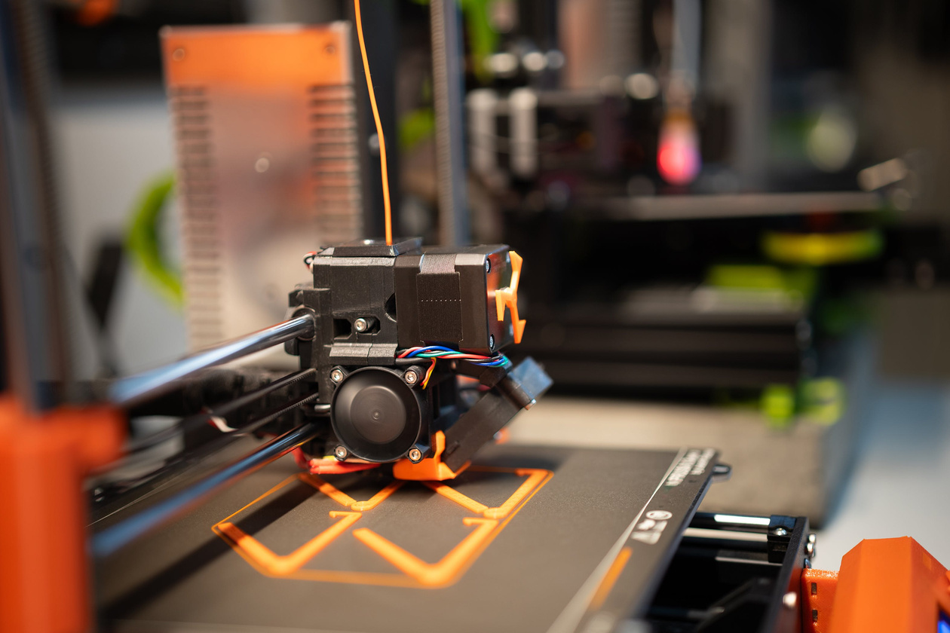
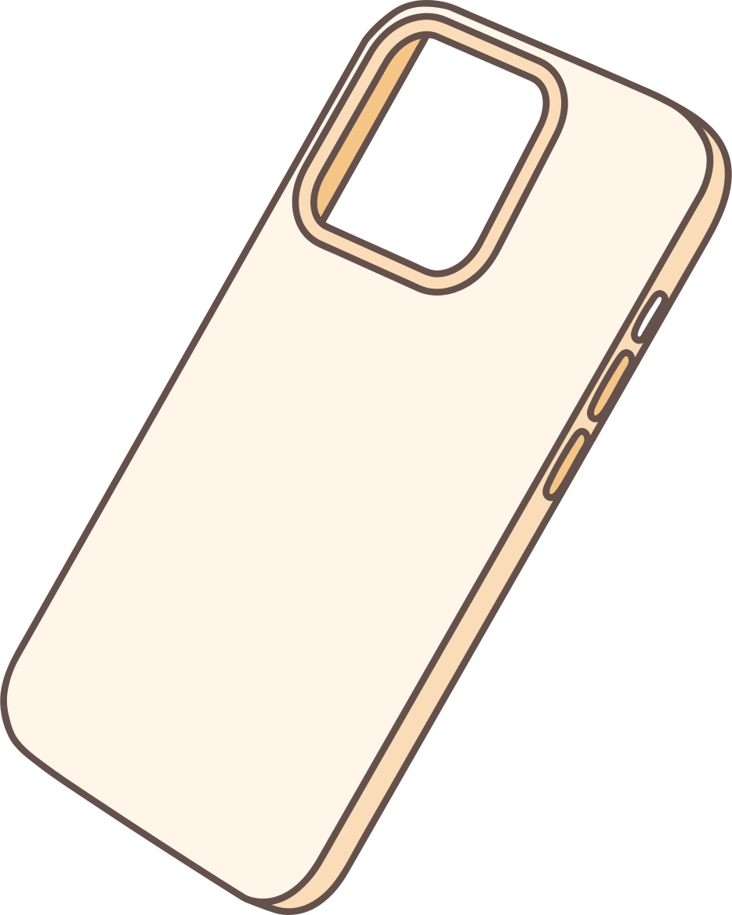
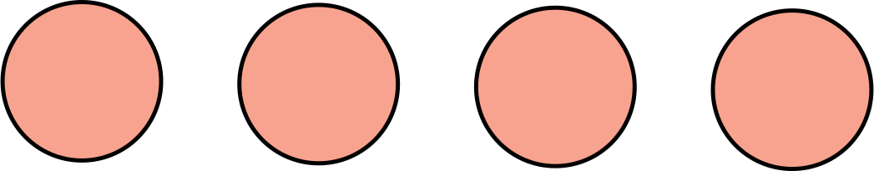
Welcome to the 3D World
Welcome everyone! Today, we are moving from the digital world of coding to the physical world of making. We are going to learn how we can take an idea from our computer and hold it in our hands using 3D printing.

Slide 2

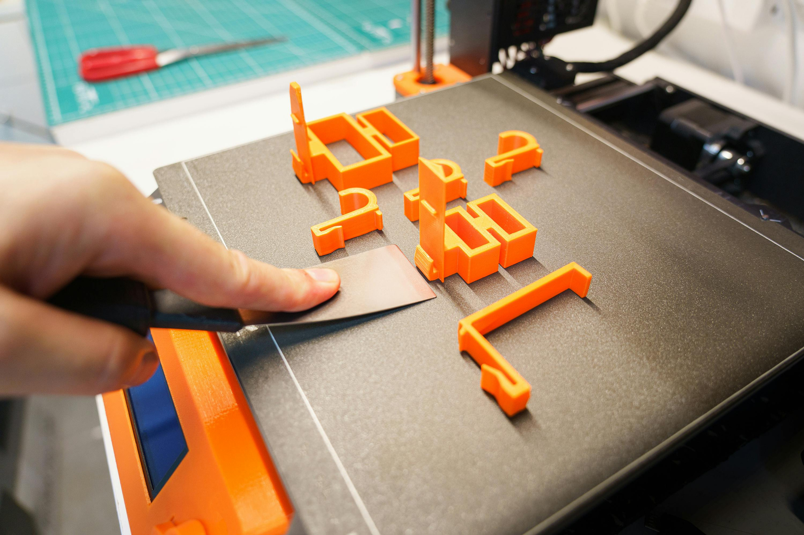

How does a 3D Printer work? (The Basics)
Think of a 3D printer like a very smart, high-tech hot glue gun. It works by 'Additive Manufacturing.' This means it builds objects layer by layer, from the bottom up. A plastic string called 'Filament' melts at high temperatures and the printer's head moves precisely to draw each layer until the object is finished.
Video

Slide 3

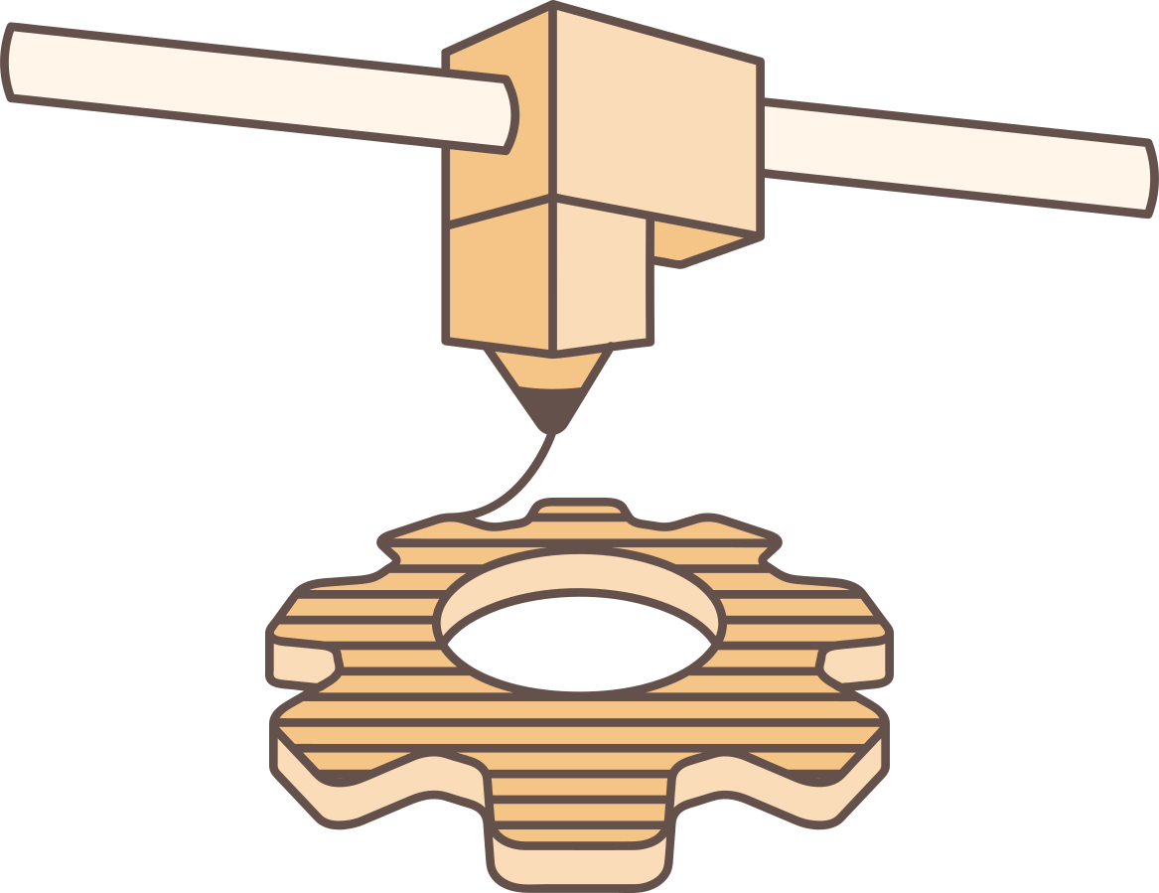
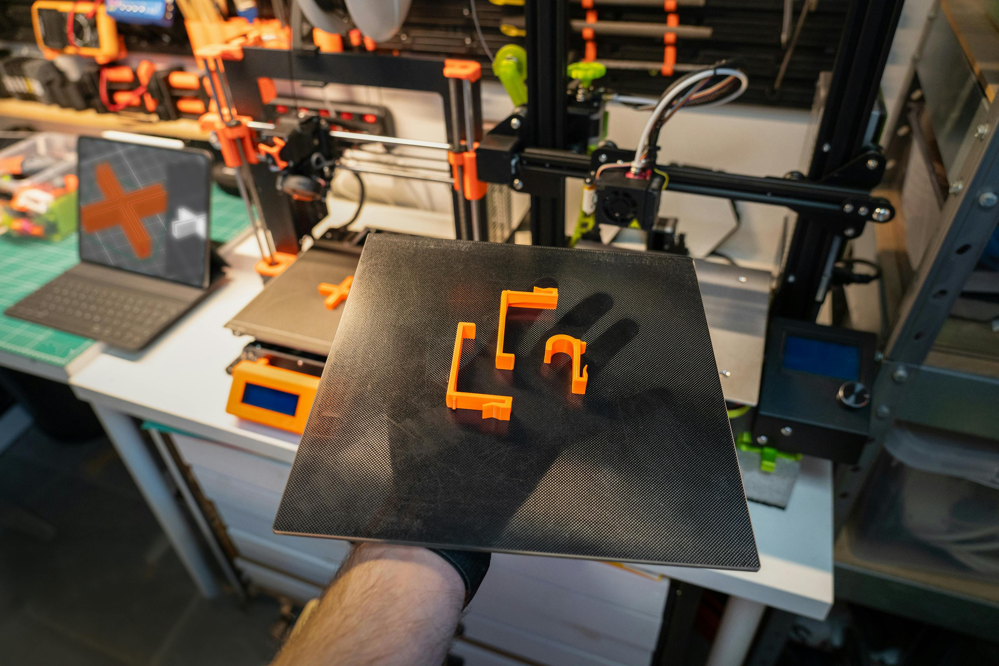


From Idea to Object (The 3 Steps)
Visual: A flow chart: 1. Design (STL) -> 2. Slice (G-Code) -> 3. Print.
"To print something, we need three steps:
Design: We create or find a 3D model (STL file).
Slice: We use a 'Slicer' program to tell the printer how to move.
Print: We send the file to the machine and wait for the magic to happen!"

Slide 4







Where to find 3D Projects? (Online Libraries)
You don't always have to be a professional designer. There are amazing online libraries where people from all over the world share their 'Green' designs for free.
Thingiverse & Printables: Thousands of ready-to-print objects.
Tinkercad: A great place for YOU to start designing your own simple shapes."

Slide 5
From stl to print file
"So, you found a cool 3D model in an STL format. Can the printer understand it yet? The answer is No.
An STL file describes only the shape of the object. But the printer needs to know how to move, how fast to go, and how much plastic to melt. To do this, we need a special software called a Slicer.
Imagine a loaf of bread. The Slicer takes your 3D model and cuts it into hundreds of thin horizontal slices (layers). For every slice, it creates a path for the printer's head to follow."

Slide 6
What do we need?
The STL File: Our 3D design (the "digital statue").
The Slicer Software: The "translator" that speaks the printer's language.
The G-Code: This is the final file (the "recipe") that we put on a USB stick or SD card for the printer.

Slide 7
Which programs can we use?
Ultimaker Cura
PrusaSlicer:
Tinkercad (Basic Slicing)
Orca Slicer
Import stl → Export Gcode

Slide 8
image to 3d file
You can find an image, logo and create a 3d image
https://imagetostl.com/convert/file/png/to/stl

Slide 9
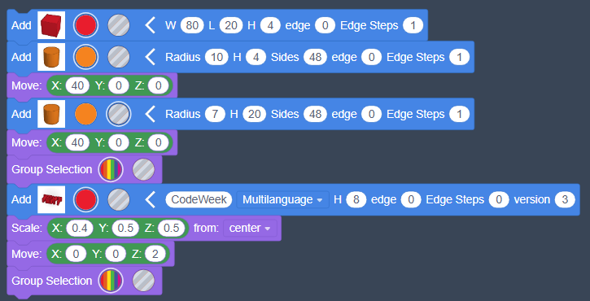
CodeBlock- tinkercad
You can use blocks like coding and create your 3d design

