Slide 1
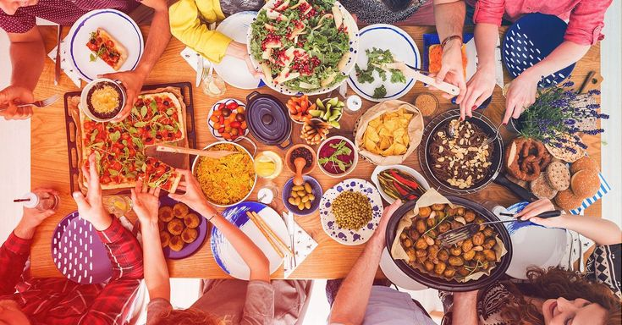
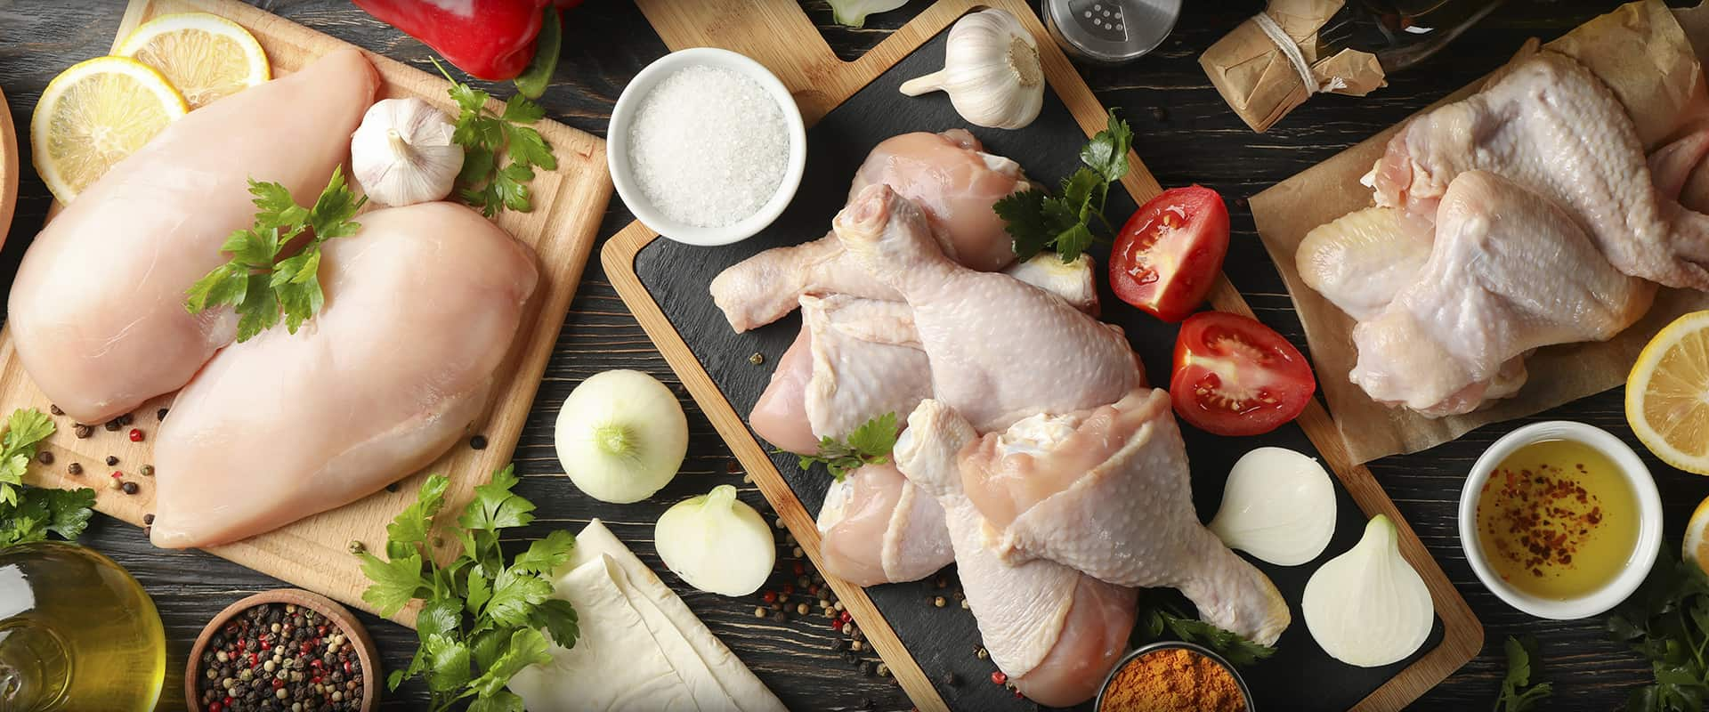
MEDITERRANEAN
Greek traditional diet is based on its cultural heritage

Slide 2
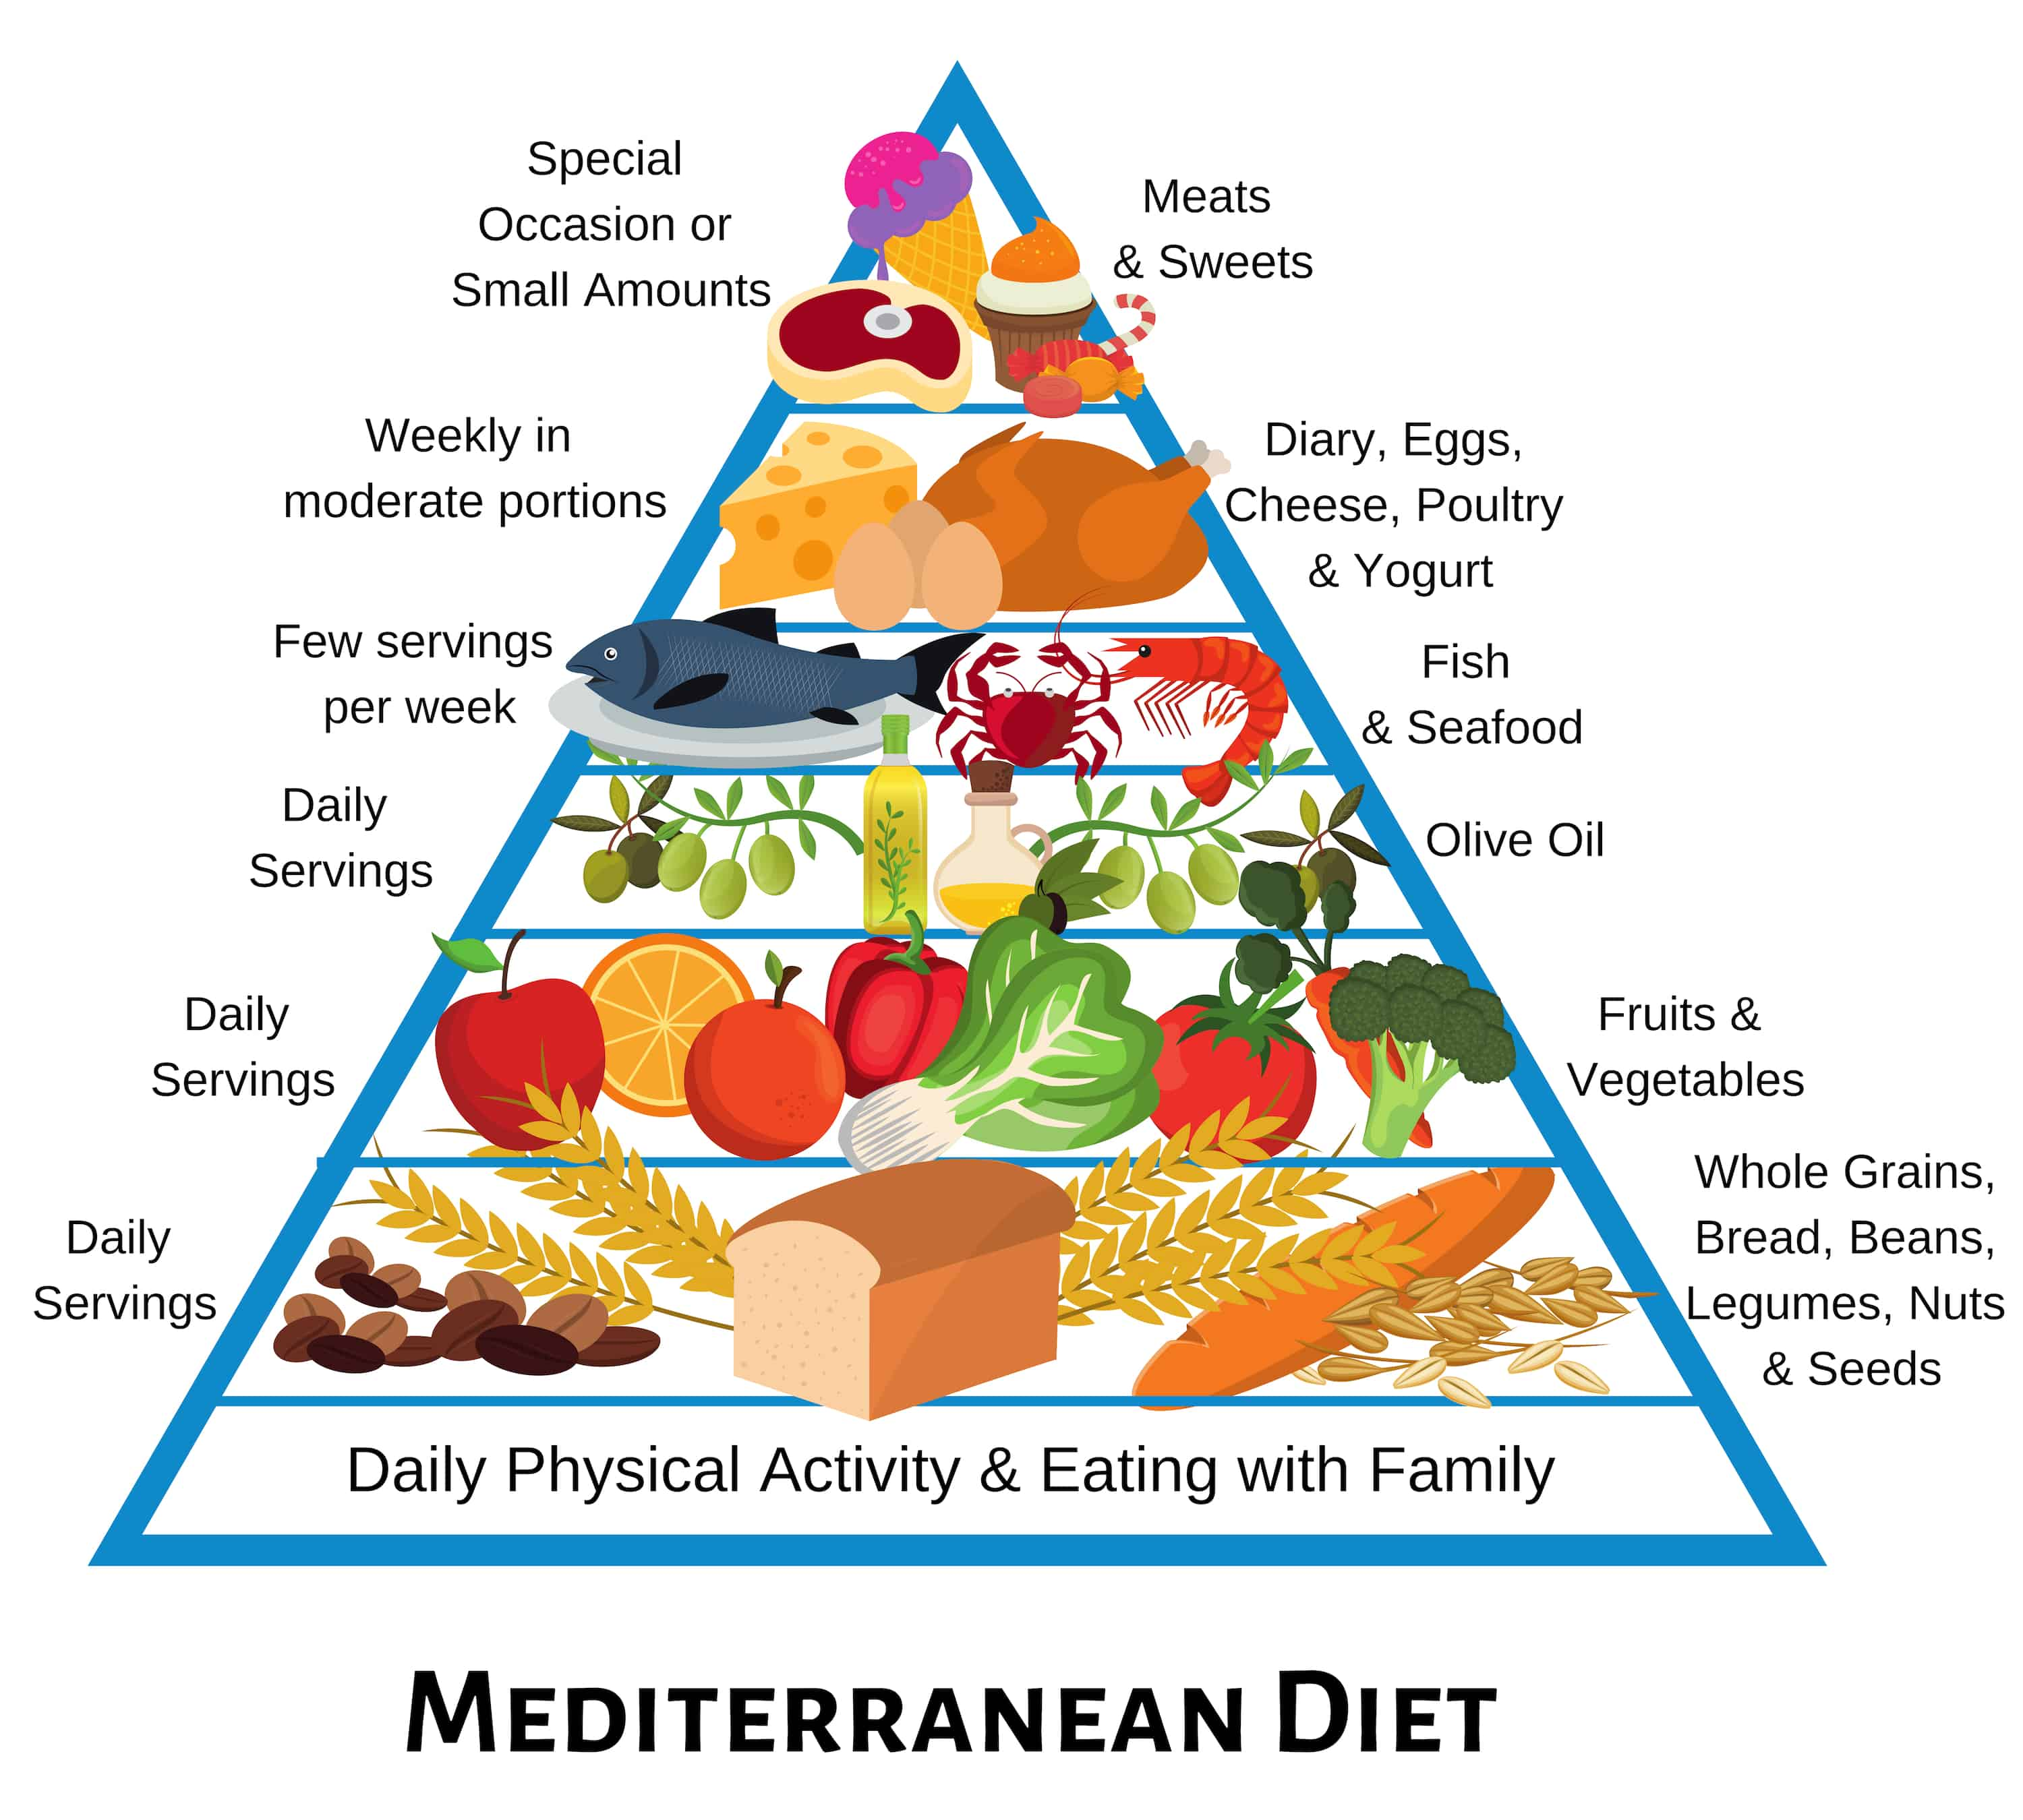

Slide 3
Daily Physical Activity
Walking, cycling, wheeling, sports, active recreation and

Slide 4
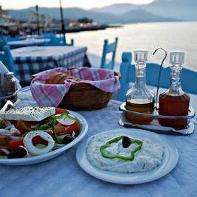
Eating with family
Eating together not only is an important aspect of life, but helps make weight control easier.

Slide 5
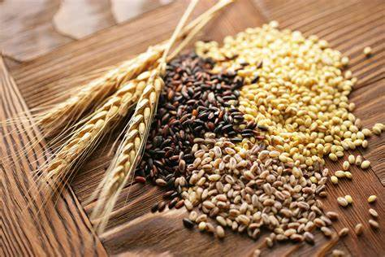
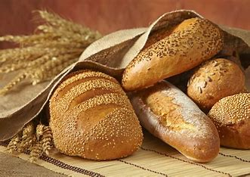
Daily serving
Whole Grains
Bread
Whole-wheat flour, bulgur (cracked wheat), oatmeal and brown rice.
Whole grain bread is made up of fully intact grains.

Slide 6
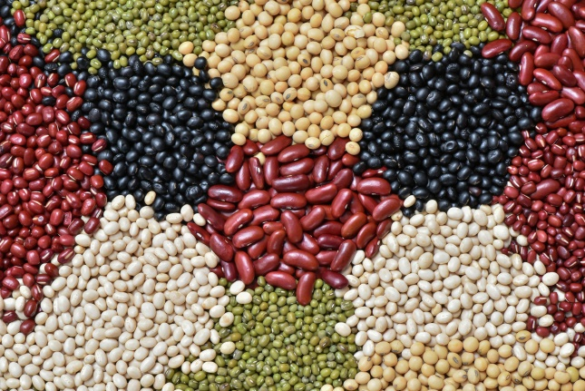
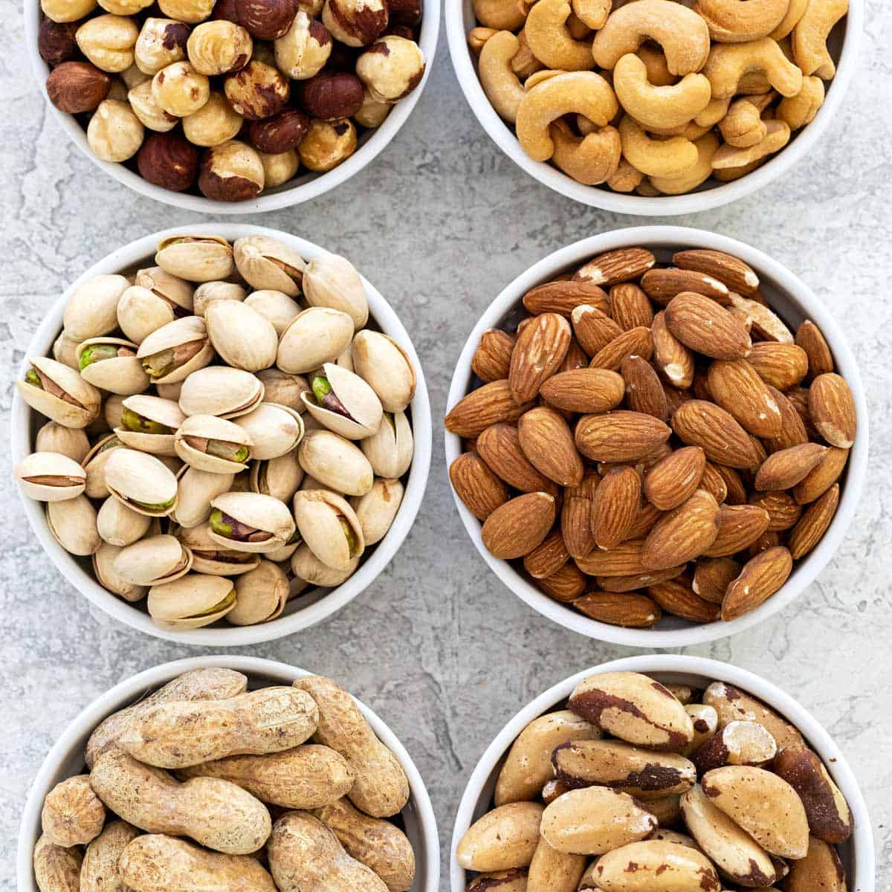
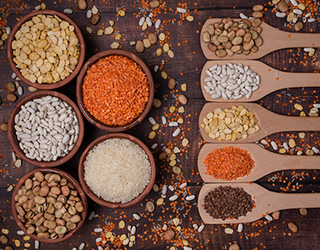
Daily servings
Legumes & Beans
Nuts & Seeds
All beans are considered a legumes, but not all legumes are considered beans.
Nuts are actually the seeds of plants

Slide 7
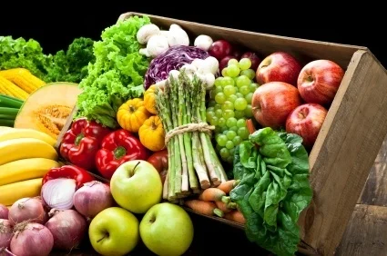
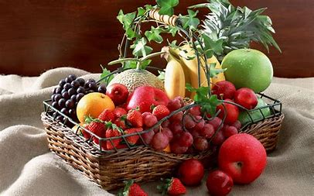
Daily serving
Vegetables
Fruits
Vegetables are parts of plants that are consumed by humans or other animals as food.
In botany, a fruit is the seed-bearing structure in flowering plants that is formed from the ovary after flowering.

Slide 8
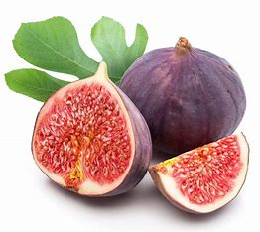
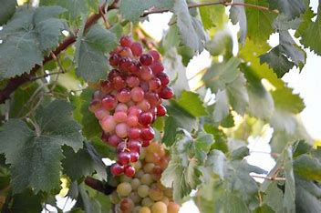
Fact:
These fruits were discovered in ancient Greece

Slide 9
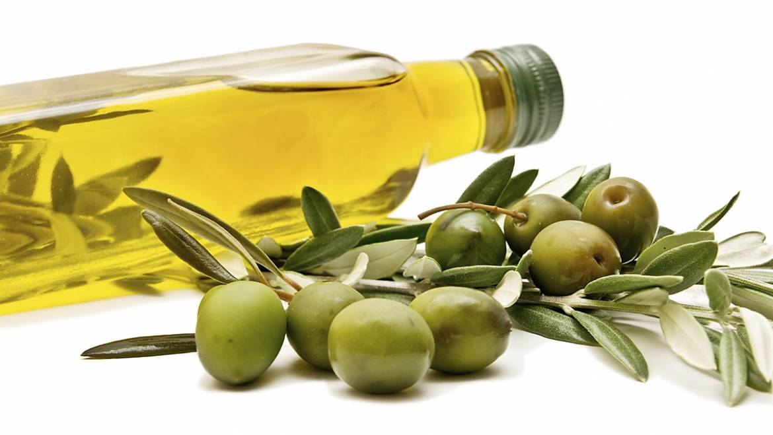
Daily serving
Olive oil is a liquid fat obtained by pressing whole olives, the fruit of Olea europaea

Slide 10
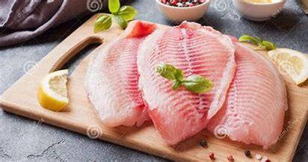
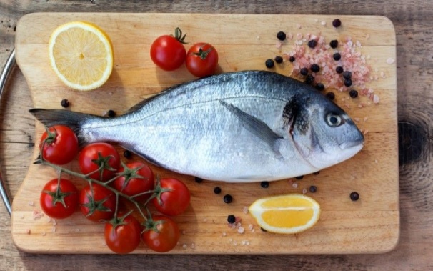
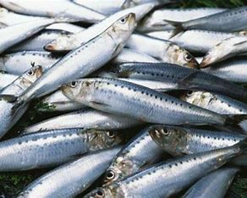
Few servings per week
Fish
Seafood
A fish is an aquatic, craniate, gill-bearing animal that lacks limbs with digits
Seafood is any form of sea life regarded as food by humans, prominently including fish and shellfish.

Slide 11
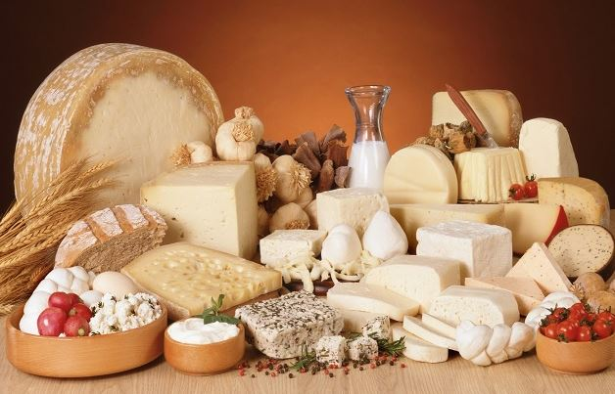
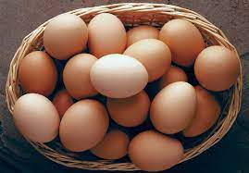
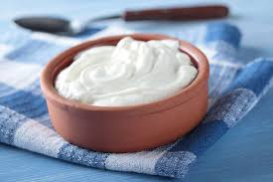
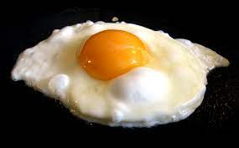
Weekly in moderate portions
Cheese & yogurt
Eggs
Cheese is nutritious food made mostly from the milk of cows but also other mammals. Yogurt is a food produced by bacterial fermentation of milk.
It’s ok to eat one whole egg, including the egg yolk, every day if you don’t have cardiovascular disease and you do have a healthy level of blood cholesterol.

Slide 12
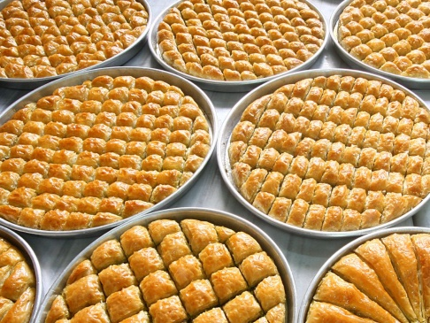
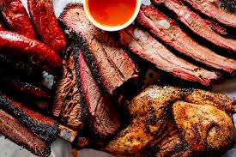
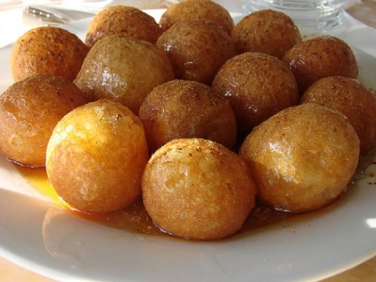
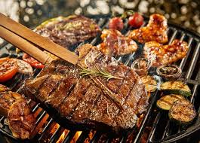
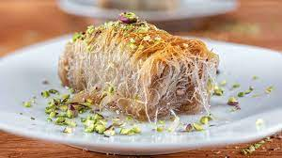
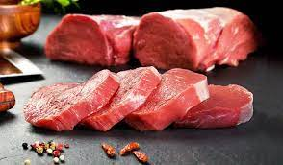
Special occasion or small amounts
Sweets
Meats
History, reasons and place are the defining factors of Greek desserts.
Meat is animal flesh that is eaten as food.

Slide 13
Thanks for watching!!!!
Irene Kaima - Penelope Agnousiotou
4-11-23

