Slide 1
Breakfasts
German and my breakfast

Slide 2
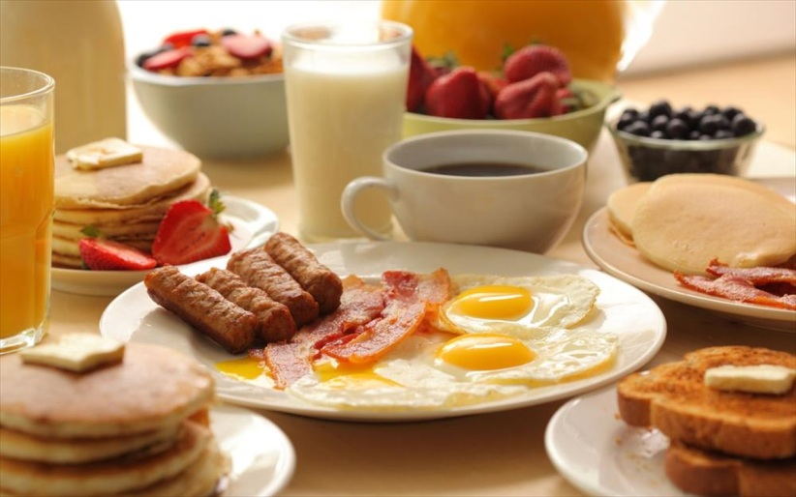
German breakfast
Coffee/tea/cocoa/orange juice
Bread
Jam/honey
Quark (kind of cheese)
Sausages
Eggs

Slide 3
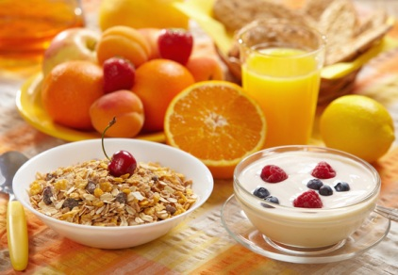
My breakfast
Milk/orange juice
Bread/cereal (musli)
Jam/honey

