Slide 1
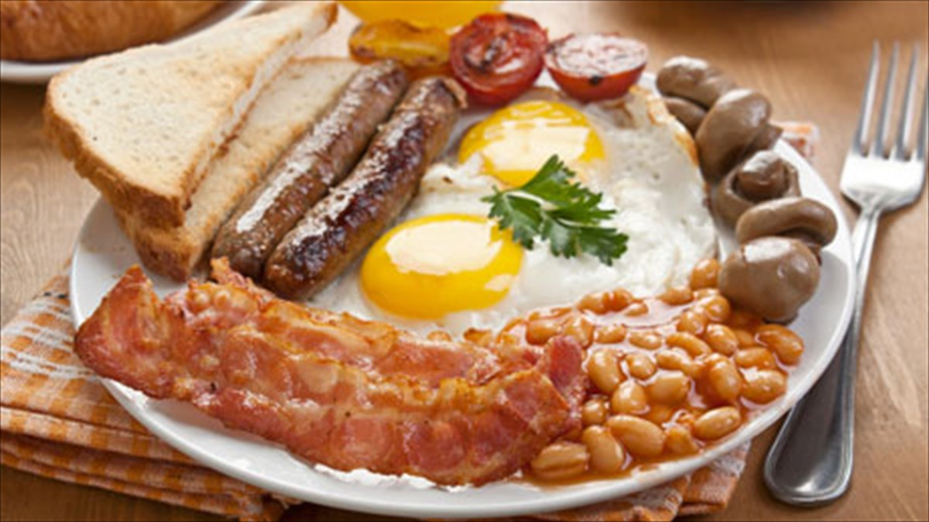
English Breakfast
2 pork sausages
4 large tomatoes
4 large mushrooms
5 slices of bacon
4 eggs
4 slices of bread
2 spoonfuls of olive oil
salt
pepper
tin of beans

Slide 2
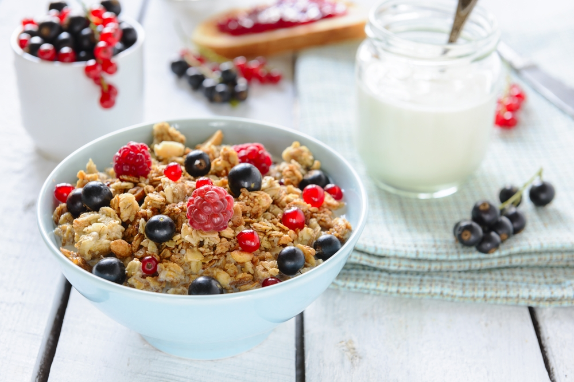
My Breakfast
milk
cereal
blueberries
cranberries
strawberry
oats

