Slide 1
CRETE
Charitini & maira & Marianna

Slide 2
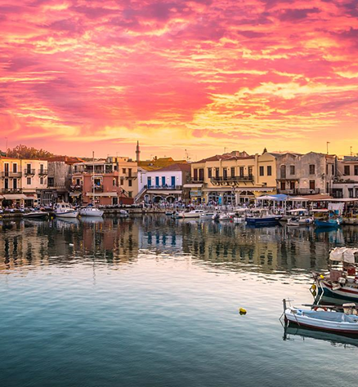
General Information
Crete is the largest and most populous island of Greece, and the fifth largest in the Mediterranean Sea, after Sicily, Sardinia, Cyprus, and Corsica. Its capital and largest city is Heraklion, which is also the seat of the Crete Region, which includes neighboring islands and islets. The island has a population of 622,909 inhabitants.

Slide 3
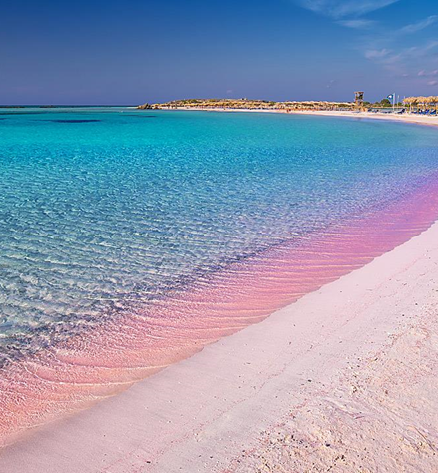
Cretan Diet
The inhabitants of Crete have been shown to have the highest longevity rates and the lowest proportional and global mortality rates from diseases such as cardiovascular disease and cancer.
The secret of the Cretan diet is that Crete has one of the oldest and most delicious cuisines in the world. It is a continuation of the tradition of flavors, aromas, ingredients, and techniques that has its roots in the Minoan era and continues to this day. Findings from archaeological excavations show that even the ancient Cretans, 4,000 years ago, consumed almost the same products as the modern Cretan. Many large jars of oil, wine, cereals, legumes, and honey were found in the Minoan palaces.
Cretans eat the products that their land produces: abundant fruits and vegetables, greens, legumes, and fruits.

Slide 4
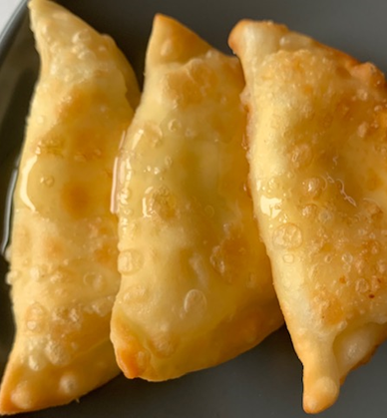
Cretan Cuisine
Dairy products are important in the Cretan diet. Fish and seafood are considered delicacies. Legumes are consumed in large quantities, usually during fasting periods, while aromatic herbs are used mainly for making various infusions and less as flavorings in cooking. The main sweeteners in Crete were and are grape must and thyme honey. Finally, we would like to make a special mention of what the Cretans themselves consider one of their greatest "secrets" for longevity and good health: Cretan "tsikoudia", a strong distillate made from the remains of the grapes after they have been pressed to make wine.
Particularly famous dairy products of the island are the graviera, the semi-hard kefalotyri, the goat cheese, the fresh (or anthotyro) and the dry myzithra stand out and are among the best Greek cheeses. A characteristic delicacy is the "dakos" with Cretan barley rusk (kritharokoulou) on which is placed tomato, oil and fresh myzithra.
As a dessert, the Cretan yoghurt is excellent, served with fragrant thyme honey, while prepare yourself for a particularly pleasant taste surprise when you put the irresistible combination of local graviera with honey in your mouth!
Cretan myzithra, honey and cinnamon are also used to make the famous Cretan "kalitsounia" or "lychnarakia". At weddings and christenings, Cretans serve "xerotigana", a kind of "dipla" dipped in local, aromatic honey.

Slide 5
Εμφάνιση προχείρων Cretan Cuisine: A taste of tradition
Authentic Cretan cuisine is a journey through flavors and aromas that have been passed down for generations. Here are some of the most emblematic dishes that define this unique culinary tradition:
1. Kalitsounia: A sweet and savory delight
The word "kalitsounia" doesn't always mean the same thing in Crete. In Eastern Crete, they are sweet pastries baked in the oven. Sometimes they are made with "instant" dough, like the "kastrina lychnarakia" (oil lamp pastries), and sometimes with "anevati" dough (a leavened dough). In this region, kalitsounia are also the name given to crescent-shaped pies filled with cheese, such as the famous "chaniotiki myzithra" (Cretan mizithra cheese) and "tyromalama" (a soft white cheese).
In Chania, on the other hand, kalitsounia refers to closed crescent-shaped fried pies filled with greens ("chortokalitsouna"), a mixture of onions ("kremmidiokalitsouna"), or the famous cheeses of Chania.
2. Cretan Dolmadakia Yalanzi: A taste of history
Although the name "dolmadakia" has Turkish origins due to the Ottoman occupation, researchers believe that their origin is actually Greek. Over time, many variations have emerged, differing from region to region.
Cretan dolmadakia are particularly famous for the grape leaves they are wrapped in. They are cooked in a pot and served with cool yogurt, making for a refreshing and flavorful combination.
3. Pilafi: A traditional staple
A traditional Cretan recipe is pilafi, or more specifically, "gamopilafo" (wedding pilafi), as it is more commonly known. This dish is a staple at Cretan weddings, where it is served as the traditional main course. It consists of rice boiled in meat broth, and it is always a popular choice. Due to its popularity, pilafi can also be found at other occasions that call for a traditional Cretan feast.

Slide 6
Our video
https://www.youtube.com/watch?v=0lLq7oH4Tpo&t=2s

Slide 7
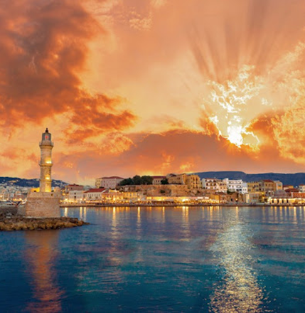
Thank you

