Slide 1
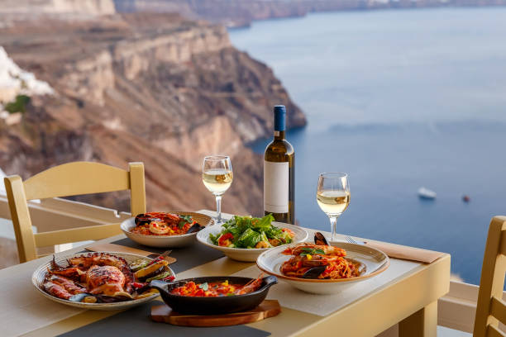
Traditional Greek cuisine

Slide 2
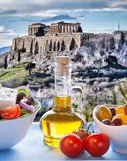
Chronology
The cuisine of the Greeks is characterized as Mediterranean. It has some common characteristics with the traditional cuisines of Italy, the Balkans, Turkey and the Levant.
This trend in Greek diet continued into the Roman and later Enaetic and Ottoman years and has changed relatively recently.
Byzantine cuisine was similar to ancient Greek cuisine and is its natural continuation. The difference is that it includes new ingredients that were not available in the past, such as caviar, nutmeg, basil and lemons, while fish continues to be an integral part.

Slide 3
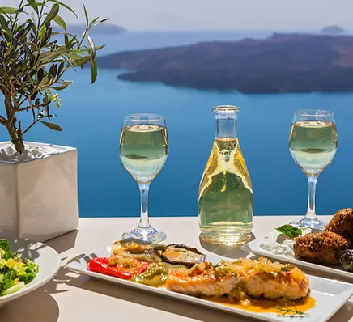
Mediterranean cuisine is internationally recognized as the healthiest cuisine. The use of olive oil as well as fresh raw materials such as fruit, fish, seafood, as well as high-quality national ones, has been proven to contribute to the reduction of blood pressure and the prevention of serious diseases such as cancer, while at the same time increasing people's life expectancy and favoring long life. In addition, bread almost always has a place on the table.

Slide 4
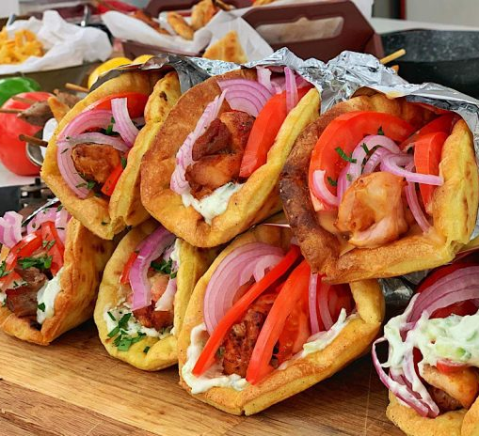
Greek souvlaki
500 gr. pork neck
olive oil
lemon juice
1/2 wine glass white wine
onion
rosemary
Salt and Pepper
Peppers

Slide 5
shrimp pasta
flour
shrimps
olive oil
onion
garlic
2 onions
tomato juice
250 ml of water
parsley,

Slide 6
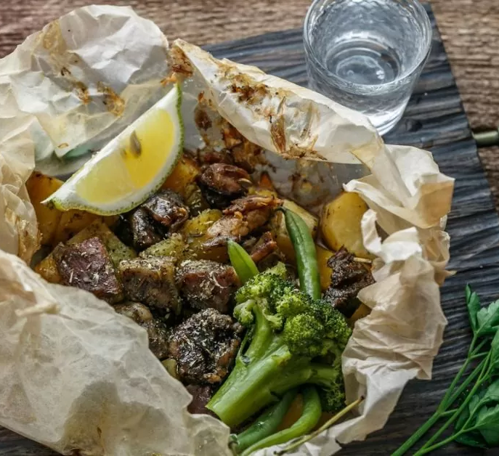
END

