Slide 1
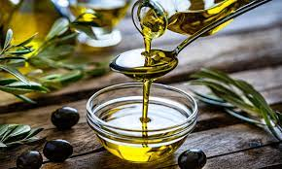
FROM STUDENTS:
ERI SINAI
KONSTANTINOS PISSARIS
PANAGIOTIS NERAS
OLIVE OIL

Slide 2
WHAT IS THE OLIVE OIL
The olive oil is the basic element of Mediterranean alimony and the oil of wrists of olive.

Slide 3
WHERE DOES OLIVE OIL COME FROM?
Today on the entire Earth there are 800 million oil trees. Firstly, the olives are gathered, and then their juice is extracted to produce olive oil.

Slide 4
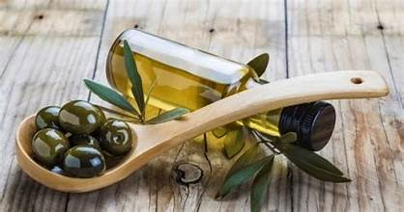

Slide 5
THE OLIVE OIL’S HISTORY
Not only was olive oil used as food in ancient times,but it also served as a source of health and power, medicine, magic and admiration.
According to the Greek mythology, the first olive tree was planted at the Acropolis from goddess Athena.

Slide 6
ITS ADVANTAGES IN NUTRITION
The extra virgin olive oil has a very high nutritious value despite having a few calories.It has healthy acids and vitamins E and K in it.

Slide 7
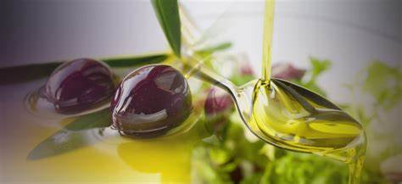

Slide 8
THE PROCESS OF OLIVE OIL’S PRODUCTION
https://youtu.be/ykIPmuWoKw4?si=X25N9g7GT8a6_JMO

Slide 9
THE END

