Slide 1
International school cooperation newsletter
Marianna Kupraiou
Charitini Papadopoulou

Slide 2
This year, our grade 2 class will do international activities with schools abroad, in the United Arab Emirates (Dubai). Our class has 23 children and the teacher is Mrs. Maria Kafantari. The themes of the actions are two: Food recycling and Greek, traditional cuisine.

Slide 3
Recycling - food composting Food waste
Recycling is the reprocessing of already processed materials, especially waste, into new products. The process of composting first appeared 4000 years ago in China, after they recycled their garbage to help plant production. Greece, according to 2006 surveys, ranks last in the European Union in terms of utilization of recycling.
European food industries produce around 30 million tones of waste per year, which ends up: as road paving materials, as low-quality fertilizer or animal feed with no nutritional value.
Food waste can be recycled into food additives, high-quality animal feed and manures in order to exploit the nutrients of the by-products.

Slide 4
Ways to reduce food waste
1. We buy the quantities we need
Buying the quantities we need and know we will consume is probably the most important way to reduce food waste. First look at what's in your fridge and cupboards to avoid buying products you may already have.
2. We plan the meals for the week.
Before we do our shopping, we plan our meals for the week. This way we know exactly the materials we will buy and the quantities we will need.
3. We calculate the portions we will cook
We often prepare large quantities of food with the result that there are several portions left over. We use the leftovers as a base for a new recipe or combine it with something else and have a brand new meal for the next day.
4. We check the expiration dates.
We tend to consume what we have recently bought first. But the most important thing is to immediately consume what expires first. Try putting them first in our fridge and cupboards.
5. Freezing
Food that we have recently bought and we do not intend to consume immediately, we put it in the freezer: this way it is preserved for a longer time. We do the same for the leftover

Slide 5
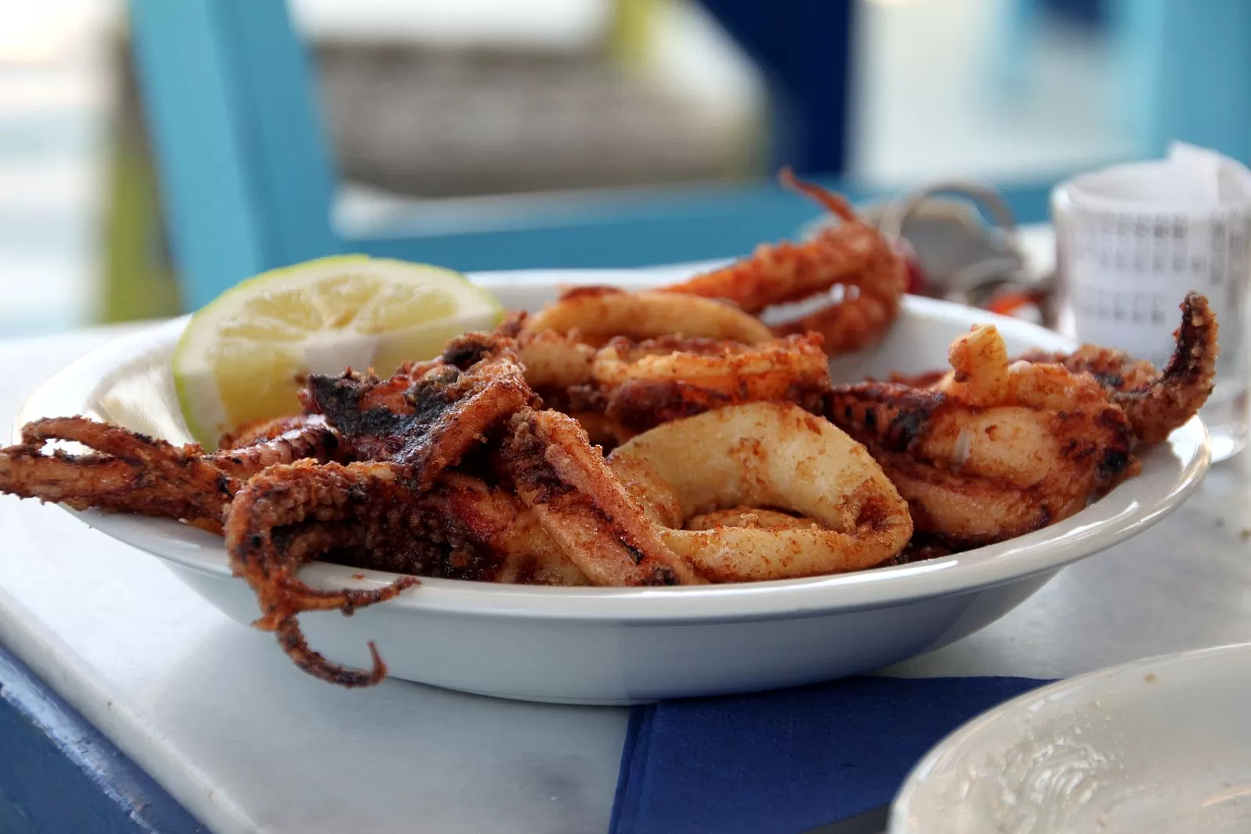
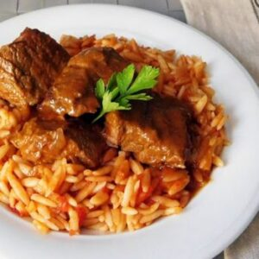
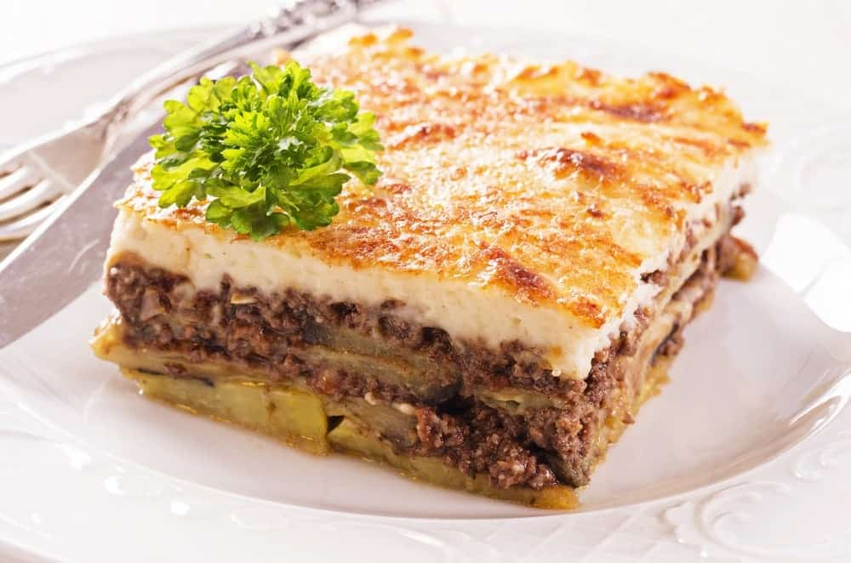
Greek cuisine
Greek cuisine is very special and includes foods that do not exist in other countries. The cuisine of the Greeks is characterized as Mediterranean, while it also has some common characteristics with the traditional cuisines of Italy, the Balkans, Turkey and the Levant (part of the Middle East).
Some of them:
Calamari Yiouvetsi Moussaka

Slide 6
Mediterranean cuisine
Mediterranean cuisine is internationally recognized as the healthiest cuisine. The use of olive oil as well as fresh raw materials such as fruit, fish, seafood, as well as high-quality national ones, has been proven to contribute to the reduction of blood pressure and the prevention of serious diseases such as cancer, while at the same time increasing people's life expectancy and favoring long life.

Slide 7
I am looking forward to this day because we will interact with schools abroad and get new information, get to know their traditional foods, see their schools and learn their customs. In addition, we will make acquaintances and friendships with them.

Slide 8
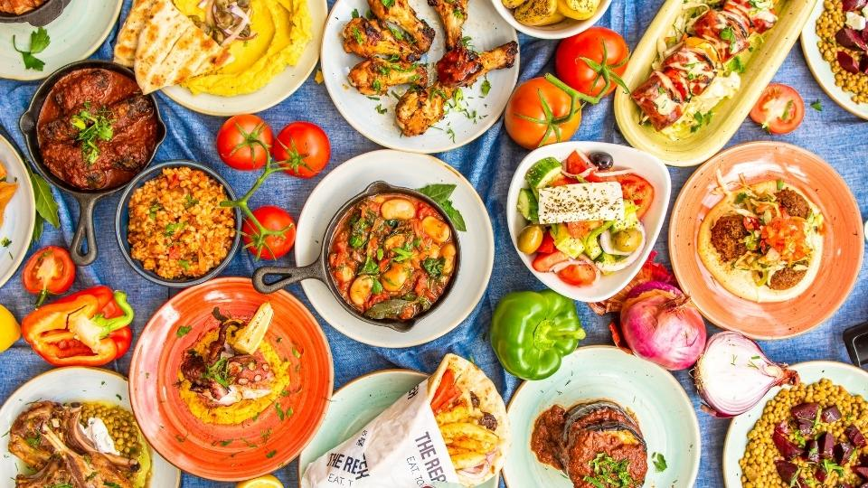
THANK YOU

