Slide 1
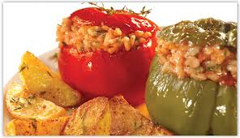
FROM THE STUDENTS
PISSARIS KONSTANTINOS
SINAI ERI
NERAS PANAGIOTIS
TRADITIONAL GREEK CUISINE

Slide 2
OVERALL INFORMATION ON GREEK CUISINE
The secrets on Greek cuisine from the ancient years until today are the perfect quality of its products, the fresh ingredients, the right use of various spices and herbs, the olive oil and of course its simplicity.

Slide 3
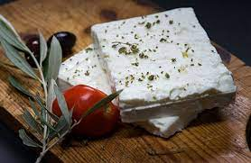
BASIC PRODUCTS
Chios’ Mastic
Ouzo
Feta Cheese
Olive Oil - Olive
Honey
Kozani’s red Saffron (krokos)
Crete’s Rusk

Slide 4
ΗISTORICAL ΒACKGROUND
The Greek gastronomy has a history of 4,000 years.
The ancient poet and philosopher Archestratus, who lived in the mid- 4th century BC, is considered the first chef in history, as he wrote the first cook book in the world.
The ancient Greek cuisine consisted of cereals, fruits, vegetables, honey, olive oil, round barley breads, pulses like lentils and chickpeas, figs and meat.
.

Slide 5
GREEK MAP OF GOODS PRODUCTION

Slide 6
More than 50% of Greek agricultural production’s value comes from fruits, vegetables and olive oil.
Naxos island with its famous graviera cheese, Kalamata with the extra virgin olive oil, Kerkira with the traditional “pastichada”, Chios’ Mastic etc.

Slide 7
GREEK TRADITIONAL FOODS
SPANAKORIZO
Spanakorizo is rice with spinach in the pot.
GALAKTOBUREKO
Galaktobureko is made of thin pastry sheets, sprinkled with melted milk butter and combined with a semolina cream.
BRAISED FRESH BEANS
Braised fresh beans are made of fresh beans together with tomatoes and are enriched with vegetables, as onions, carrots, potatoes etc.

Slide 8
PASTITSIO
Pastitsio is made with thick spaghetti, meat sauce and cream..

Slide 9
GREEK SALAD
Greek salad is one of the favourite salads made with fresh tomatoes, onions, cucumber-sprinkled with oregano- feta cheese and olive oil.

Slide 10
THE END

