Slide 1
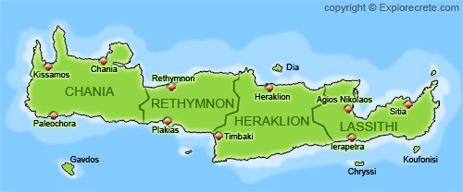
Kalitsounia (Crete foods)
Irene Kaima,
Penelope Agnousiotou
Catherine Anastasiadi, Eva Zouganeli

Slide 2
What will we learn about Crete:
Where she is
Her Climate
Her Cuisine

Slide 3
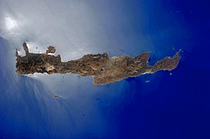
Where is Crete?
Crete is the largest and the most populous islands of Greece and the fifth largest in area in the Mediterranean, after Sicily, Sardinia, Cyprus and Corsica. Its capital and largest city is Heraklion, which is the seat of the region of Crete which includes neighboring islands and islets. With a population of 617.360 inhabitans, approximately 160 kilometer south of the Greek mainland and stretching from west to east, it is washed by the Cretan Sea to the north and Libyan Sea to the south. It is an important part of the economy and cultural heritage of Greece, preserving its own cultural elements. During the years 3000BC-1400BC the Minoan civilization, the oldest civilization in Europe, flourished on the island, with its main centers being Knossos, Phaistos, Malia, Zakros and Gournia where palace complexes were found.

Slide 4
Her Climate:
The climate of Crete is probably the mildest in Europe. During the hot summer months, southwesterly winds, the meltemias, moderate the hot atmosphere. Rainfall is very rare during the summer season. Autumn is the friendliest season in Crete with temperatures that often exceed those of spring. The mountains that cross the island acts as a weather barrier, causing several times the simultaneous existence of different climatic conditions between the northern and southern parts of the island

Slide 5
Her cuisine:
The philosophy of Cretan cuisine is based on the freshness of the ingredients, the simplicity of its preparation and the balance between the few elements that must be combined to prepare a meal. The main ingredients are virgin olive oil and fresh seasonal fruits, as well as herbs and vegetables from the Cretan land.
But today we are going to tell you about its dish….
Kalitsounia!

Slide 6
Kalitsounia
On the rise or of the moment, kalitsounia are one of the most exquisite and delicious Cretan dishes. Those pies that have yeast and “rise” (swell) are called rising, while they are made with a simple sheet. The simple kalitsounia look like asteroid-shaped tarts, while the rising are made mainly at Easter and are a bit reminiscent of the tsoureki. Both have a filling of myzithra or anthotyro, honey and cinnamon. They are eaten both for dessert, and to accompany your raki, which suits it so well with something slightly sweet and cheesy.
*Myzithra is a traditional type of cheese in various forms. It is prepared from sheep’s or goat’s milk, curd with added milk.

Slide 7
Recipe Ingredients
For the dough
1 fl. Butter
1fl. sugar
1 fl. Evaporated milk
2 eggs
2 t.b.sp baking powder
1kg of wheat flour
For the kalitsounia, first prepare the dough. Mix the butter, sugar, milk, and eggs well, until they become a uniform mixture.
Sieve the flour and baking powder with a sieve and add them to the mixture.
The dough should be soft.
Equipment:
Sieve
Oven pan
Oven

Slide 8
For the filling:
1 kilo of unsalted Cretan myzithra
½ kilo of sugar
1 tbsp of butter
1 tsp cinnamon
4 vanilla pods
2 eggs
1 vanilla cornflour
Some cinnamon to put on the kalitsounia
1-2 eggs beaten with a little water
1 tbsp honey
Orange leaves washed well
Pass the myzithra through the purre machine, add the eggs, honey, vanilla, sugar, butter, cinnamon and cornflour and mix them all together very well.
Grease the tart case with oil. We take some dough, the size of a small walnut, put it in the center of the case and spread it with our fingers until it covers the entire surface of the case. Put a spoonful of filling inside and after spreading it evenly throughout the case, brush with some of beaten eggs with water (for colour) and add some cinnamon.
Equipment:
Sieve
Oven pan
Oven

Slide 9
Instructions (Step by step)
When we take the kalitsounia out of the oven, take them out of the cases and put the orange leaves on top for aroma
Pinch the dough around to form the characteristic shape. We repeat the same process in all cases. When we are done, put the cases in a baking tray. Bake in a preheated oven at 170C for 20’-30’, until they take on colour.

Slide 10
The End!

