Slide 1
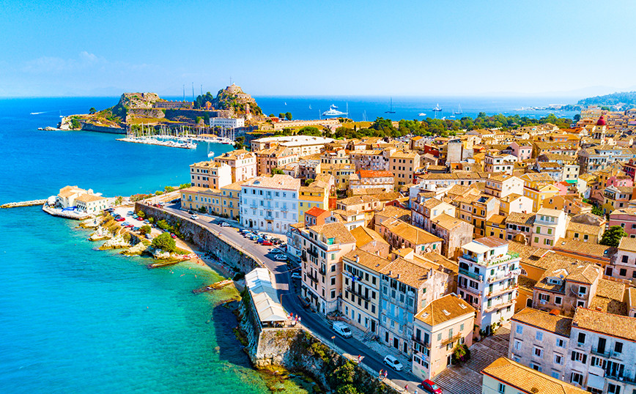
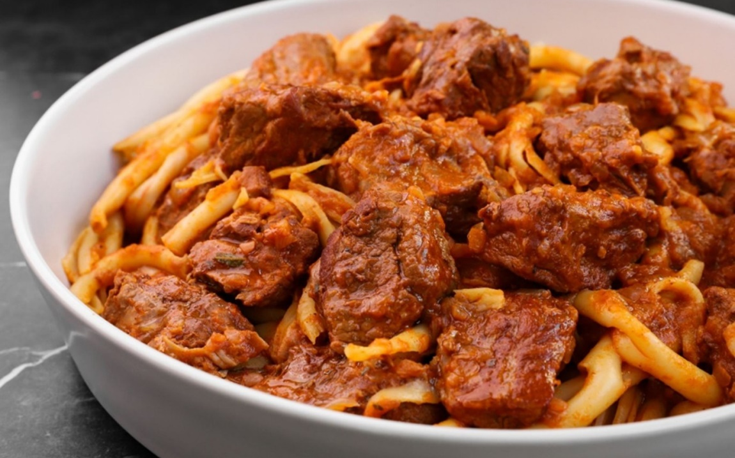
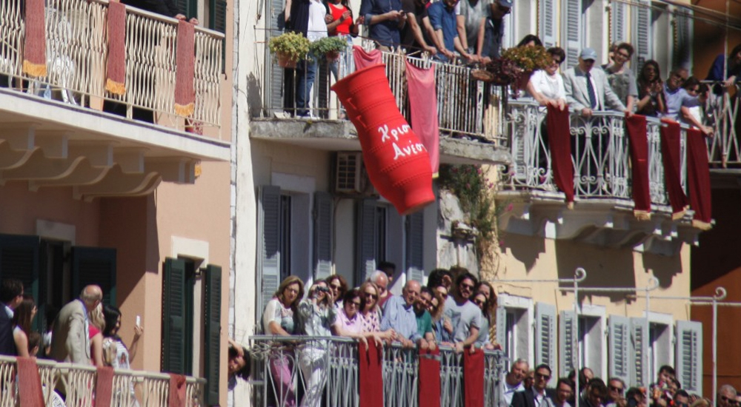
Αθηνά, Νάσια, Αριάδνη
Pastitsada is a traditional dish of Kerkira which has as its main ingredients meat and thick pasta.
Kerkira or Corfu, is one of the Ionian Islands in northwestern Greece. With adjacent small islands, it forms the Corfu department with population of 99,134 (2021). The town of Corfu is the departmental capital with a population of 32,095. Corfu occupies an area of 592 km².

Slide 2
Pastitsada
Ingredients:
1 ½ kg veal leg or shoulder scallop cut into portions
2 soupspoon butter
a few drops of olive oil
2 medium onions finely chopped
2 cloves of garlic, finely chopped
2 soupspoons tomato paste
1 teaspoon sugar
1/2 -1 teaspoon spice mixture Spetseriko
3/4 of teacup red wine
1 package of chopped tomatoes
1-1/2 package of thick spaghetti (pasticcio)
Salt
freshly ground pepper
grated kefalotiri or dry grated myzithra
For the mixture Spetseriko
1/2 cinnamon stick
1/2 teaspoon cloves
1/2 teaspoon grated nutmeg
1/2 teaspoon spice in yolks
1/2 teaspoon cumin
1 teaspoon red pepper
1 dried bay leaf
Αθηνά, Νάσια, Αριάδνη

