Slide 1
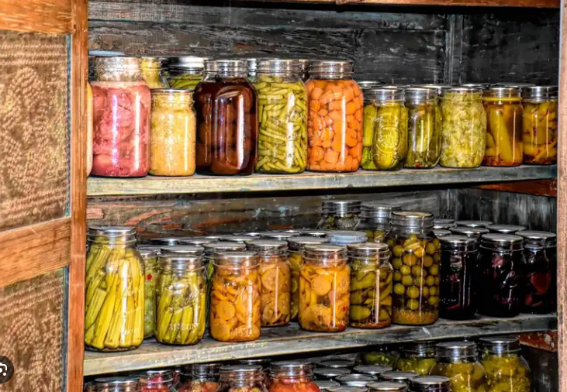
Proper Food Storage
Vasilis Koutroumanos – Fanis Kiamos
Project ST1

Slide 2
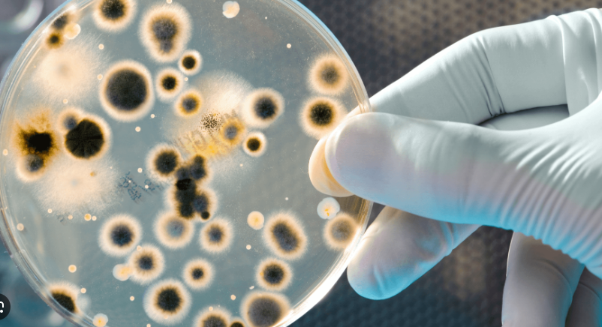
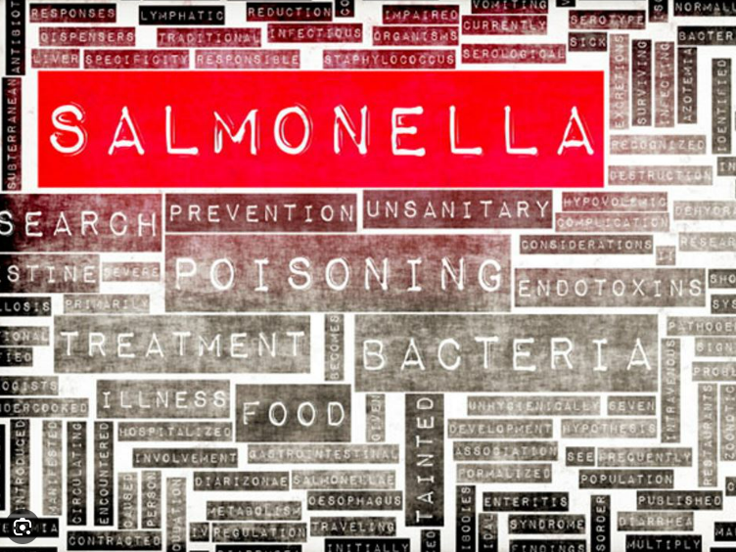
Proper Storage protects food from
Proper Storage protects consumers from
Rapid growth of microbes
Possible contaminations
Quality degradation
Food poisoning
Nutrient reduction

Slide 3
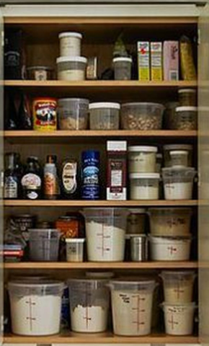
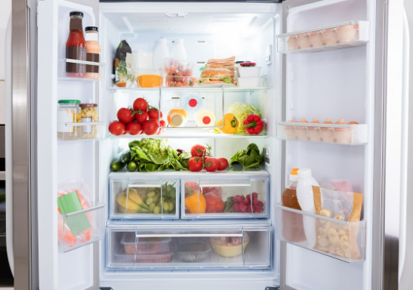
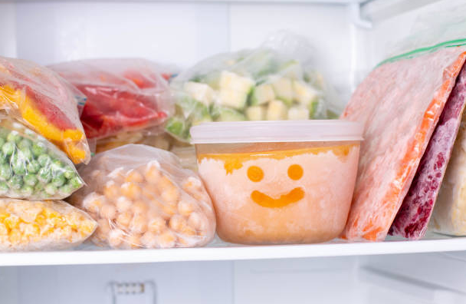
Storage conditions
Dry Storage: Ambient Temperature (10–21˚C) and Relative Humidity 50-60%-> Items: canned goods, pasta, legumes, flour, bread, nuts, cereals, jams, nuts, chocolates, etc.
Maintenance/Cooling: Temperature 1-5˚C and Relative Humidity 75%-> Items: meat, fish, cheeses, dairy products, cured meats, doughs, delicatessen (eg salads), some fruit and vegetables, etc.
Freezing: Temperature <-18˚C -> Items: frozen meat, fish, vegetables, etc

Slide 4
Rules of Good Storage Practice
The products must be stored in areas with the appropriate conditions, temperature and humidity that are controlled.
The storage area must have a proper construction infrastructure and be suitable to maintain the correct temperature and humidity.
Regular maintenance of technical equipment.
Apply cleaning at regular intervals.
Application of disinfestation & mycicide system (whenever needed or host appears).
The products must not come into contact with the floor or the walls (at least 10cm distance).
It is forbidden to store products under parts that drain water or coolants.
It is recommended to place raw products under ready-to-eat products.
The products must have appropriate packaging.
Correct product recycling (First In- First Out, FIFO).

Slide 5
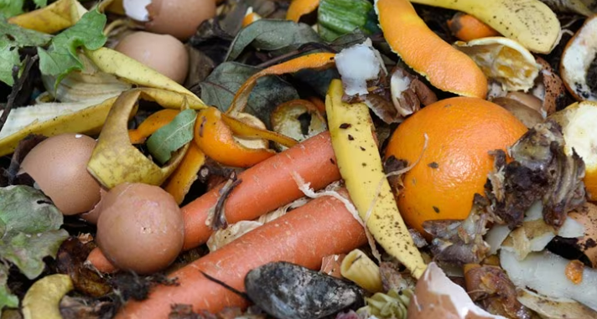
Proper waste management
Food waste should not accumulate in the kitchen
Do not fill the sink with waste, because there the conditions are ideal for the growth of bacteria
Waste must be placed in tightly closed containers, kept in good condition, cleaned and disinfected
Don't fill garbage bags and throw away food waste every day
Wash your hands after handling the waste bags
Transport sealed garbage bags
Do not carry toilet waste into the kitchen

Slide 6
Special requirements
Chemical substances, such as detergents, disinfectants, insecticides, etc., must be placed in a separate cabinet
Stored products should be placed in such a way as to avoid overcrowding and leave space for ventilation
Packaged products must be placed properly so that there is no risk of them falling, opening or breaking
After opening the packages, the contents must be transferred to a clean container with a lid that closes satisfactorily.
Light-sensitive products (eg potatoes) must be placed in a dark place
Flour, dried food and cereals should be placed in closed containers
Warehouses and stored products should be regularly checked for expired products, the presence of hosts, for any changes, etc.

Slide 7
Special Requirements (For refrigerators/freezers)
Never put unpackaged food in the fridge or freezer
Use containers, containers or transparent films for this purpose
Place the foods in the correct order
Do not leave the refrigerator door open
Never put hot food in the refrigerator
Do not open and close the refrigerator door for no reason
Make sure the refrigerator is working properly
Do not overload the refrigerator and never place food in front of the air outlet or inlet
NEVER freeze products that have already been thawed

Slide 8
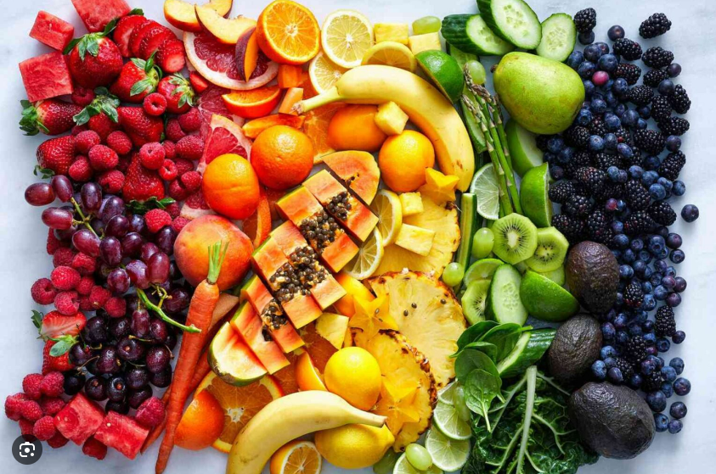
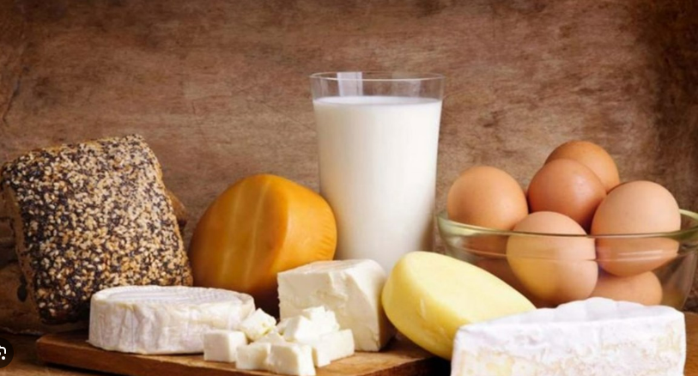
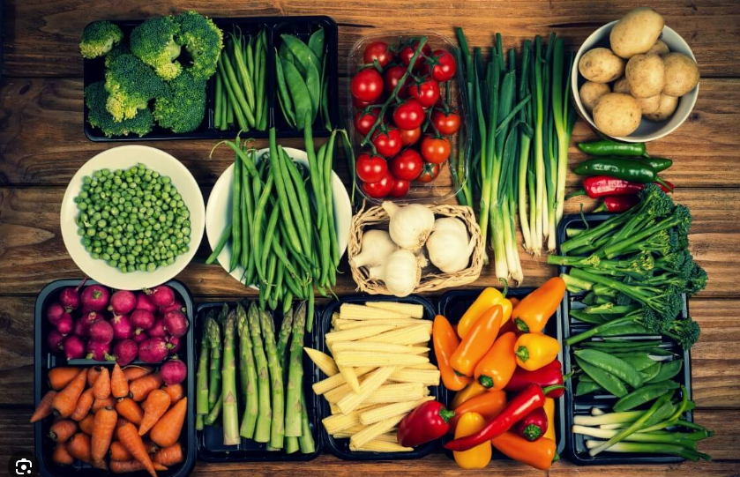
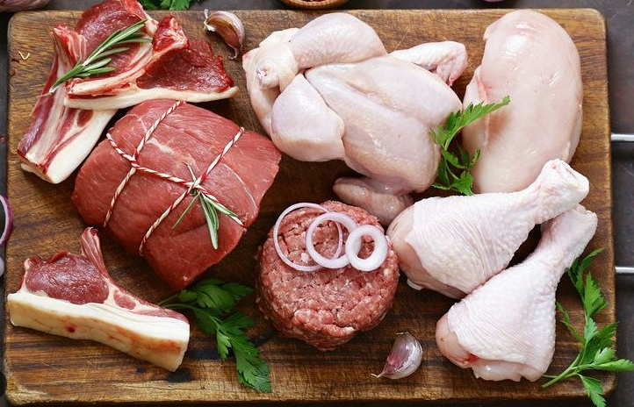
Special Requirements (For refrigerators/freezers)
Place fresh meat, fish, poultry in a non-drip container and cover with plastic wrap
Fish on ice ->
Whole fish: direct contact with ice
Fish fillets: no direct contact with the ice, placing a film in between
Shellfish: placing on a tray on ice. If placed in a refrigerator then at 7°C (Obligation: They must always be alive)
Vegetables, fruits (refrigerated):-> Do not wash before storage-> Place them separately from the rest of the food
Eggs, whites/yolks, store at <=5˚C
UHT, aseptic packaging, cans, etc., after opening to be placed in another container and in the refrigerator
Modified atmosphere products, to be discarded, when they have torn or damaged packaging
Chocolate <=12-13˚C
Sweets, cakes <=5˚C

