Slide 1
Olive oil
Αριάδνη Κώτση , Νάσια Αρμπάρα , Αθηνά Χρυσικού
Τάξη Στ΄1
Δασκάλα : ΚΑ Πάτρα
4 Νοέμβριου 2023

Slide 2
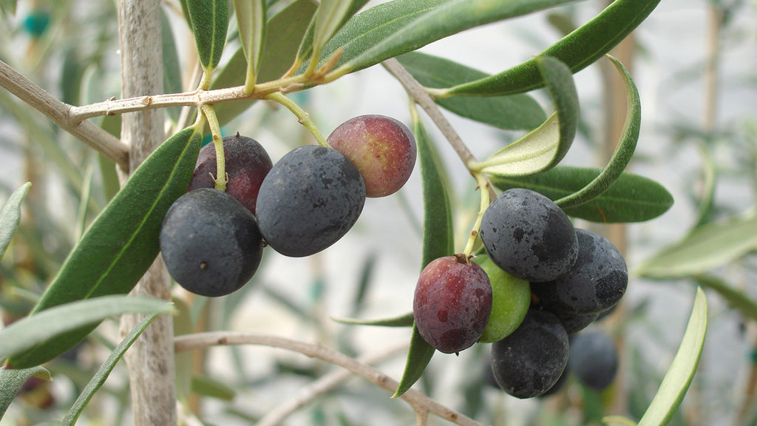
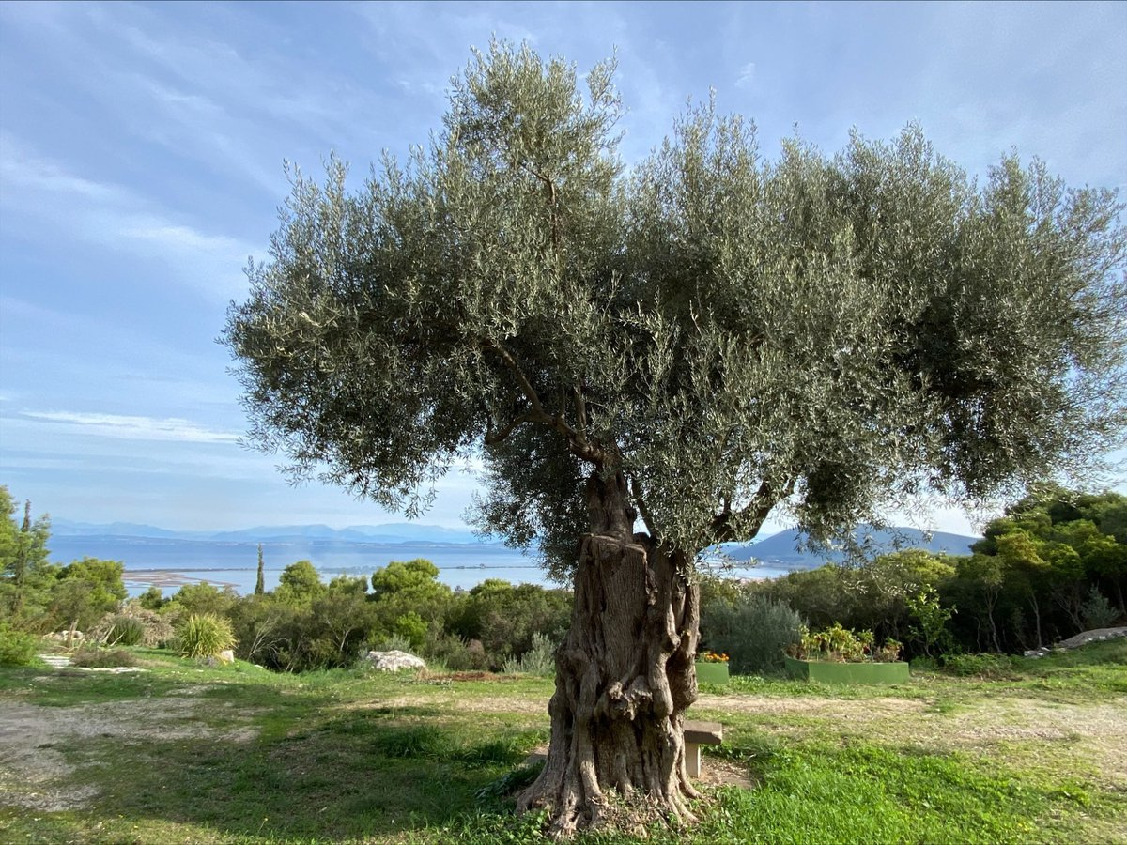
WHERE OLIVE OIL COMES FROM ?
Olive oil is the oil that comes from the fruit of the olive tree. The olive is a tree that grows only in Mediterranean countries. Olive oil is produced by pressing the olives, which must be collected before their final ripening, i.e. when they have a green-eggplant color.

Slide 3
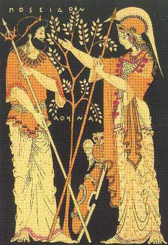
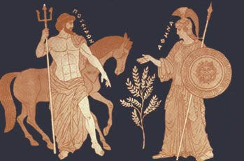
MYTHOLOGY & OLIVES
The Goddess Athena gave the Athenians the world's first olive tree, which grew where her spear hit, during the fight between the gods to be the protector of Athens.

Slide 4
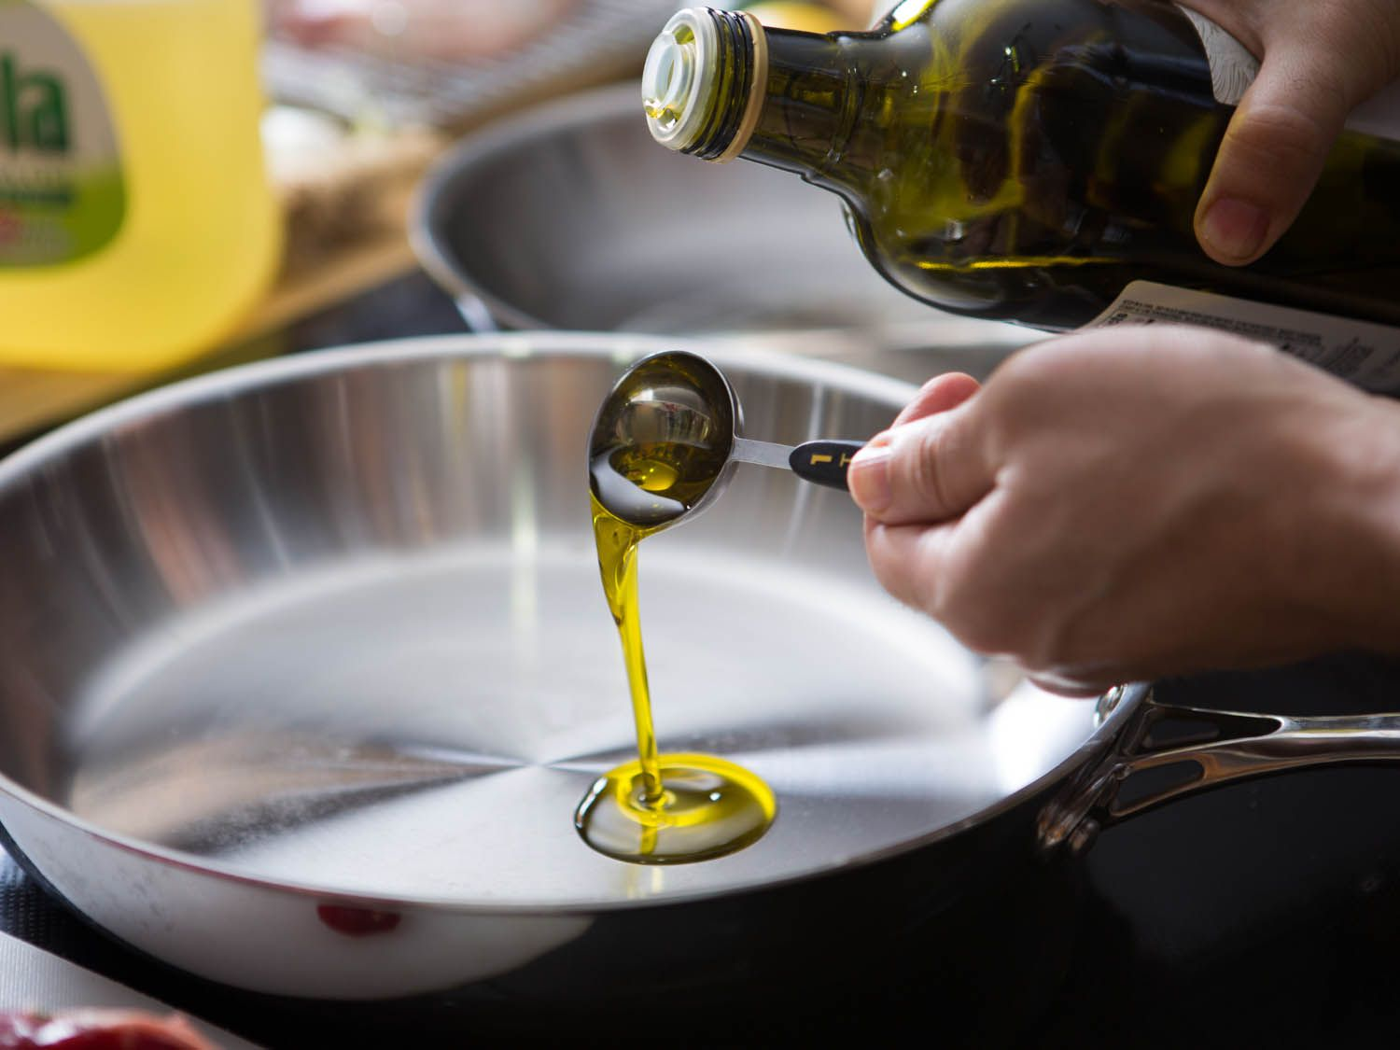
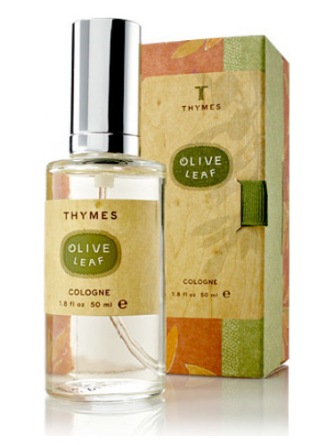
THE USE OF OLIVE OIL
The olive oil is used:
For cooking and confectionery
for perfumes (aromatic oils)
for body care / cleaning
for lighting (lamps)
as a preservative

Slide 5
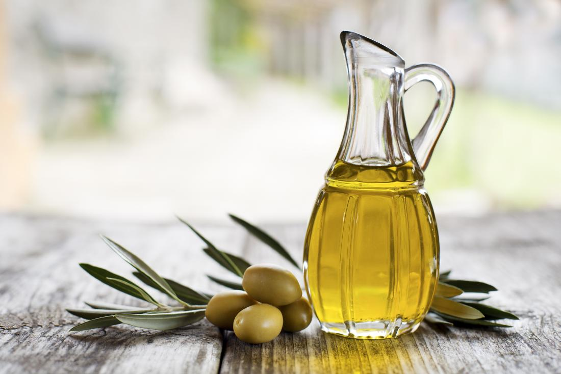
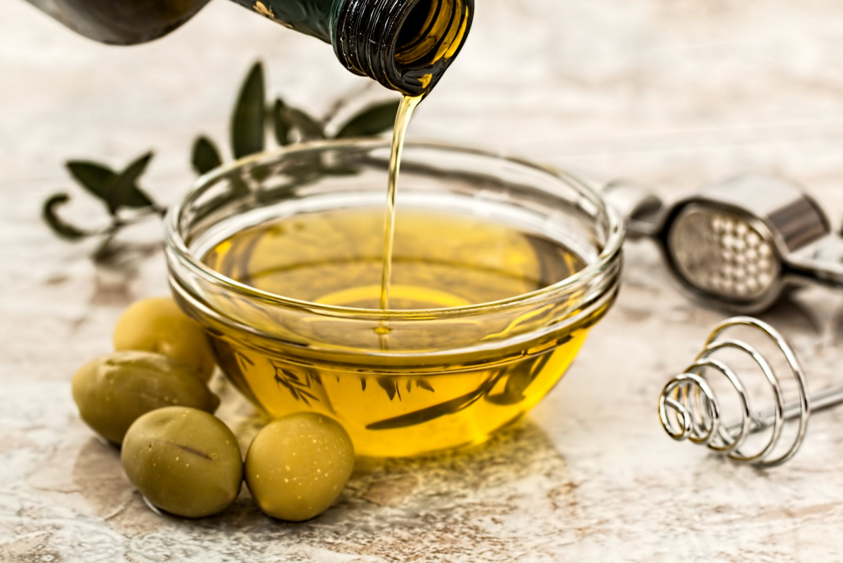
THE NUTRITIONAL VALUE OF OLIVE OIL
Oil, like all fats, is the body's main source of energy, which is why fats are necessary for our diet. If we have to choose between other oils for cooking, olive oil is the best.
It is a key element of the Mediterranean diet and is considered a healthy food product due to its content of antioxidants.

Slide 6
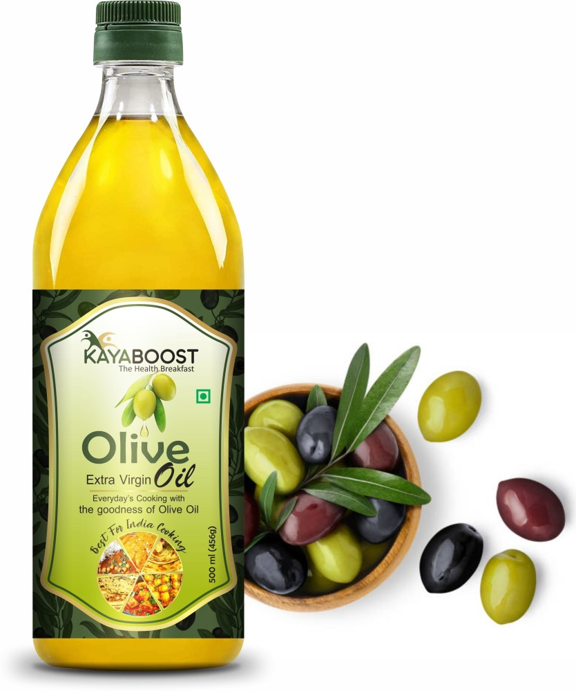
PROPERTIES AND BENEFITS
it is a source of energy
it helps us eliminate the toxic elements that enter our body.
it is a rich source of antioxidants,
it helps in the absorption of vitamins
it protects the heart
it strengthens the functioning of the brain

Slide 7
THANKS FOR WATCHING

