Slide 1
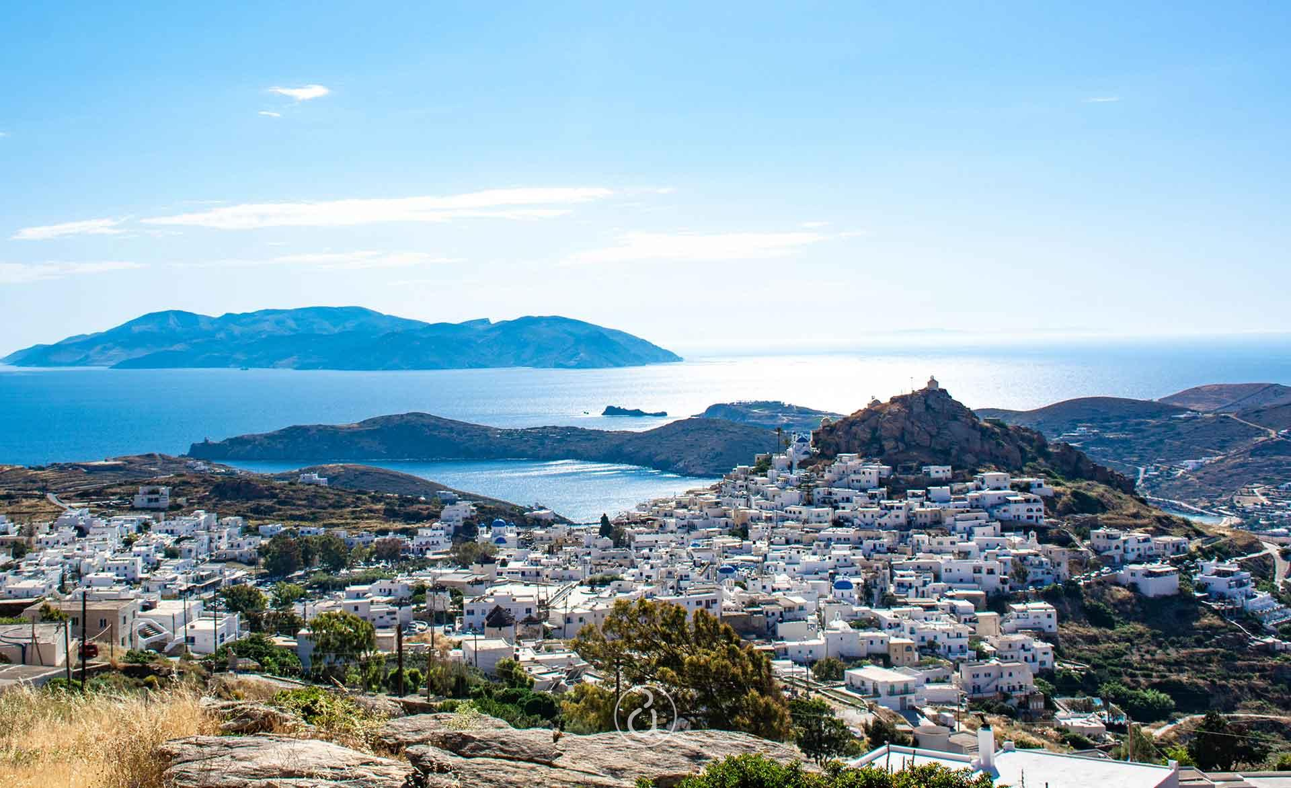
Cyclades Food
Γιώργος-Παντελής-Άγγελος-Κωνσταντίνος Β

Slide 2
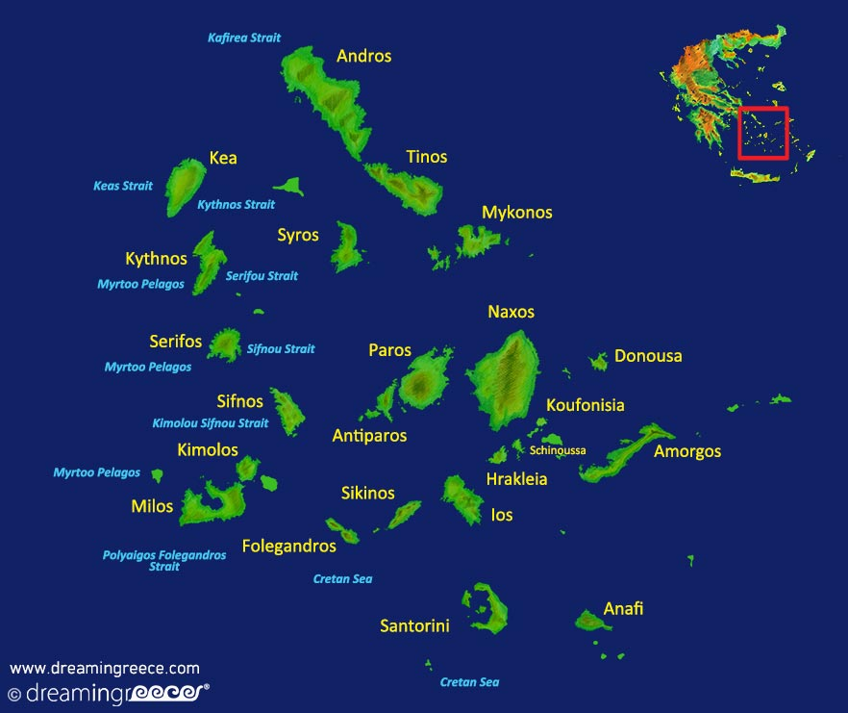
Cyclades
The Cyclades are an island complex in the Aegean Sea. The arrangement of the islands is in two parallel lines, in the imaginary continuation of Cape Sounion and Evia respectively, from which the distinction between Western and Eastern Cyclades emerges. They are the homonymous prefecture of Cyclades with Ermoupolis as its capital. The total population of the prefecture is 117,987 inhabitants.

Slide 3
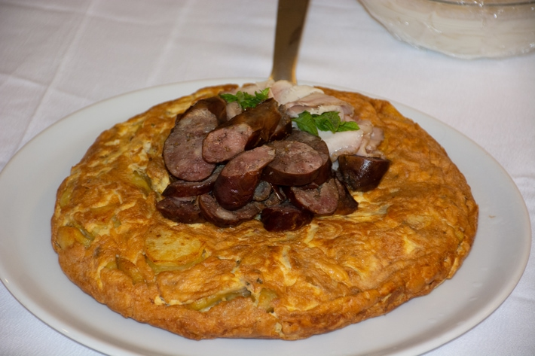
Φρουτάλια Άνδρου
Heat the olive oil and brown the sausages for 3 minutes. Add the potatoes and onion, stir for 5 minutes until the onion wilts. Lower the heat and cover the pan for 10-15 minutes, until the potatoes are tender. Crumble the eggs into a bowl. Beat them with the whisk attachment. Add the milk and salt and pepper and continue until the ingredients are well mixed. Drizzle the ingredients of the pan with the eggs. Shake the pan, until the egg mixture goes everywhere. Bake the froutalia in a preheated oven at 180°C and for about 15 minutes. When the Andros froutalia rises and stabilizes, it is ready. Turn it over on a cutting board and cut it into 6 triangle pieces.
3 tablespoons olive oil, 2 sausages cut into slices with half an cm thickness, 4 medium potatoes cut into slices, half cm. thickness 1 medium onion, 8 eggs, 1/2 cup milk, salt, pepper

Slide 4
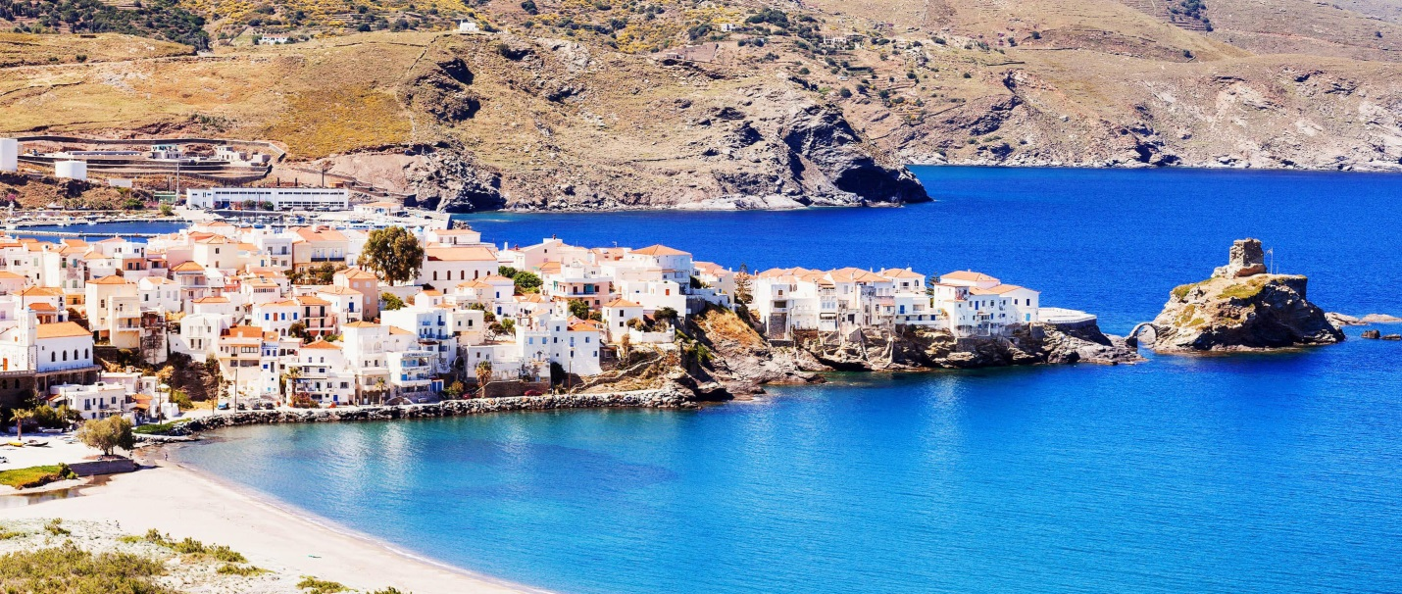
Andros
Andros is an island in the Aegean Sea, southeast of Evia. It is the northernmost island of the Cyclades and the second largest in area, after Naxos. It extends from northwest to southeast, occupying an area of 381 sq. km. It has a population of 9,170. The capital of the island is Andros or Chora, while its port is Gavrio.

Slide 5
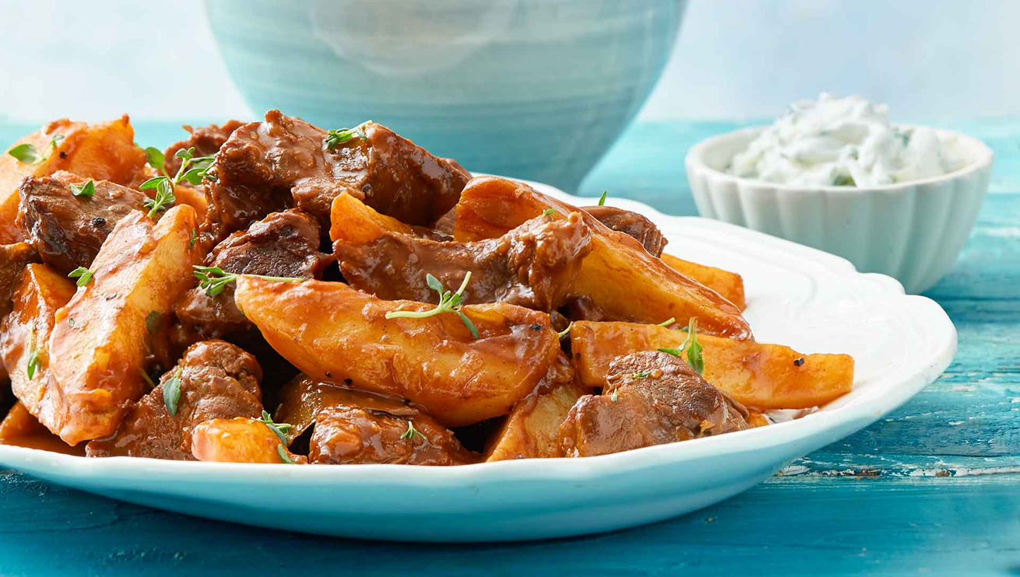
Πατατάτο Αμοργού
Heat the olive oil first in a pot over medium-high heat and brown the meat around to make a nice crust, about 6 ́- 7 ́. Add the onion and garlic and let them wilt and become translucent, stirring with a wooden spoon for 3 ́- 4 ́. Add the potatoes and mix well until they are oiled. Add the tomato paste and rub it with the spoon at the bottom of the pot until it is cooked for 2 ́- 3 ́ and releases all the concentrated aroma of the tomato. Deglaze the pan with the wine and let the alcohol evaporate for a few minutes. Finally, top up with hot water to half cover the ingredients. Add the allspice, bay leaves, and cinnamon. Let it come to a boil. Lower the heat and simmer the food for about 1 hour and 20 minutes until the meat and potatoes are very tender and the food is left with minimal sauce. Towards the end, season with salt and pepper. Heat the olive oil first in a pot over medium-high heat and brown the meat around to make a nice crust, about 6 ́- 7 ́. Add the onion and garlic and let them wilt and become translucent, stirring with a wooden spoon for 3 ́- 4 ́. Add the potatoes and mix well until they are oiled. Add the tomato paste and rub it with the spoon at the bottom of the pot until it is cooked for 2 ́- 3 ́ and releases all the concentrated aroma of the tomato. Deglaze the pan with the wine and let the alcohol evaporate for a few minutes. Finally, top up with hot water to half cover the ingredients. Add the allspice, bay leaves, and cinnamon. Let it come to a boil. Lower the heat and simmer the food for about 1 hour and 20 minutes until the meat and potatoes are very tender and the food is left with minimal sauce. Towards the end, season with salt and pepper.
1.200 g beef (cut into portions (alternatively lamb or goat), 5 tablespoons olive oil ,1 red onion dried (finely chopped) ,2 cloves garlic (crushed), 6 medium potatoes (peeled and quartered), 2 tablespoons tomato paste, 1 cup white wine ,(dry) 4-5 allspice grains ,1 bay leaf, 1 small cinnamon stick (optional), salt and pepper (freshly ground)

Slide 6
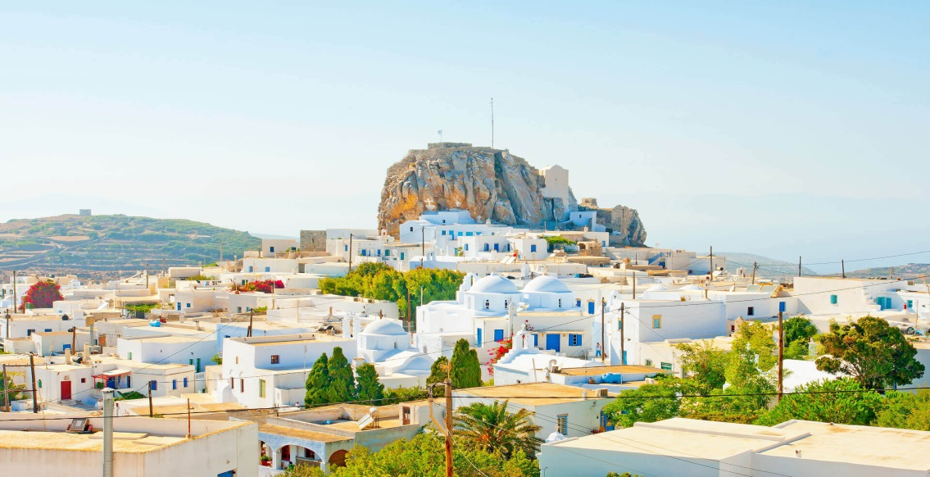
Amorgos
Amorgos is a Cycladic island in the Aegean Sea. It took its name from the plant amorgi, a type of flax from which the "alikoi amorgides", tunics of Amorgos, were made. It is located at the southeastern tip of the Cyclades, southeast of Naxos and at a distance of 136 nautical miles from Piraeus. Its surface is estimated at 121,464 sq.km., while it has a coastline of 126 km. It is an oblong island that extends from SW to NE with steep mountainous terrain. It has two natural harbors, Katapola and Aegiali. The capital is Chora of Amorgos with Katapola as its main port.

Slide 7
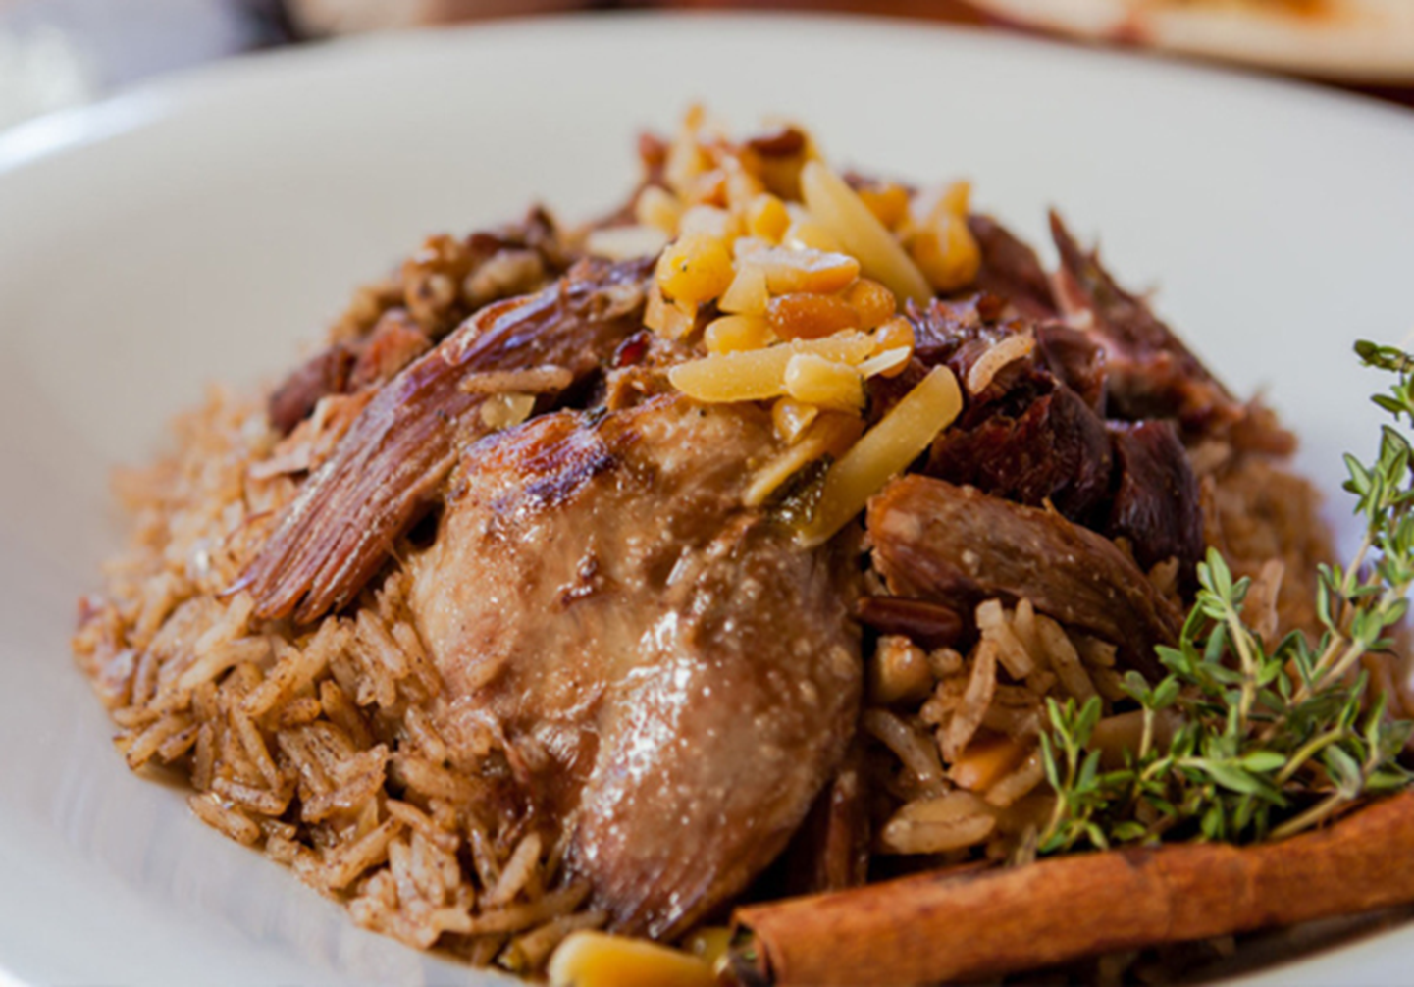
Μπάτουδο Νάξου
Method First brush the lamb internally and externally with olive oil, then season with salt and pepper very well and set aside the salt to catch it. Meanwhile, prepare the filling. Wash all your herbs very well and finely chop. In a deep pot, heat the olive oil and sauté the onion and leek finely chopped until golden. Add the spinach or chard and herbs, fennel, dill, mint. Season with salt and pepper and cook for 5 minutes, stirring occasionally. Then, add the rice and half a cup of water, stir and remove from heat. Finally, add the raisins. We put the filling on the belly of the lamb and sew with thread or carefully closing with toothpicks. Transfer to a baking pan lined with vine branches or parchment paper. Cover with parchment paper and aluminum foil and bake in a preheated oven at 200 degrees for about 3 hours. In the last hour we uncover and we let it get some color.
7-8 kg lamb or goat 100ml Extra virgin olive oil, Salt, Pepper For the filling 100 ML extra virgin olive oil, 1 large dry onion, 2 leeks (the white part), 1.5 kg chard or spinach 1 bunch fennel, 1/2 bunch dill, 1/2 bunch mint, 400g Glaze rice, 200g raisins, salt and pepper

Slide 8
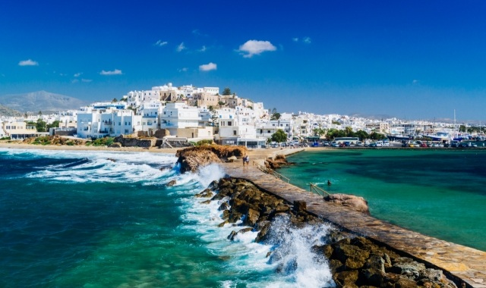
Naxos
Naxos is the largest island of the Cyclades, with an area of 429.79 sq.km. It is 103 nautical miles from Piraeus. The capital of Naxos is Chora (Naxos), with 7,070 inhabitants (2011 census). According to tradition, the first inhabitants of the island were the Thracians and the Pelasgians. Later came the Carians, led by Naxos, to whom the name of the island is attributed. It was the center of the archaic Cycladic civilization. The island is known as a source of emery, a rock rich in corundum, which until modern times was one of the best abrasives available.

